Slide 1

Behaviour Change Science and Debriefing
Orla O’Doherty, Education Fellow, UCLPartners
1 December 2022

Slide 2
Outline
What and why
Over to you
Theory of behaviour change
Putting it into practice
Next steps

Slide 3
What and why

Slide 4
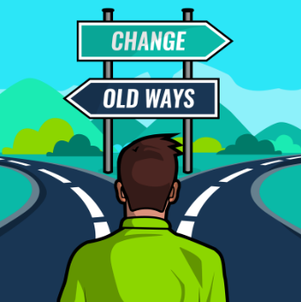
What is a behaviour change science approach to debriefing?
It is…
Supporting clinicians to implement their learning
Person-centred
Evidence-based
Complimentary
It is not…
Telling clinicians how to behave

Slide 5
Why behaviour change matters

Slide 6
Over to you…

Slide 7
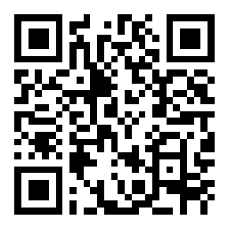
Tell me about some of the challenges you face in supporting clinicians to change their practice
Scan the QR code
OR
Go to Slido.com and enter the code 3724215

Slide 8
Theory of Behaviour Change

Slide 9

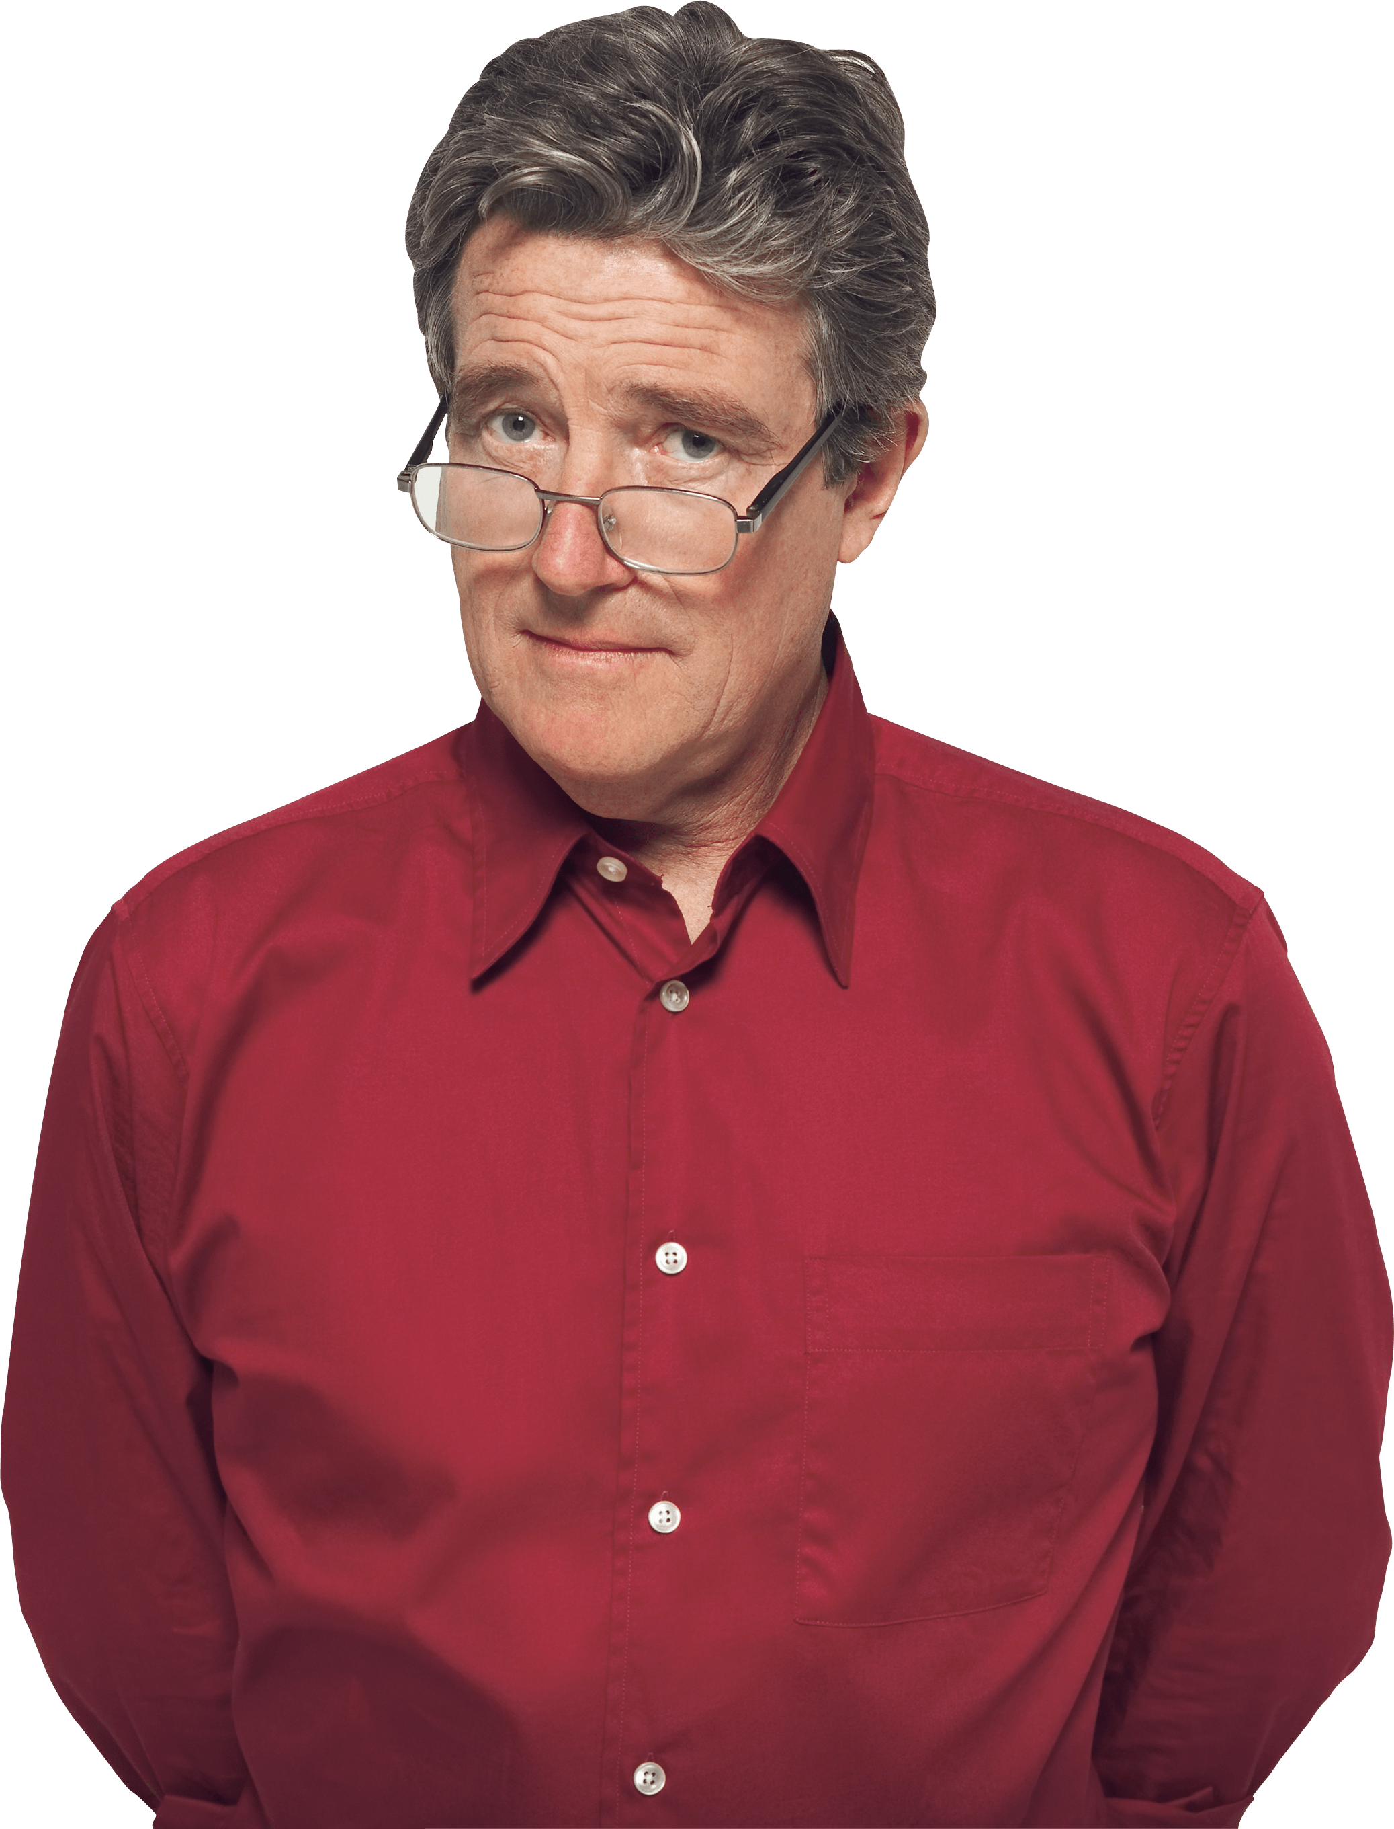



WHO DOH?
Dan (victim)
Luke (son)
Rachel (business partner)
Jan (ex-wife)

Slide 10


WHO DOH?
Luke
Jan
Rachel
MEANS
MOTIVE
OPPORTUNITY

Slide 11
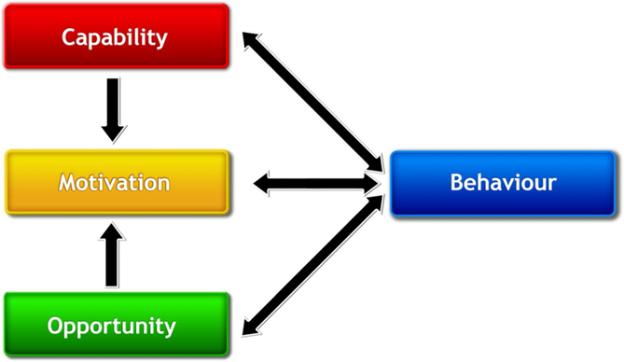
What is the Theory of Behaviour Change?
83 Theories of Behaviour Change
Means
Michie, Van Stralen, & West (2011) Reproduced with permission

Slide 12



COM-B in detail
knowledge
skill
behavioural regulation
memory, attention and decision processes
social learning/imitation
social/professional role and identity
intention
beliefs about capabilities
optimism
beliefs about consequences
values
reinforcement
needs
subjective norms
attitude toward behaviour
motivation
self-image
feedback processes
emotion
general attitudes/beliefs
goals
perceived suscept/vulnerab
- environmental context and resources
social influences
behavioural cueing
norms

Slide 13
Putting it into Practice

Slide 14
Common barriers to behaviour change for health professionals
knowledge
skill
behavioural regulation
memory, attention and decision processes
social learning/imitation
social/professional role and identity
intention
beliefs about capabilities
optimism
beliefs about consequences
values
reinforcement
needs
subjective norms
attitude toward behaviour
motivation
self-image
feedback processes
emotion
general attitudes/beliefs
goals
perceived suscept/vulnerab
- environmental context and resources
social influences
behavioural cueing
norms

Slide 15
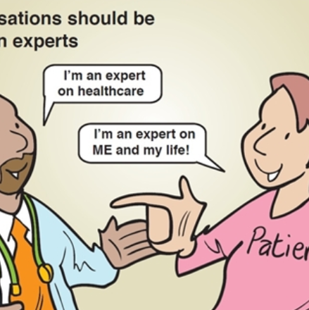
Supporting health professional behaviour change
BE CURIOUS
BE COLLABORATIVE
BE RESPECTFUL
BE ENCOURAGING
I’m an expert on working in healthcare
I’m an expert on training healthcare professionals

Slide 16
Supporting health professional behaviour change
Spot your chance
Listen to learn
Summarise
Advise (with permission)
Make a plan
Reflect
Use questions
You mentioned…
Do you mind if I ask…

Slide 17
Supporting health professional behaviour change
Spot your chance
Listen to learn
Summarise
Advise (with permission)
Make a plan
Reflect
Use questions
Aim to understand their perspective
Avoid judging or jumping ahead

Slide 18
Supporting health professional behaviour change
Spot your chance
Listen to learn
Summarise
Advise (with permission)
Make a plan
Reflect
Use questions
How have you…?
Do you usually…?
Do you mind if I ask…?

Slide 19
Supporting health professional behaviour change
Spot your chance
Listen to learn
Summarise
Advise (with permission)
Make a plan
Reflect
Use questions
It sounds like…
You’ve struggled to…

Slide 20
Supporting health professional behaviour change
Spot your chance
Listen to learn
Summarise
Advise (with permission)
Make a plan
Reflect
Use questions
So you’re saying that…
Just to summarise…

Slide 21
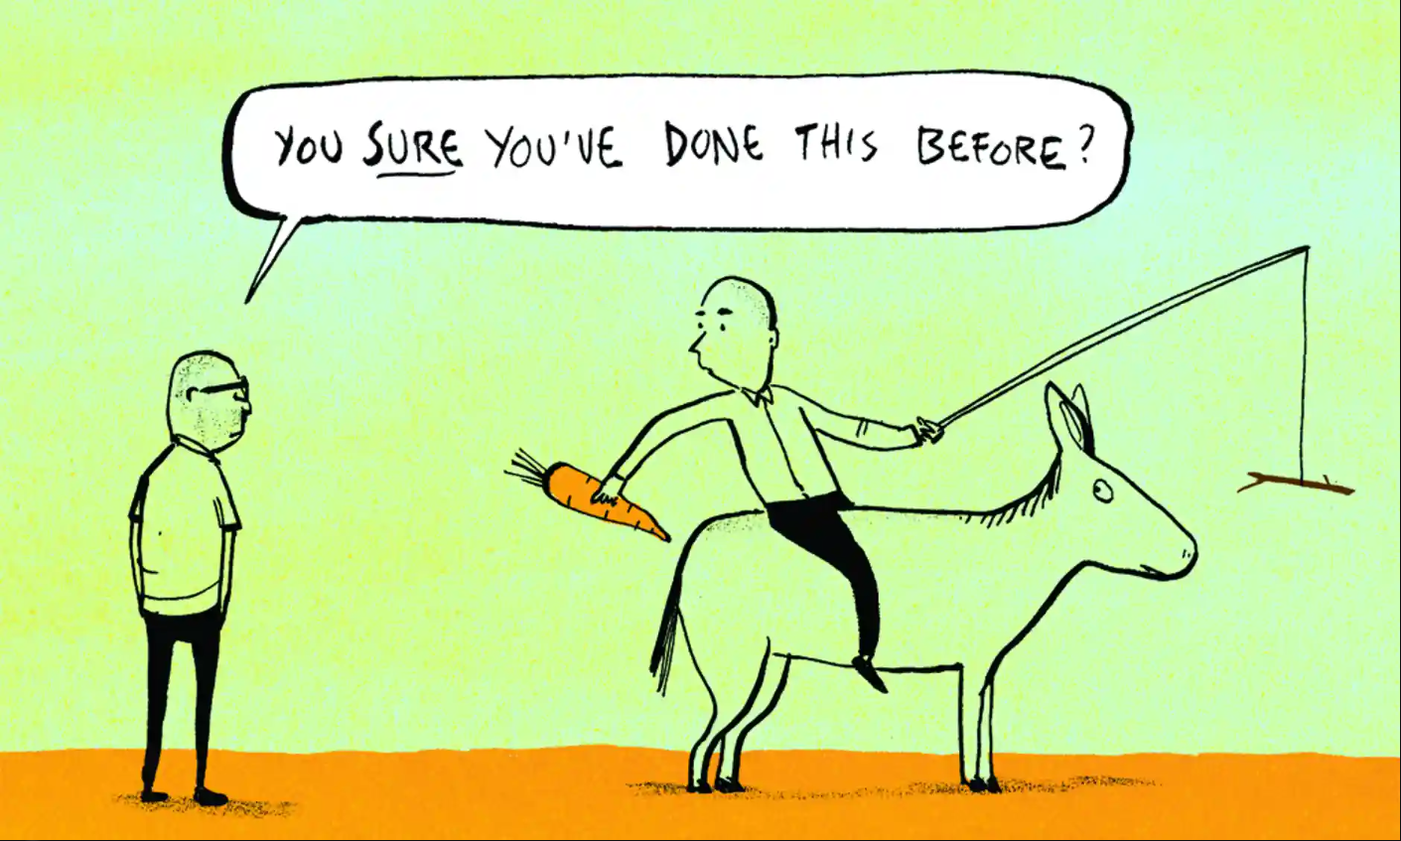

Slide 22
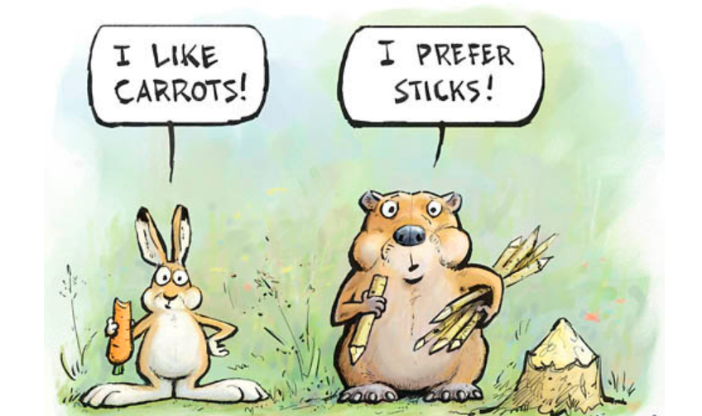

Slide 23
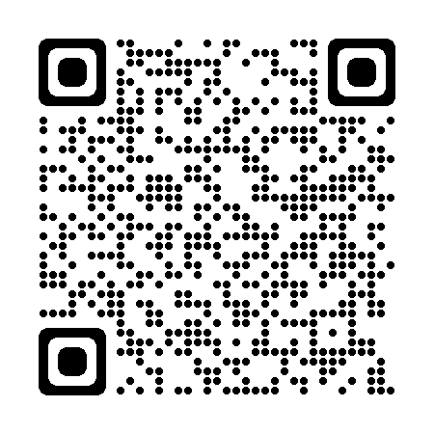
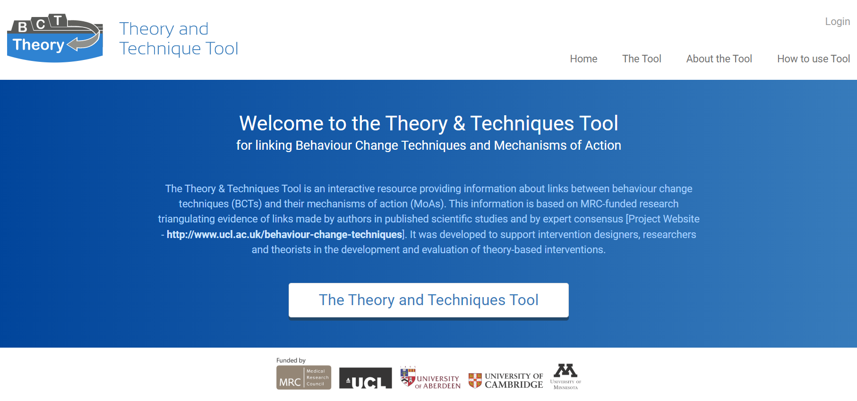
Theory and Techniques Tool
https://theoryandtechniquetool.humanbehaviourchange.org/tool

Slide 24
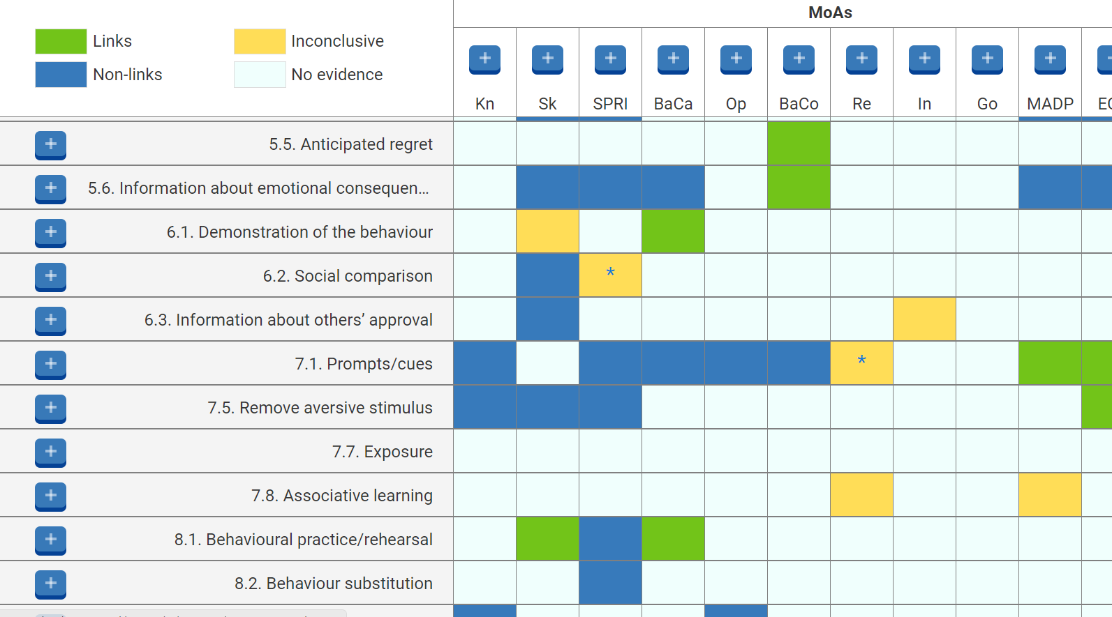
Theory and Techniques Tool
BARRIERS / ENABLERS
BEHAVIOUR CHANGE TECHNIQUES

Slide 25
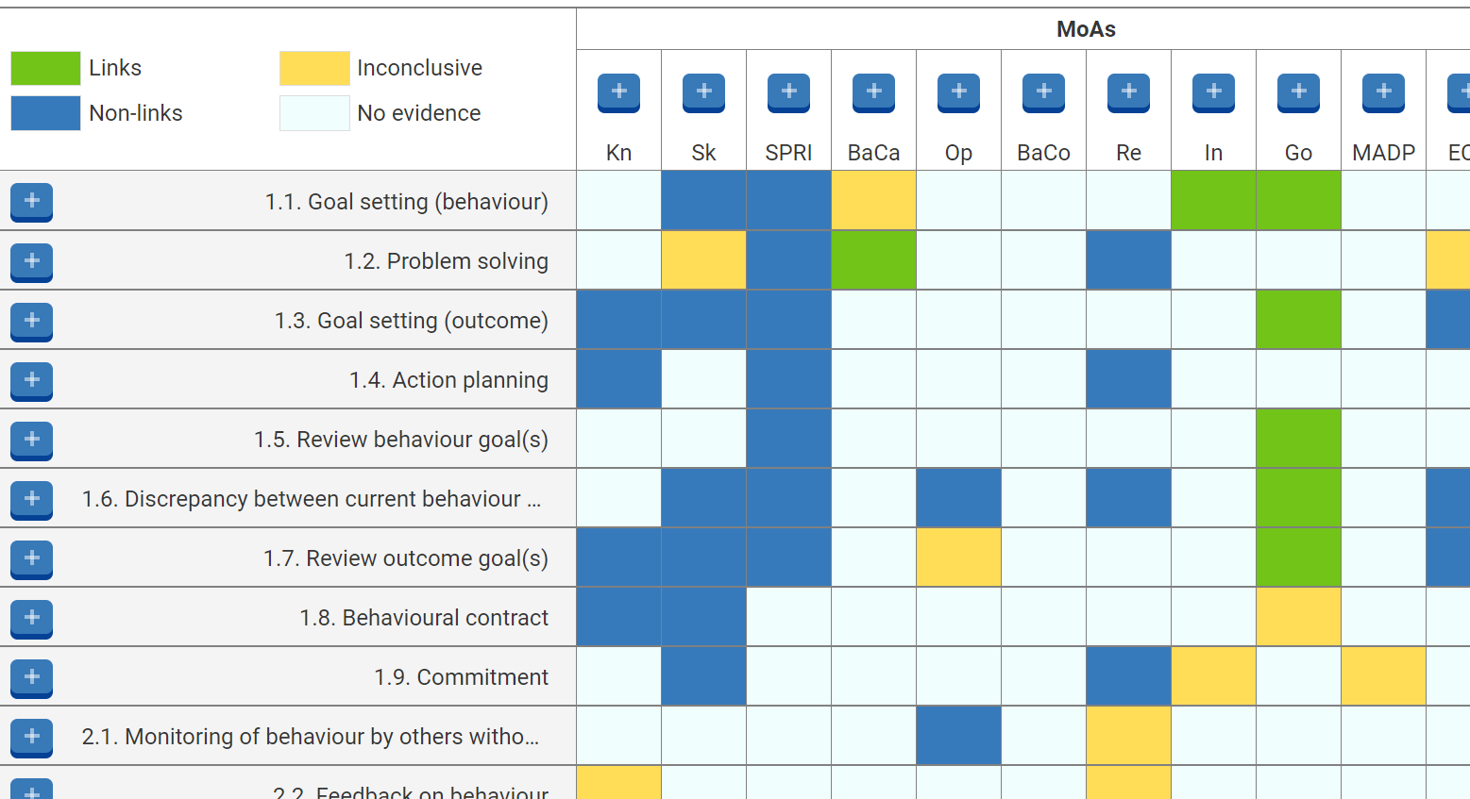
Theory and Techniques Tool
BARRIERS / ENABLERS
BEHAVIOUR CHANGE TECHNIQUES

Slide 26
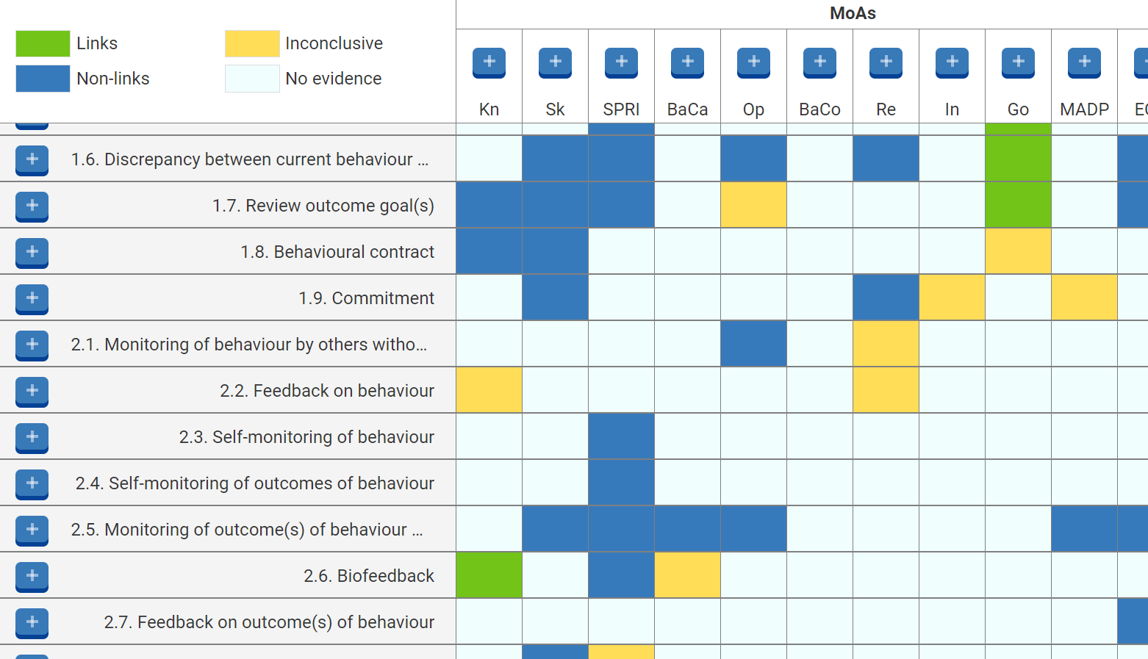
Theory and Techniques Tool
BARRIERS / ENABLERS
BEHAVIOUR CHANGE TECHNIQUES

Slide 27
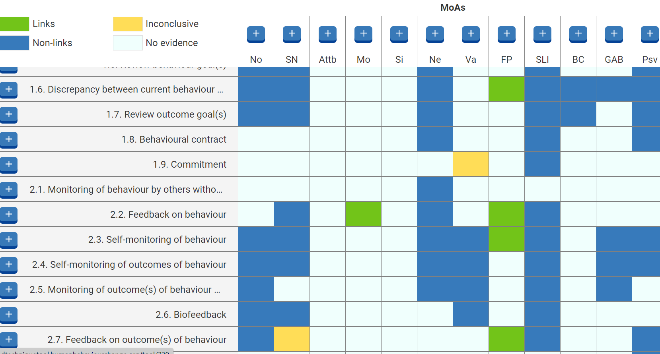
Theory and Techniques Tool
BARRIERS / ENABLERS
BEHAVIOUR CHANGE TECHNIQUES

Slide 28
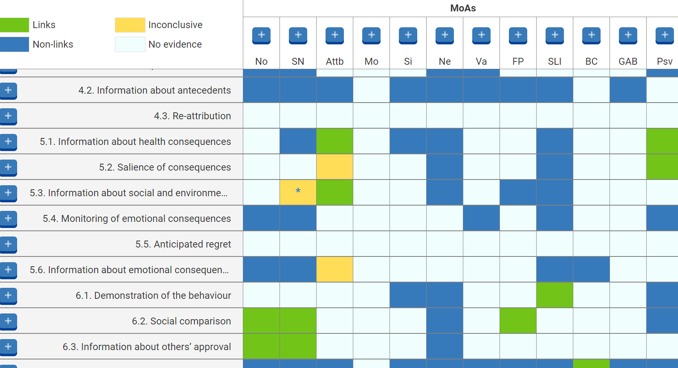
Theory and Techniques Tool
BARRIERS / ENABLERS
BEHAVIOUR CHANGE TECHNIQUES

Slide 29
Supporting health professional behaviour change
Spot your chance
Listen to learn
Summarise
Advise (with permission)
Make a plan
Reflect
Use questions
We have some resources to help with that – can I share them with you?

Slide 30
Supporting health professional behaviour change
Spot your chance
Listen to learn
Summarise
Advise (with permission)
Make a plan
Reflect
Use questions
What one thing will you do to…?
How can you…?

Slide 31
Next steps…

Slide 32
What one thing will you do…?
Consider the challenge(s) you face
Set a SMART goal
Map your challenge(s) to a barrier/enabler (MoA) on the Theory and Techniques Tool
Use the Theory and Techniques Tool to generate possible behaviour change techniques (BCTs) to address your challenge
Make a plan for when, where, how and with whom you will have a go

Slide 33
Orla O’Doherty
orla.o’doherty@uclparners.com

Slide 34
Additional Slides

Slide 35

What if we could simplify the theory of behaviour change?
https://www.youtube.com/watch?v=AE4xIkC1nvo&t=3s

Slide 36
What is the Theory of Behaviour Change?
‘’Tim’s not a big fella, there were knives in the flat’’
‘’You believed he was having an affair with your wife’’
‘’You were there’’
Michie, Van Stralen, & West (2011) Reproduced with permission
Notes:
COM-B – a unifying theory of behaviour change
Capability: Knowledge; Skill; Memory, attention and decision processes; Behavioural regulation; Social learning/imitation;
Motivation: Social/Professional role and identity; Beliefs about capabilities; Optimism; Beliefs about consequences; Reinforcement; Intention; Goals; Emotion; Subjective norms; Attitude towards the behaviour; Motivation; Self-image; Needs; Values; Feedback processes; General attitudes/beliefs; Perceived susceptibility/vulnerability
Opportunity: Environmental context and resources; Social influences; Norms; Behavioural cueing
Changing behaviour requires changing one or more of three underpinning elements, either directly or indirectly

Slide 37

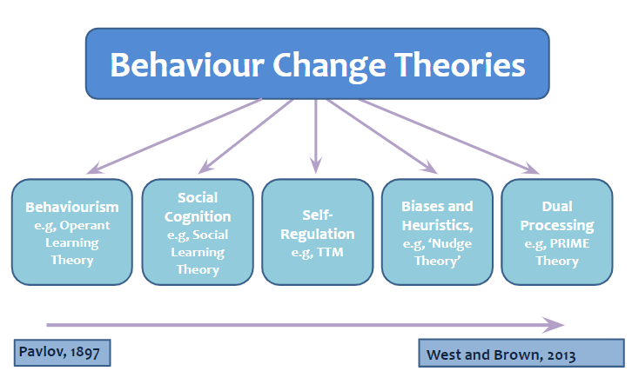
What is the Theory of Behaviour Change?
Notes:
Behaviourism: identifies the influence of environmental factors on how we learn behaviours. Classical conditioning, for example, describes learning of involuntary behaviours by association with environmental stimuli. Operant Learning Theory (OLT) proposes that we learn behaviours through the consequences of our actions and identifies reinforcement (positive and negative) and punishment (positive and negative) as key constructs. These theories fail to account for the social influences of behaviour.
Social Cognition: Social cognition theories target cognitive variables which are arguably more amenable to change than socio-environmental factors. They can be classified as: motivational, multi-stage or behavioural enaction.
Motivational theories such as Social Cognitive Theory (SCT) (Bandura, 1986) and the Theory of Planned Behaviour (TPB) (Ajzen, 1991) are composed of variable, but overlapping constructs, commonly including some measure of perceived control and intention, assuming rational appraisal of expectancy and value. Lack of experimental evidence, considerable construct overlap, and evidence of human irrationality (Ariely, 2008) and an intention-behaviour gap (Sniehotta, Scholz, & Schwarzer, 2005), call their comprehensiveness into question.
Multi-stage models address the entire change process. The Transtheoretical Model (TTM) (Prochaska, & DiClemente, 1982), for example, identifies constructs including decisional balance and self-efficacy, influencing sequential movement through stages of change, proposing that interventions should be tailored to individuals’ stage.
The intention-behaviour gap represents a need for volitional, post-motivational, self-regulatory constructs (Rhodes, & de Bruijn, 2013). Behavioural enaction models acknowledge impulse control to explain why some with strong intentions fail where others succeed. Gollwitzer’s (1993) Implementation Intentions for example, aims to close this gap using simple interventions such as planning where and when behaviour will occur (Orbell, Hodgkins, & Sheeran, 1997). This approach triggered a paradigm shift towards theories of self-regulation.
Self-Regulation: Described as ‘’efforts undertaken…to alter one’s behaviour’’ (Sniehotta, Scholz, Schwarzer, et al., 2005, p.146), conscious, deliberate and goal directed techniques such as action planning and self-monitoring are employed to mitigate behavioural barriers.
Lab studies of ego-depletion tasks suggest that self-control is resource-dependent (Baumeister, Bratslavsky, & Muraven, 1998; Sripada, Kessler, & Jonides, 2014) indicating that self-regulation is amenable to training but is a limited resource, creating ethical implications given society’s inherent inequities.
Biases and Heuristics: Nudge
Dual Processing: They explain behaviour in terms of propositional and unconscious reasoning, driven by responses to internal and socio-environmental cues, and their mediating factors (Houlihan, 2018). Consequently, they have greater potential to address inter-individual variability by affording a degree of tailoring (e.g. Troelstra, Kunst, & Harting, 2019). PRIME theory (West, & Brown, 2013), for example, identifies five subsystems: plans; responses; impulses; motives; and evaluations. By accounting for associative learning, imitation learning, and reflective processes, it represents a theoretically integrated understanding of motivation. It has generated new insights such as the influence of the immediate environment in the absence of salient plans, for example. This is contrary to other motivational theories which hold self-efficacy, for instance, as more trait-like, and stage theories in which planning is essential for behaviour change. These propositions are supported by studies of smoking cessation which show that strength of urge to smoke better predicts successful quitting than consumption scales (Fidler, Shahab, & West, 2011) and that plans alone do not predict all quit attempts (Kotz, Brown, & West, 2013).

Slide 38

How to support healthcare professional behaviour change
I’m an expert on working in healthcare
I’m an expert on training healthcare professionals

Slide 39




How to support healthcare professional behaviour change
O
open questions
A
affirm / normalise
R
reflect
S
summarise

Slide 40
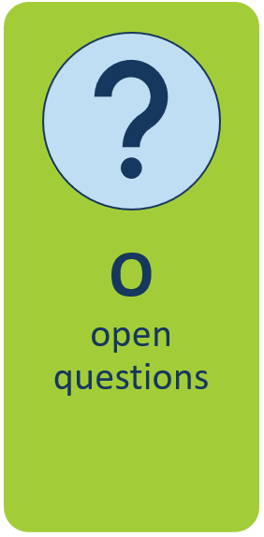
1. Be Curious
Tell me…
How does that…
What gets in the way of…
When do you find…
Tell me…

