Slide 1

Optimising Cholesterol to Prevent Cardiovascular Disease

Slide 2
Cholesterol and Cardiovascular Risk
High cholesterol causes cardiovascular disease and is associated with an increased risk of cardiovascular death.¹
Lifestyle change is important to reduce cardiovascular risk. Where this is ineffective or in people at highest risk (e.g. pre-existing CVD, familial hypercholesterolaemia (FH) or high QRisk score), drug therapy with statins and other medications is very effective.
Every 1mmol/l reduction in low-density lipoproteins (LDL) cholesterol reduces risk of a cardiovascular event by 25%.²
UCLP searches indicate that 1 in 5 people with CVD are not on lipid lowering therapy and 3 in 5 are on suboptimal treatment – so there is substantial scope for improving care.
People with high cholesterol who also have other risk factors (e.g. high blood pressure, diabetes, smoking) are at significantly greater risk of CVD and have most to gain from a reduction in cholesterol.
FH is high-risk but very treatable. Half of men with FH will have a heart attack or stroke before age 50 and a third of women before age 60. Statins are highly effective at reducing this risk.³
References:
Lewington S, Whitlock G, Clarke R, et al.. Blood cholesterol and vascular mortality by age, sex, and blood pressure: a meta-analysis of individual data from 61 prospective studies with 55,000 vascular deaths. Lancet 2007;370:1829–39. 10.1016/S0140-6736
https://jamanetwork.com/journals/jama/fullarticle/2556125
https://www.nice.org.uk/guidance/cg71/chapter/Context

Slide 3
CVDACTION – The Cholesterol Dashboard
CVDACTION is a case finding tool to improve care and outcomes for people who are at high risk of heart attack, stroke and other cardiovascular disease (CVD).
The CVDACTION Cholesterol dashboard groups patients into 4 domains – secondary prevention, cholesterol monitoring, primary prevention, and Familial Hypercholesterolaemia.
Patients are stratified into cohorts to help prioritise, plan where to begin and spread clinical workload over time. For example, priority groups would include people with pre-existing CVD who are not on lipid lowering therapy, on suboptimal dose or intensity, or whose non-HDLc is not treated to NICE recommended target and potentially eligible for second line therapies.
You can also filter by ethnicity, deprivation, severe mental illness or learning disability to focus on specific populations and target health inequalities.
To deliver best care for patients and maximise capacity, consider two complementary interventions:
  Clinical optimisation – delivered by nurse, pharmacist or GP, starting with those at greatest risk or highest priority
  Broader, proactive care to optimise support for education, self-management and behaviour change. This can be provided by a member of the wider primary care team such as ARRS* roles (e.g. care coordinators) and healthcare assistants.
The UCLPartners Proactive Care Frameworks offer a wide range of free resources to help team members to deliver these interventions and optimise care.
*Additional Roles Reimbursement Scheme

Slide 4
Cholesterol:
Data To Inform Pathway Transformation
CVDACTION Cholesterol domains – Stratify & Prioritise
CVD not on lipid therapy
CVD suboptimal lipid therapy
Primary prevention suboptimal therapy
Clinical Optimisation
(eg pharmacist, nurse)
Holistic Proactive Care
(eg. ARRS* roles)
Optimise clinical management
Review blood results, CVD risk & symptoms
Review complications and co-morbidities
Check adherence and adverse effects.
Initiate or optimize therapy
Address wider risk factors eg smoking, obesity
Structured support for
Education e.g.
  What is cholesterol and cardiovascular risk?
  How to check and reduce cardiovascular risk?
Self-management e.g.
  Cholesterol and diet
  Information on statins & shared decision making
  How to check your blood pressure at home
Behaviour Change – brief interventions/ signposting
  Healthy eating & Physical activity
  Smoking cessation/Alcohol
*ARRS = Additional Role Reimbursement Scheme

Slide 5
CVDACTION – Cholesterol Indicators
Secondary prevention | Secondary prevention monitoring | Primary prevention | Familial Hypercholesterolaemia (FH)
CVD not on statins: CVD not on lipid lowering therapy | CVD no lipid test: CVD and no cholesterol test in last 12 months | QRisk > 10% no statin: QRisk ≥10% or CKD OR DM1 >40years not on statin | FH not on lipid treatment: FH not on Lipid Lowering therapy
CVD not max statin: CVD on statin but not high dose high intensity |  | QRisk >10% statin not HIST: QRisk ≥10% or CKD or T1DM not on high intensity statin | FH on statin but not HIST: FH on statin but NOT high dose, high intensity statin
CVD high non-HDLc: CVD on max statin therapy but non HDL>2.5mmol/L or no non-HDL or LDL |  | QRisk >20% no statin: QRisk ≥20% not on statin | Under 30 FH case finder: NOT coded FH <30yrs WITH Lipids above possible FH threshold
 |  | Aged 40-84 no QRisk: No QRisk in last 5years age 40-84 (Excluding CVD, CKD ,T1DM, FH or existing lipid therapy) | 30 plus FH case finder: NOT coded FH >30yrs WITH Lipids above possible FH threshold
 |  |  | Coded as FH: Patients coded as FH

Slide 6
Clinical Next Steps
Support for lifestyle change is central to cholesterol management
  Resources to support staff helping patients to understand their conditions, to self-manage and to make lifestyle changes
Lipid management – patients with pre-existing CVD
  Ensure on high dose high intensity statin (ie atorvastatin 80mg or rosuvastatin 20mg) – or start statin if not already prescribed– and support lifestyle change
  If non-HDLc not reduced to target or statin not tolerated, consider ezetimibe, Inclisiran, PCSK9i(mab) or bempedoic acid
Lipid management – patients without pre-existing CVD
  Record up to date QRisk score and support lifestyle change
  If QRisk score ≥10% (or if CKD or T1 diabetes aged 40 plus years), ensure on high intensity statin (eg atorvastatin 20mg) or start statin if lifestyle change alone is not effective
  If non-HDLc not reduced to target, (or if statin not tolerated) titrate statin dose and consider ezetimibe or bempedoic acid
Familial hypercholesterolaemia diagnosis
  Suspect possible FH in people under 30 if not on FH register and total cholesterol >7.5 mmo/l or non-HDLc >6 mmol/l
  Suspect possible FH in people 30 years and over not on the FH register and total cholesterol >9 mmol/l or non-HDLc >7.5 mmol/l
  Review diagnosis of patients on the FH register (ensure genetic confirmation) because incorrect coding is common
  Familial hypercholesterolaemia management
  Ensure on high dose high intensity statin (ie atorvastatin 80mg or rosuvastatin 20mg) – or start statin if not already prescribed– and support lifestyle change
  If non-HDLc not reduced to target or statin not tolerated, consider ezetimibe, PCSK9i(mab) or bempedoic acid

Slide 7
Implementation Resources
Optimisation Pathway for Secondary Prevention
Optimisation Pathway for Primary Prevention
Statin Intolerance Pathway
Muscle Symptoms Pathway
Abnormal Liver Function Test Pathway
Shared Decision-Making Resources
Statin Intensity Table
Summary of Lipid Lowering Therapies
Inclisiran for Secondary Prevention
Bempedoic Acid for Use in Statin Intolerance
QRISK2/3
Familial Hypercholesterolaemia (FH) Detection and Management in Primary Care

Slide 8

Lipid Optimisation Pathway for Secondary Prevention¹
Is the patient on high dose, high intensity statin³?
(atorvastatin 80mg daily or rosuvastatin 20mg daily)
Check fasting triglyceride levels & manage according to national guidance.
Lipid lowering therapies should be offered to all patients
with established CVD¹
Yes
No
Initiate / increase to high dose high intensity statin^{2,3,4} if possible
and re-enforce lifestyle and diet measures
NICE NG238: Cardiovascular disease: risk assessment and reduction, including lipid modification
Dose may be limited, for example if:
  CKD: eGFR<60ml/min – recommended starting dose - atorvastatin 20mg
  Drug interactions
  Drug intolerance
  Older age / frailty / end of life
See statin intensity table.
Use shared-decision making and incorporate patient preference in treatment and care decisions.
NICE Guidance: Evolocumab, Alirocumab
At any point consider iscosapent ethyl in addition to statins +/- other lipid lowering therapies, if fasting
triglycerides ≥1.7 mmol/L AND LDL > 1.04 mmol/L and ≤2.6 mmol/L
Review within 2 to 3 months
Is LDL-chol ≤ 2mmol/L or non-HDL ≤ 2.6mmol/L?¹
No
Yes
Check adherence to statin and lifestyle¹
Consider intensifying therapy⁴
Consider adding ezetimibe⁴ 10mg daily to maximum tolerated statin to reduce CV risk, even where the lipid target has been achieved.¹
Consider ezetimibe 10mg daily.
Reassess within three months.
Assess eligibility for injectable therapies:
Inclisiran - if LDL-C ≥ 2.6mmol/L
OR
PCSK9i (mAB)⁵ if LDL-C > 4mmol/L (or > 3.5mmol/L if FH or recurrent CV events)
If statin intolerant – offer ezetimibe. Reassess within 2 to 3 months and, if not achieving target, consider bempedoic acid and injectable therapies in line with eligibility criteria.¹
Monitoring statin therapy
Initiation | Full lipid profile, LFTs
Within 3 months | Lipid profile, LFTs
Annually | Full lipid profile , LFTS (first year only)
Review annually, assessing treatment to target, adherence to drugs and offering support for diet and lifestyle measures

Slide 9
Optimization Pathway for Patients with High Cardiovascular Risk – Primary Prevention^{1,2}
Review and re-enforce lifestyle and diet measures
Primary prevention should be offered to all patients with a QRisk ≥ 10%
after addressing lifestyle modification
(It may also be considered in individuals with QRIsk < 10% )¹
Is patient on high intensity statin? (atorvastatin 20mg or equivalent)
No
Yes
Initiate atorvastatin 20mg/day^{3,4}
Optimal High Intensity Statin for Primary Prevention
Atorvastatin | 20mg
Rosuvastatin | 10mg
After 3 months - has non-HDL-C reduced by 40% or more from baseline?¹
No
Check adherence and lifestyle measures
NICE NG238: Cardiovascular disease: risk assessment and reduction, including lipid modification
High cardiovascular risk:​
  QRisk >10% in ten years​
  CKD 3-5​
  Type 1 Diabetes for >10 years or over age 40
See statin intensity table.
Use shared-decision making and incorporate patient preference in treatment and care decisions.
Consider titrating statin up to atorvastatin 80mg or equivalent taking into account
patient preferences, co-morbidities, polypharmacy, frailty and life expectancy^{3,4}
If statin intolerant – offer ezetimibe. Reassess within three months and, if not achieving target, consider bempedoic acid¹
Yes
If non-HDL cholesterol has not fallen by 40% or more from baseline, consider adding ezetimibe 10mg daily⁴
Review annually, assessing adherence to drugs, diet and lifestyle

Slide 10
Statin Intolerance Pathway
Important considerations
A structured approach to reported adverse effects of statins
Stop for 4-6 weeks.
If symptoms persist, they are unlikely to be due to statin
Restart and consider lower initial dose
If symptoms recur, consider trial with alternative statin
If symptoms persist, consider ezetimibe +/- bempedoic acid
Most adverse events attributed to statins are no more common than placebo*
Consider food and drug interactions which may be contributing to adverse effects – see Summary of Product Characteristics (SmPC) **
Stopping statin therapy is associated with an increased risk of major CV events. It is important not to label patients as ‘statin intolerant’ without structured assessment
If a person is not able to tolerate a high-intensity statin, aim to treat with the maximum tolerated dose
A statin at any dose reduces CVD risk – consider annual review for patients not taking statins to review cardiovascular risk and interventions
*(Collins et al systematic review, Lancet 2016)
**SmPC:
Atorvastatin
https://www.medicines.org.uk/emc/product/5274/smpc#gref
Rosuvastatin https://www.medicines.org.uk/emc/product/4366/smpc#gref

Slide 11
Muscle Symptoms Pathway
Muscle Symptoms
Exclude other possible causes e.g. ethnicity, rigorous exercise, physiological, infection, recent trauma, drug or alcohol addiction. Stop statin if intolerable symptoms, or clinical concern
Check CK
CK>50x ULN
CK >10-50 ULN
CK >4-10 ULN
CK 0-4x ULN
Check renal function
No improvement in CK or symptoms intolerable
Tolerable symptoms
Consider rhabdomyolysis. Stop statin and seek specialist advice urgently
Yes
Renal function deteriorating?
No
Discuss with patient. Continue statin and review at 2 weeks. Consider lower dose or alternative statin
Stop statin for 4-6 weeks.
2 weeks after symptoms resolved and CK normalised,
restart statin at lower dose
(Consider low dose rosuvastatin if previously on atorvastatin)
Seek specialist advice if CK not normalised
Monitor CK , continue statin and review at 6 weeks
Titrate to higher dose if tolerated.
Detailed guidance: https://www.england.nhs.uk/aac/publication/statin-intolerance-pathway/
If recurrence of symptoms - Consider ezetimibe +/- bempedoic acid and/or inclisiran and/or referral for PCSK9i (mAB)⁺ in line with eligibility criteria
⁺ NICE Guidance: Evolocumab, Alirocumab

Slide 12
Abnormal Liver Function Test (LFT) Pathway
Abnormal LFTs
If transaminase is raised >3 times
If transaminase is raised <3 times
Check liver function at baseline, within 3 months and 12 months after initiation of statin therapy.
Stop statin and restart once LFTs normalise. (Consider rosuvastatin if previously on atorvastatin)
Continue and repeat after one month – if remains <3x ULN – continue and repeat at 6 months
Consider other causes of abnormal LFT – alcohol, fatty liver, cirrhosis, cancer, viral hepatitis etc and investigate/treat appropriately.
Seek specialist advice if concern of causal relationship between statin and of liver damage.
Do not routinely exclude from statin therapy people who have liver transaminase levels that are raised but are less than 3 times the upper limit of normal.
Most adults with fatty livers are likely to benefit from statins and this is not a contraindication.

Slide 13
Information to Support Shared
Decision-Making
Benefits per 10,000 people taking statin for 5 years | Events avoided
Secondary Prevention: Major CV events* avoided in patients with pre-existing CVD & a 2mmol/l reduction in LDL | 1,000
Primary Prevention: Major CV events* avoided in patients with no pre-existing CVD & a 2mmol/l reduction in LDL | 500
Adverse events per 10,000 people taking statin for 5 years | Adverse events
Myopathy | 5
Haemorrhagic Strokes | 5-10
Diabetes Cases | 50-100
Shared decision-making resources:
BHF information on statins
Heart UK: Information on statins
NICE shared decision-making guide​
*Major CV events = CV death, non-fatal myocardial infarction and non-fatal stroke
Collins et al 2016 Lancet Systematic Review Lancet 2016; 388: 2532–61

Slide 14
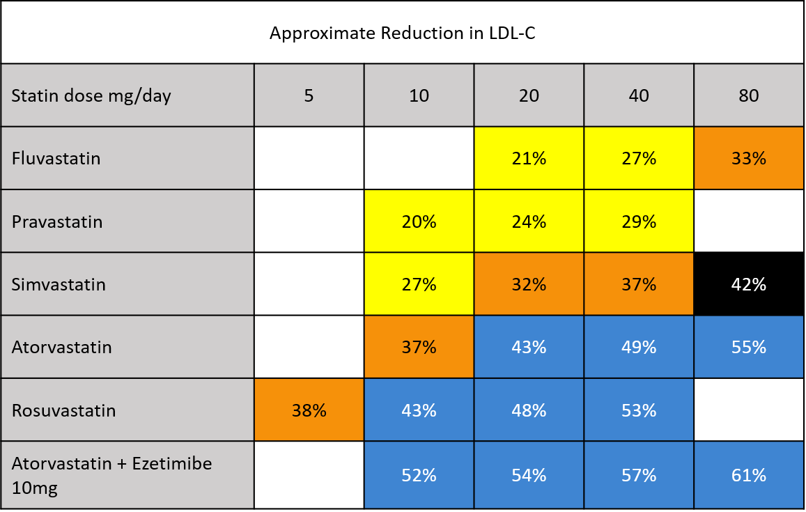
Statin Intensity Table
NICE recommends Atorvastatin and Rosuvastatin as First Line
Low/moderate intensity statins will produce an LDL-C reduction of 20-30%
Medium intensity statins will produce an LDL-C reduction of 31-40%
High intensity statins will produce an LDL-C reduction above 40%
Simvastatin 80mg is not recommended due to risk of muscle toxicity

Slide 15
Summary of Lipid Lowering Therapies
Drug class | NICE approved Recommendation | Administration | LDL-lowering efficacy | CV outcomes evidence | Safety data
Statins | Primary prevention, Secondary prevention, Familial hypercholesterolaemia (FH) | Oral tablet given once daily | High intensity statins can lower LDL-C by 40% -55% (depending on agent and dose)¹ | Multiple outcome studies confirming CV outcomes benefit across a wide range of patient cohorts. For every 10,000 people treated for 5 years: In secondary prevention (established CVD): 1,000 heart attacks, strokes or deaths avoided NNT over 5 years = 10 In primary prevention: 500 heart attacks, strokes or deaths avoided⁷ NNT over 5 years = 20 | Long term safety data has been well established over 30 years For every 10,000 people treated for 5 years: 5 cases of myopathy 5-10 haemorrhagic strokes 50-100 new cases of diabetes ⁷
Ezetimibe | Primary prevention, Secondary prevention and FH where statins are contraindicated, not tolerated or ineffective | Oral tablet given once daily | An additional LDL-C reduction of 24% in combination with statins² | Two CV outcomes studies in secondary prevention on top of statins^{8,9} For every 10,000 people with CVD treated for 7 years: Approximately 200 major CV events avoided NNT 50 for preventing major cardiovascular event over 7 years. ¹⁰ | Long term safety data has been well-established over 20 years
PCSK9i (Alirocumab/ Evolocumab) | Secondary prevention and FH in patients who meet eligibility criteria | Self-administered S/C injection every two weeks | An additional LDL-C reduction of approximately 50% (range 25-70%) alone or in combination with statins or ezetimibe. ^{3,4} | Two CV outcomes studies in secondary prevention on top of statins ^{11,12} For every 10,000 people treated for 2.5 years: Approximately 150 major CV events avoided NNT over 2.5 years = 65¹³ | Safety data has been established over 7 years
Bempedoic acid | For use where statins are not tolerated in combination with ezetimibe, if ezetimibe alone does not control LDL-C well enough | Oral tablet given once daily | An additional LDL-C reduction of approximately 28% (range 22-33%) when combined with ezetimibe⁵ | No CV outcomes data. On-going studies due to report in 2022. | Short term safety data from trials of up to 2 years.
Inclisiran | Secondary prevention in patients who meet eligibility criteria | S/C injection administered by a healthcare professional every six months, once stabilised | An additional LDL-C reduction of approximately 50% (range 48-52%) alone or in combination with statins or ezetimibe⁶ | No CV outcomes data. On-going studies due to report in 2026. | Short term safety data from trials of up to 2 years.
References:
1. NICE CG181 2014 https://www.nice.org.uk/guidance/cg181/chapter/1-recommendations; 2. NICE TA385 2016 https://www.nice.org.uk/guidance/ta385; 3. NICE TA393 2016. https://www.nice.org.uk/guidance/ta394 4. NICE TA394 2016. https://www.nice.org.uk/guidance/ta394 5. NICE TA694 2021. https://www.nice.org.uk/guidance/ta694 6. NICE TA733 2021. https://www.nice.org.uk/guidance/ta733. 7. Collins et al. 2016. Lancet 2016; 388: 2532–61. 8. Cannon CP et al. 2015. N Engl J Med 2015; 372:2387-2397; 9. Amerenco P et al. 2020. N Engl J Med 2020; 382:9-19; 10. Can Fam Physician. 2015 Mar; 61(3): 251. 11. Sabatine et al. 2017: N Engl J Med 2017; 376:1713-1722; 12. Schwarz GG et al. 2018. N Engl J Med 2018; 379:2097-2107; 13. Can Fam Physician. 2018 Sep; 64(9): 669.

Slide 16
Inclisiran for Secondary Prevention
(NICE TA* recommendation)
Inclisiran is indicated for patients:
  With established CVD
  On optimal oral lipid lowering therapy including high intensity statins where tolerated
  Where LDL-C remains ≥ 2.6mmol/L
Inclisiran lowers LDL-C by approx. 50%, but there are currently no long term CVD outcome data or safety data which should be taken into account when making a shared decision with the patient about appropriate treatment choices.
Inclisiran is administered at a dose of 284mg by subcutaneous injection.
It should be given at month 0 (initiation), month 3, month 9 and then every 6 months thereafter.
  If a planned dose is missed by more than 3 months, a new dosing schedule should be started again from month 0 as above.
  It should be administered by a healthcare professional into the abdomen; alternative injection sites include the upper arm or thigh.
The only adverse reactions associated with Inclisiran reported to date are injection site reactions (8.2%)
More information on Inclisiran can be found here.
*Technology Appraisal

Slide 17
Bempedoic Acid for Use in Statin Intolerance
(NICE TA* Recommendation)
Bempedoic acid with ezetimibe is recommended as an option for treating primary hypercholesterolaemia (heterozygous familial and non-familial) or mixed dyslipidaemia as an adjunct to diet in adults. It is recommended only if:
  statins are contraindicated or not tolerated
  ezetimibe alone does not control low-density lipoprotein cholesterol well enough
Bempedoic acid with ezetimibe can be used as separate tablets or a fixed-dose combination.
The recommended dose of bempedoic acid is one film-coated tablet of 180 mg taken once daily.
Bempedoic acid lowers LDL-C by an additional 28% (range 22-33%) when combined with ezetimibe.
Bempedoic acid was associated with a slightly increased risk of tendon rupture, involving the biceps tendon, rotator cuff, or Achilles tendon. Other more commonly reported adverse events in clinical trials were upper respiratory tract infection, back pain, abdominal pain or discomfort, bronchitis, pain in extremity, anaemia, and elevated liver enzymes.
More information on bempedoic acid can be found here.
*Technology Appraisal

Slide 18
CV Risk assessment - QRISK®2/3
QRisk2 can be accessed here: https://www.qrisk.org/2017/
QRisk3 can be accessed here: https://www.qrisk.org/three/
QRISK®3 includes more factors than QRISK®2 to help identify those at most risk:
Chronic kidney disease, which now includes stage 3 CKD
Migraine
Corticosteroids
Systemic lupus erythematosus (SLE)
Atypical antipsychotics
Severe mental illness
Erectile dysfunction
A measure of systolic blood pressure variability

Slide 19
Familial Hypercholesterolaemia

Slide 20
Familial Hypercholesterolaemia:
Increasing Detection and Optimising Management
The UCLPartners FH pathway will help improve identification & management of patients with possible undiagnosed Familial Hypercholesterolaemia (FH).
92% of people with the condition are estimated to be undiagnosed.
A significant number of patients with coded FH do not have the condition and the diagnosis needs to be reviewed.
The Simon Broome (SB) criteria can be used to determine if a patient with high cholesterol needs genetic testing.
This pathway automates and simplifies this process and offers a pragmatic solution to case-finding:
  Searches identify patients with a high cholesterol above the NICE recommended (CG71) thresholds.
  An ARRS* role or other team member then arranges fasting lipids plus renal, liver, thyroid and HbA1c to identify possible secondary causes of raised lipids. Cholesterol levels should then be re-checked after secondary causes are managed.
  If the triglycerides are below 2.3mmol/l, a simplified family history questionnaire can be texted to the patient, with interpretation checked by the ARRS role. If family history of early CHD is positive, the Simon Broome criteria for genetic testing are met.
  If family history is negative, the patient should be assessed for tendon xanthomata (TX). This service could be provided across a PCN or CCG by a trained pharmacist or nurse. If TX are present, the Simon Broome criteria for genetic testing are met.
  For patients in whom Simon Broom criteria are met and for those with known (coded) FH, a desktop review is conducted by a trained pharmacist or nurse to check results and coding, exclude secondary causes for the elevated lipid levels and referral to specialist service for assessment and genetic testing.
*Additional Roles Reimbursement Scheme

Slide 21
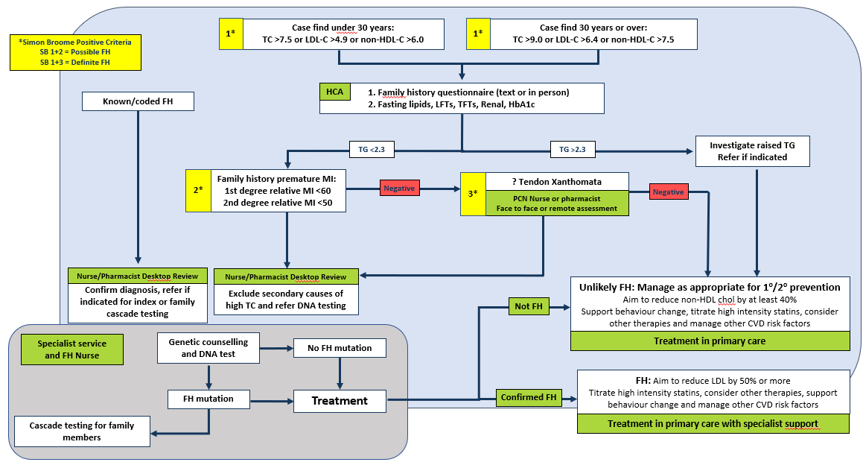
UCLPartners Familial Hypercholesterolaemia Pathway

Slide 22
Familial Hypercholesterolaemia:
Family History Questionnaire
We have reviewed your cholesterol results and would like some information on your family history to help inform your treatment. Please answer the following questions:
Have any of your first-degree blood relatives (mother, father, brother or sister) had a heart attack under the age of 60?
  If Yes, which relative (mention how they are related to you) and how old were they when they had the heart attack?
Have any of your second-degree blood relatives (grandparents, aunts, uncles, nephews, nieces and half brothers and half sisters) had a heart attack aged 50 or under?
  If Yes, which relative (mention how they are related to you) and how old were they when they had the heart attack?
1
Yes/ No
2
Yes/ No

Slide 23
Desktop Review for People with Coded FH
Identify patients coded as Familial Hypercholesterolemia
Review notes and medications
Have they had a genetic test to confirm diagnosis?
Yes
No
Are they under regular lipid clinic review?
Calculate probability of FH using Simon Broom or Dutch lipid clinic criteria and refer to specialist lipid clinic if meets criteria
No
Yes
Continue management as per specialist team
Consider referral to lipid clinic if appropriate

Slide 24
Simon Broome Criteria – Definite FH
Definite FH is defined as one of the cholesterol levels (total cholesterol or LDL cholesterol) as outlined in the table below:
 | Adult | Child (less that 16 years)
Total Cholesterol | Greater than 7.5mmol/L | Greater than 6.7mmol/L
Low-Density Lipoprotein (LDL) Cholesterol Concentration | Greater than 4.9mmol/L | Greater than 4.0mmol/L
    Plus one of the following:
    Tendon xanthomata (or evidence of tendon xanthomata) in the person, a first-degree relative (parent, sibling, or child) or a second-degree relative (grandparent, uncle, or aunt), or
    DNA-based evidence of an LDL receptor mutation, familial defective apo B-100, or a PCSK9 mutation.

Slide 25
Simon Broome Criteria – Possible FH
Definite FH is defined as one of the cholesterol levels (total cholesterol or LDL cholesterol) as outlines in the table below:
 | Adult | Child (less that 16 years)
Total Cholesterol | Greater than 7.5mmol/L | Greater than 6.7mmol/L
Low-Density Lipoprotein (LDL) Cholesterol Concentration | Greater than 4.9mmol/L | Greater than 4.0mmol/L
and at least one of the following:
    Family history of myocardial infarction — before 60 years of age in a first-degree relative or before 50 years of age in a second-degree relative.
    Family history of raised total cholesterol — greater than 7.5 mmol/L in an adult first- or second-degree relative, or greater than 6.7 mmol/L in a child or sibling (of the person with suspected FH) aged younger than 16 years.
Reference: https://cks.nice.org.uk/topics/hypercholesterolaemia-familial/diagnosis/assessment-diagnosis/#the-simon-broome-the-dutch-lipid-clinic-network-criteria

Slide 26
Dutch Lipid Clinic Criteria
Family history
First-degree relative with known premature coronary and/or vascular disease (men aged <55 years and women aged <60 years) or First-degree relative with known low-density lipoprotein-cholesterol (LDL-C) above the 95th percentile for age and sex |  | 1
First-degree relative with tendinous xanthomata and/or arcus cornealis or Children aged <18 years with LDL-C above the 95th percentile for age and sex |  | 2
Clinical history
Patient with premature coronary artery disease (ages as above) |  | 2
Patient with premature cerebral or peripheral vascular disease (as above) |  | 1
Physical examination
Tendon xanthomas |  | 6
Arcus cornealis prior to 45 years of age |  | 4
LDL-C (mmol/L)
 | LDL-C ≥8.5 | 8
 | LDL-C 6.5–8.4 | 5
 | LDL-C 5.0–6.4 | 3
 | LDL-C 4.0–4.9 | 1
Deoxyribonucleic acid (DNA) analysis: Functional mutation in the low-density lipoprotein receptor (LDLR), apolipoprotein B (APOB) or proprotein convertase subtilisin/kexin type 9 (PCSK9) gene |  | 8

Slide 27
Dutch Lipid Clinic Criteria
Stratification | Total score
Definite familial hypercholesterolaemia (FH) | ≥8
Probable FH | 6–7
Possible FH | 3–5
Unlikely FH | <3
ApoB, apolipoprotein B; DNA, deoxyribonucleic acid; FH, familial hypercholesterolaemia; LDL-C, low-density lipoprotein-cholesterol; LDLR, low-density lipoprotein receptor; PCSK9, proprotein convertase subtilisin/kexin type 9

Slide 28
Management of FH in Primary Care
Offer referral for genetic testing and cascade testing
Offer a high-intensity statin to all adults with FH - aim for at least a 50% reduction in LDL-C concentration. Increase the dose of statin after 3 months if not achieving a 50% reduction in LDL-C and not already prescribed maximum dose.
Use ezetimibe in patients with FH who have contraindications to, or cannot tolerate, statin therapy and consider adding bempedoic acid
Add ezetimibe to statin therapy in patients who are not achieving a 50% reduction in LDL-C concentration despite maximum dose high intensity statin OR where statin dose is limited by side effects. Consider inclisiran in patients with CVD, who are not achieving an LDL-C<2.6mmol/L despite optimal oral lipid lowering therapy (high intensity statins with or without ezetimibe)
Refer patients to a specialist for consideration of further treatment:
  if treatment with the maximum tolerated dose of a high-intensity statin and ezetimibe +/- inclisiran is inadequate
  if they are assessed to be at very high risk of a coronary event:
    A family history of premature coronary heart disease
    Two or more other cardiovascular risk factors (for example, they are male, they smoke, or they have hypertension or diabetes)
  If they have established cardiovascular disease
Specialists may initiate PCSK9i (alirocumab or evolocumab), bile acid binders (resins) or fibrates in patients with an inadequate response to first line lipid lowering therapies
PCSK9i are recommended for use in people with FH:
  For primary prevention when LDL remains > 5mmol/L despite optimal statin / ezetimibe therapy
  For secondary prevention when LDL remains > 3.5mmol/L despite optimal statin / ezetimibe therapy

Slide 29
Proactive Care Consultations
Structured support for education, self-management and behaviour change

Slide 30
Proactive Care Consultations
Members of the wider primary care team (e.g. ARRS* roles such as health care assistants and care coordinators) can provide structured support for education, self-management and behaviour change, sharing trusted information from charity and other websites. The UCLPartners Proactive Care Frameworks include education and training resources to support these consultations and educational digital resources to share with patients.
Education e.g.
  What is high blood pressure, cholesterol
  How to check and reduce cardiovascular risk?
Self-management e.g.
  How to check your blood pressure at home
  How to choose a blood pressure monitor
  When to seek advice
Behaviour Change – brief interventions and signposting.
  Healthy eating
  Physical activity
  Smoking cessation
  Alcohol
*Additional Roles Reimbursement Scheme

Slide 31
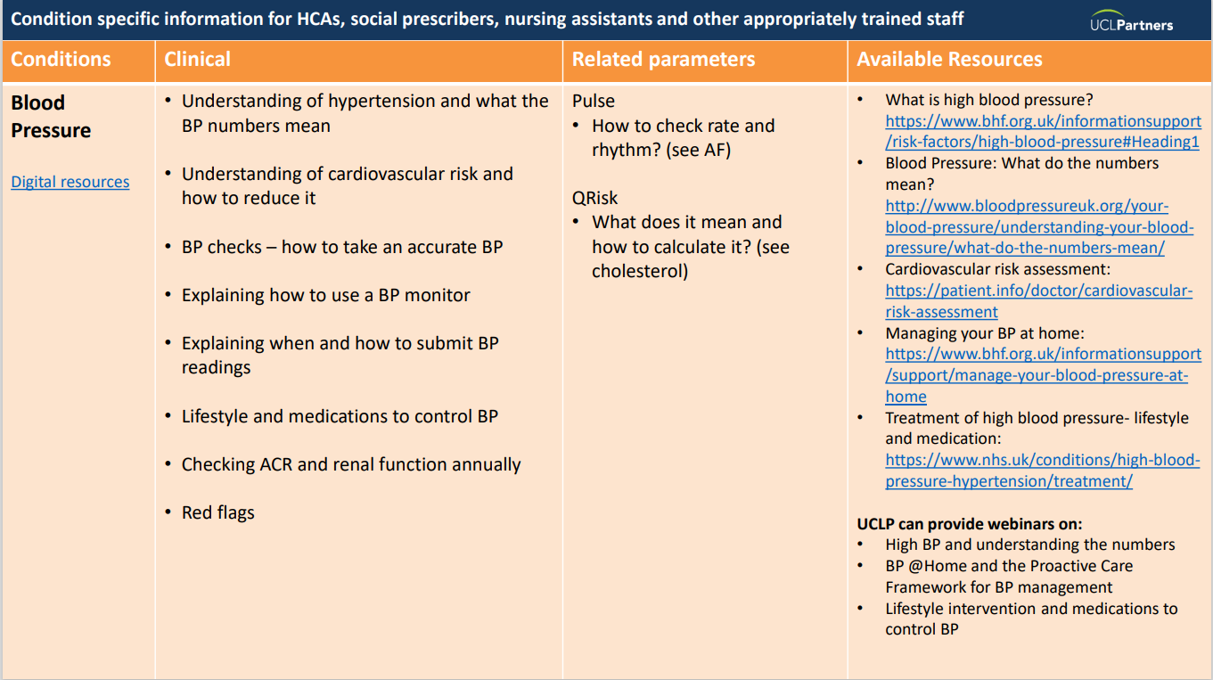
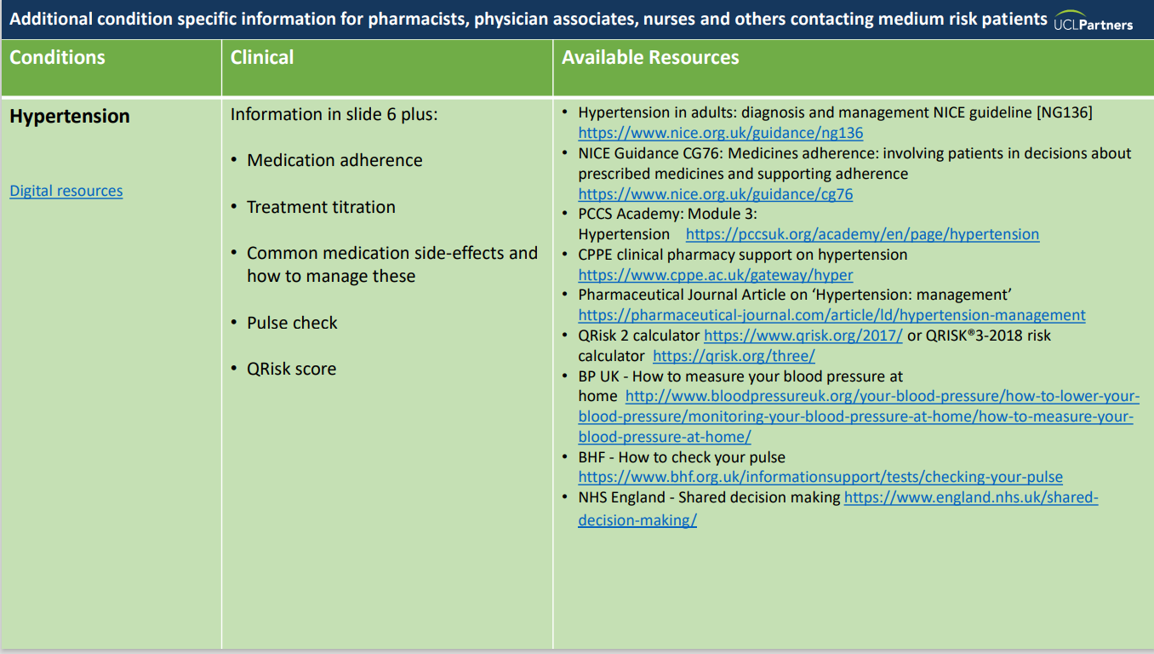
Resources to Support Proactive Care Consultations
Education and training resources:
Recommended training slides
Proactive Care Consultations Guide
Motivational interviewing

Slide 32
Education
Understanding cholesterol
Risk factors for heart and circulatory disease
All about statins
Familial Hypercholesterolemia
Understanding high blood pressure
Self-management
How to lower your cholesterol
Cholesterol – your 5 top questions answered
Statins – your questions answered
South Asian diets and cholesterol
How to check your blood pressure (video)
Behaviour Change
Eat well
Healthy eating guide
BHF Recipe search
Get active
Get active indoors
Ways to move
Quit smoking
Drink Less
Resources for Patients

Slide 33
References
NHS England statin intolerance pathway
NICE cardiovascular disease prevention clinical guidance
ESC Guidelines on cardiovascular disease prevention
Summary of National Guidance for Lipid Management for Primary and Secondary Prevention of CVD – AAC Subgroup March 2020

Slide 34







Thank you
Sign up to our monthly newsletter to
receive the latest news, opportunities
and events from UCLPartners
    UCLPartners.com/newsletter
    www.uclpartners.com
    @uclpartners
    linkedin/company/uclpartners
    CVDACTION@uclpartners.com

Slide 35
Version tracker
Version | Edition | Changes Made | Date amended | Review date
2 | 2.0 | Updated lipid optimisation pathways | Jan 2024 | Dec 2024
2 | 2.1 | Updated CVD ACTION logo and slide template | March 2025 | March 2026

