Slide 1
“What we tried to achieve with VR in simulation-based education at Homerton?”
Sini John/ Dr Tom Ngan
Simulation team
Homerton Health care
Notes:
I am here to talk about one of the face to face simulation course in which we incorporated the capabilities of a virtual platform which Simbonix gastroscope provide.

Slide 2

Hi-F.I.V.E
Human Factors
In
Virtual Endoscopy

Slide 3
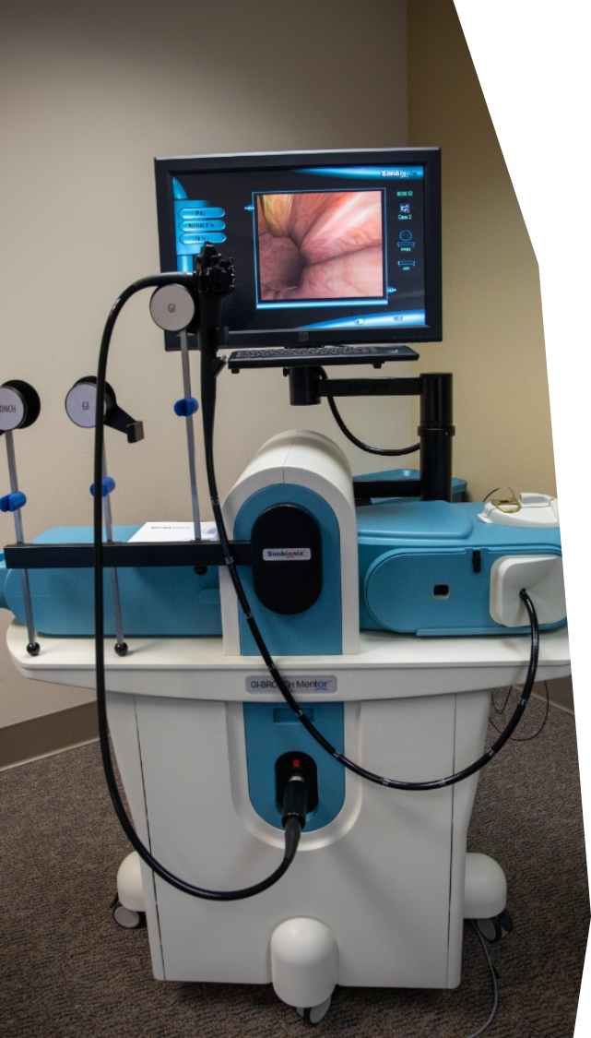
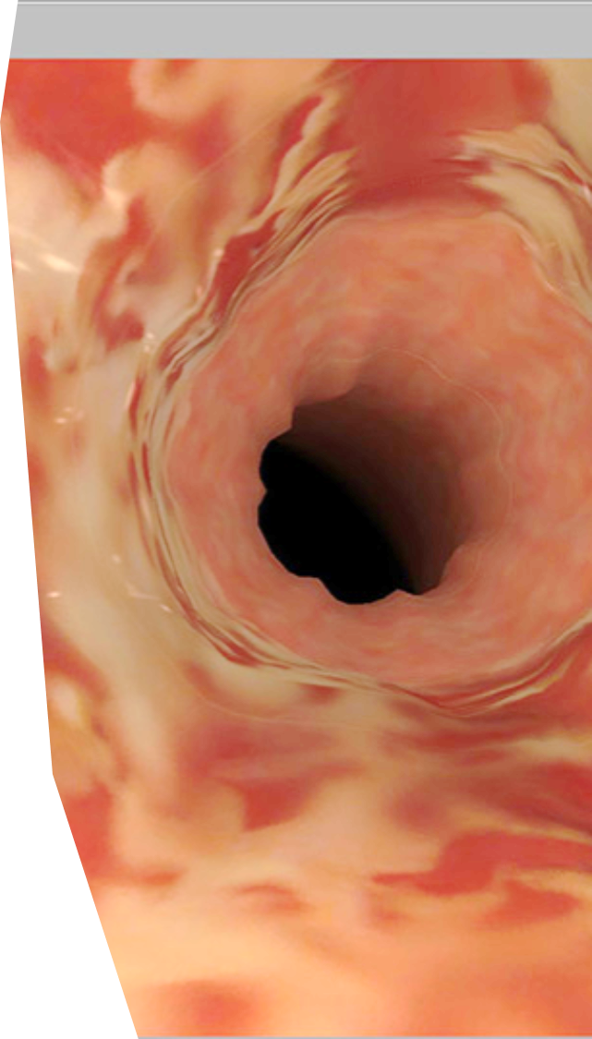
GI MENTOR
Our VR simulator
Notes:
The GI Mentor is for the training of gastrointestinal upper and lower endoscopic procedures, offering a comprehensive library of modules with more than 120 tasks and virtual patient cases.simulator provides multiple training opportunities with true to life patient cases offering realistic scenarios of clinical situations, ranging from simple diagnostic procedures to advanced ERCP and Endoscopic Ultrasound (EUS) procedures. been customized to provide realistic simulation including tactile sensations and various endoscopic tools.

Slide 4
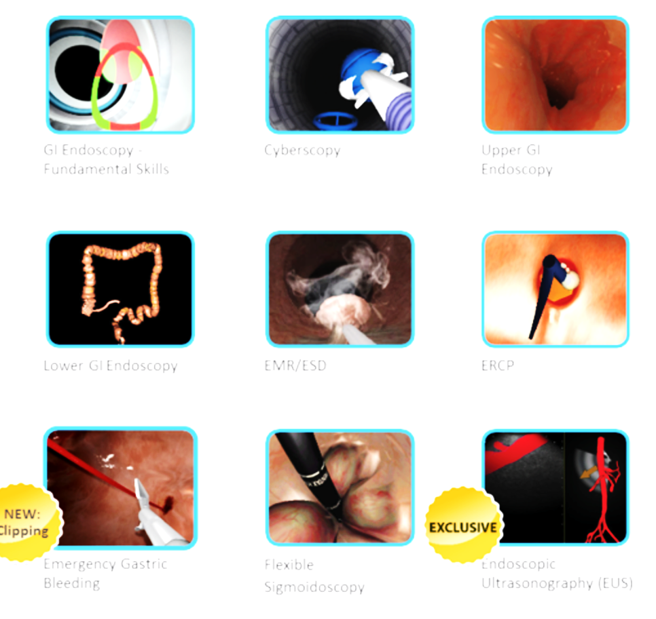
Available Modules
GI endoscopy Fundamental Skills
Emergency Gastric Bleeding
Cyberscopy
Upper GI Endoscopy
EUS
Lower GI Endoscopy
EMR/ESD
ERCP
Flexible sigmoidoscopy

Slide 5

NCEPOD report 2004
Failings in teamwork and non-technical skills

Slide 6
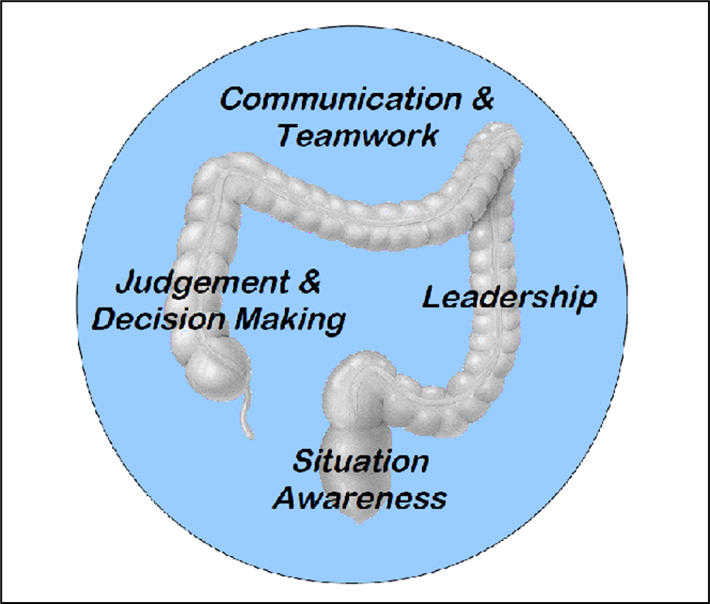

Endoscopy Non-technical skills (ENTS)

Slide 7

What is HiFIVE simulation course?
One day course
Multidisciplinary
Focuses on range of human factors, mapped to the endoscopic non-technical skills (ENTS) framework
First course in 2012
It’s a national recommended course for Gastro trainees

Slide 8
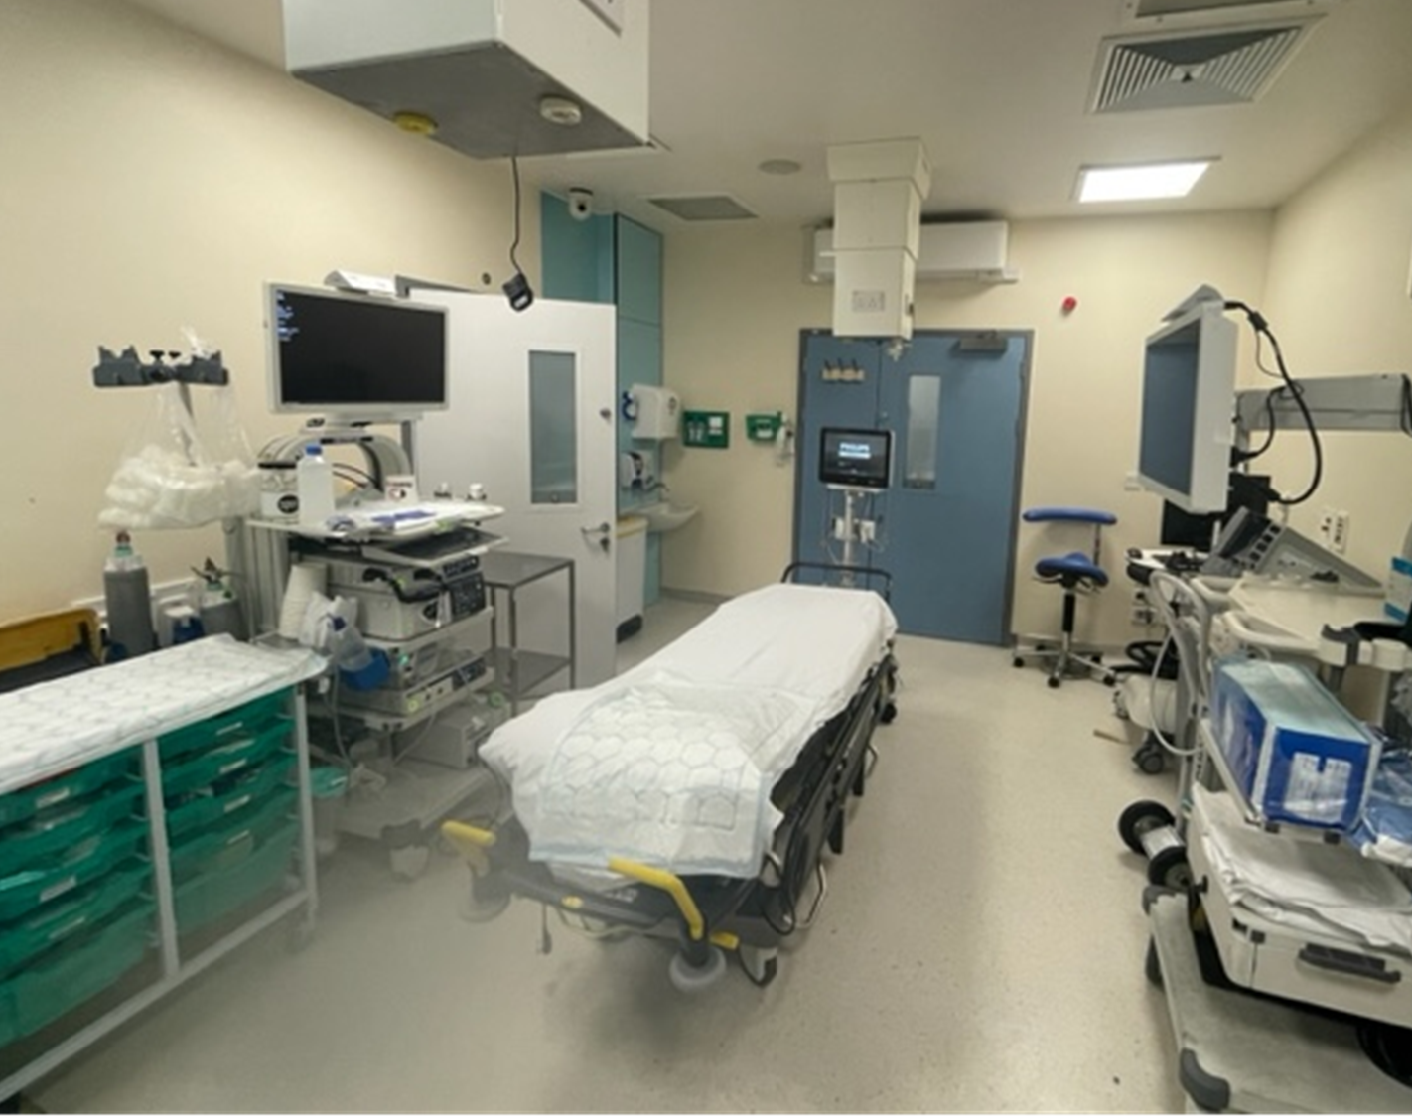
An endoscopy suite

Slide 9
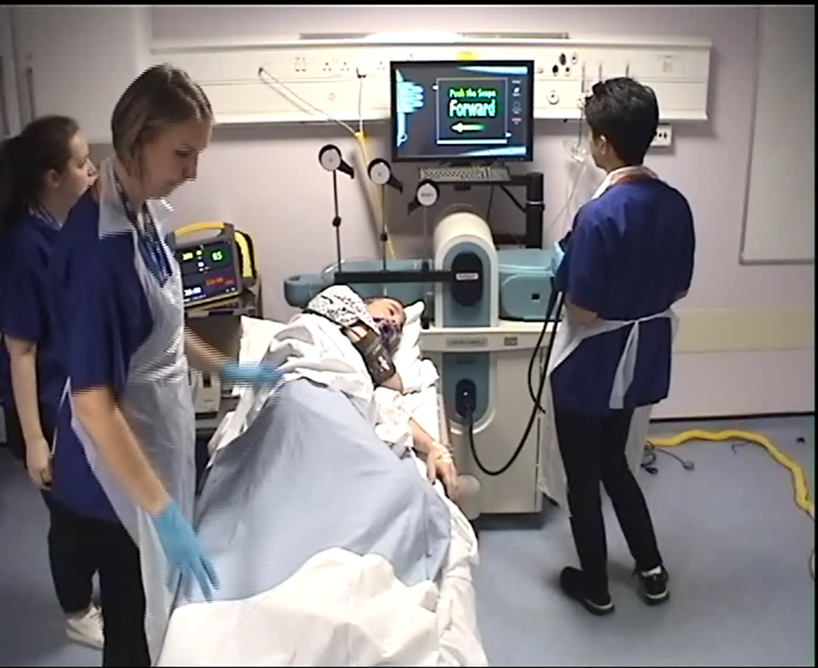
Snippet from the HiFIVE course

Slide 10

SNIPPET scenario

Slide 11
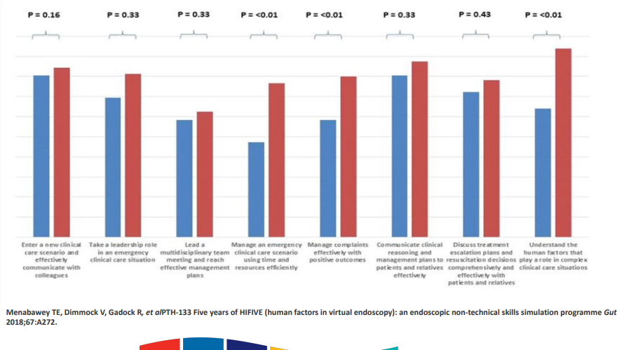
Feedback

Slide 12
Sustainability and Next Steps
HiFIVE course for clinical endoscopists
Nurse only HiFIVE course
Train the trainer opportunities for both courses
Use similar format for surgical courses…?

