Slide 1


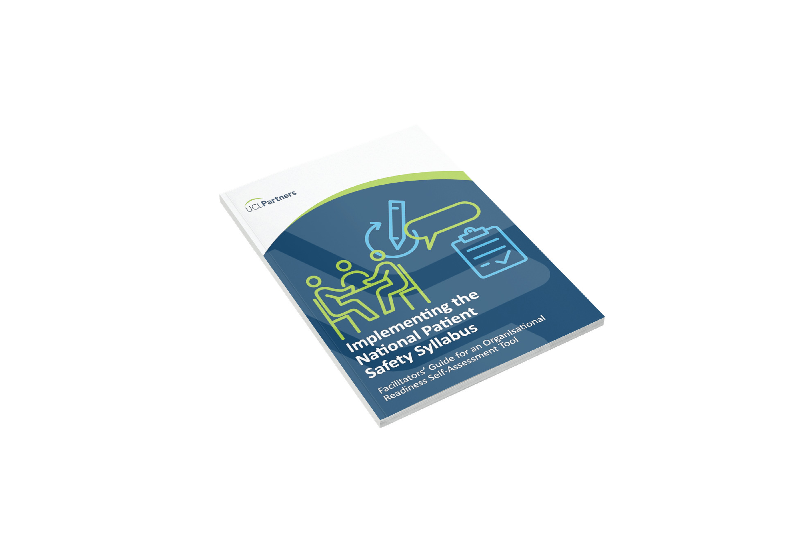

Development of an Organisational Readiness Self-Assessment Tool
Mark Sujan
CIEHF / Human Factors Everywhere

Slide 2
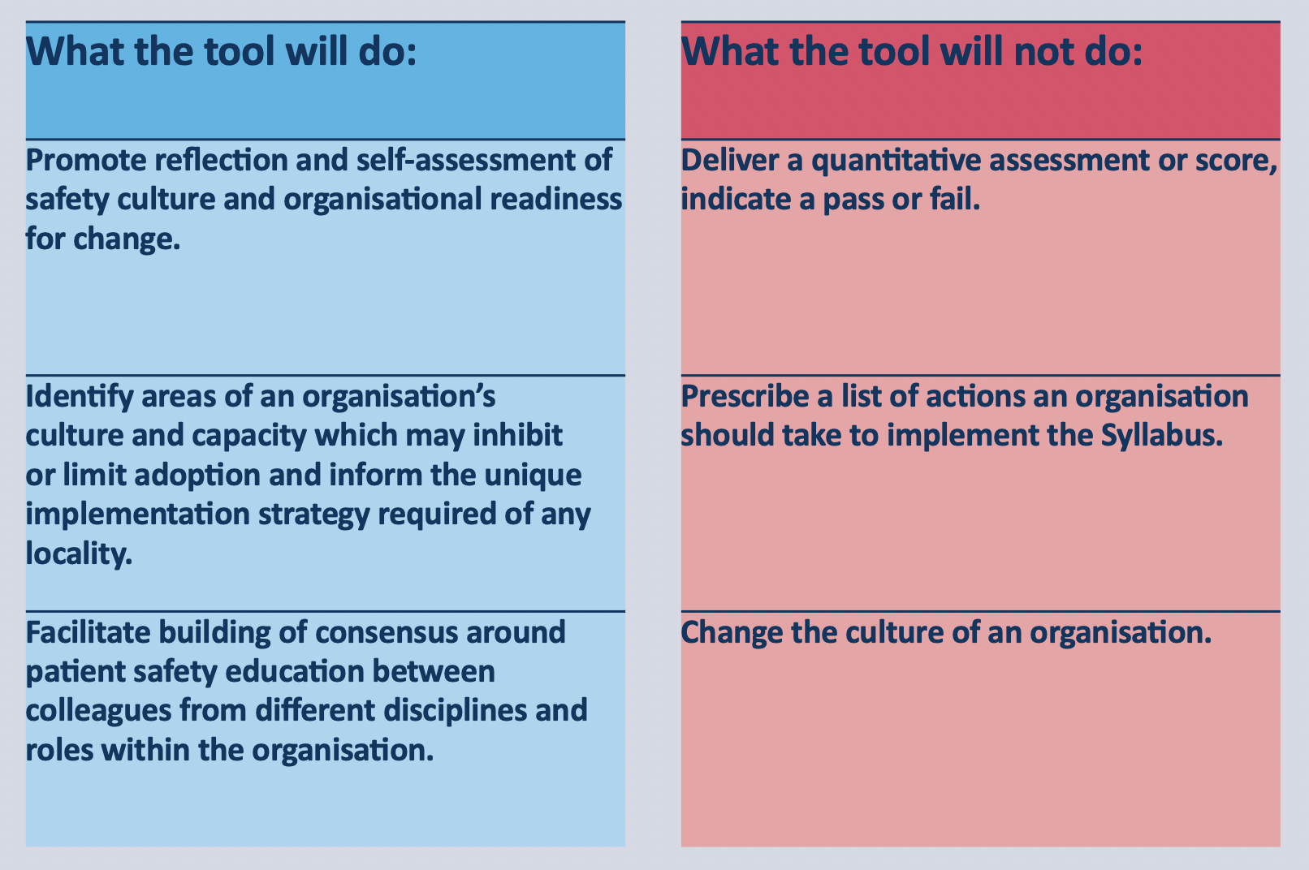

Slide 3
How the tool was developed
Phase 1
Existing patient safety education
Scaling
Phase 2
Literature review on Organisational Readiness for Change and Safety Culture Assessment instruments
Prototype self-assessment tool
Phase 3
Testing in two organisations
Guidance development
Barriers / facilitators

Slide 4
Existing Education
Clinical skills, incident investigations, non-technical skills, just culture
Focus on specific staff groups
Smaller organisations do not have education infrastructure

Slide 6
Tool Prototyping
Organisational Readiness for Change
27 instruments
Change commitment & efficacy (Weiner)
Safety Culture Assessment
SAQ, HSPSC, MaPSaF, SCORE
Assessment vs dialogue
Prototype
OR and SC
24 items

Slide 7
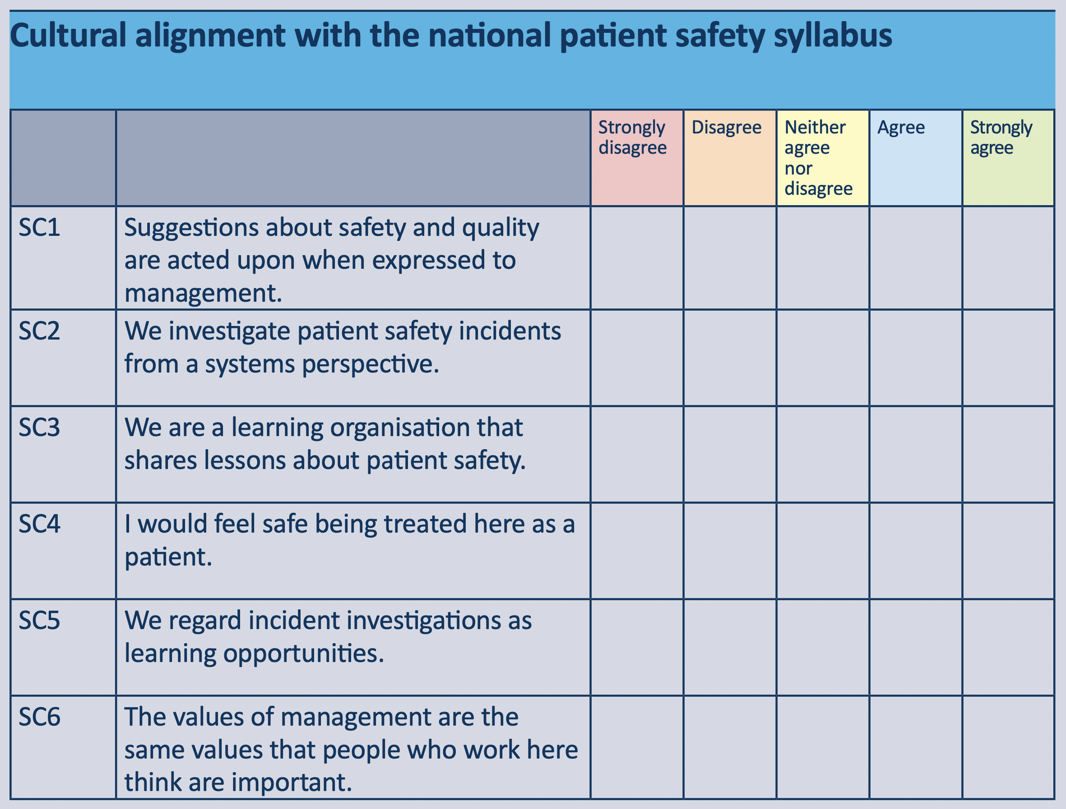
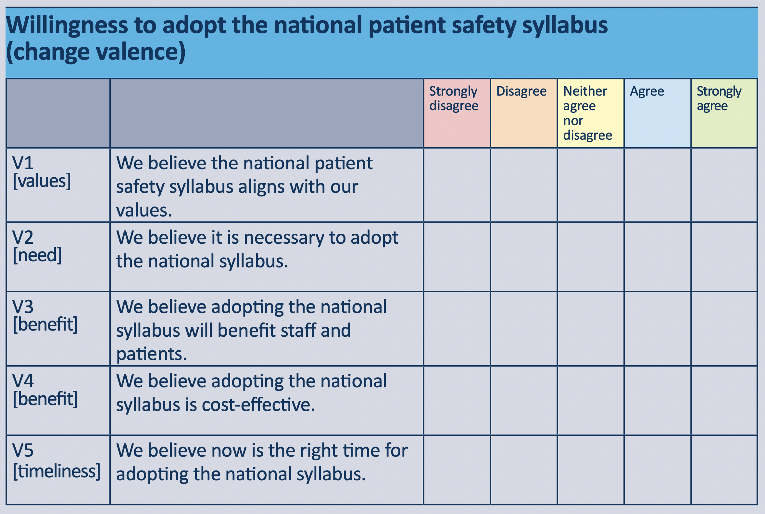
Self-Assessment Tool

Slide 8
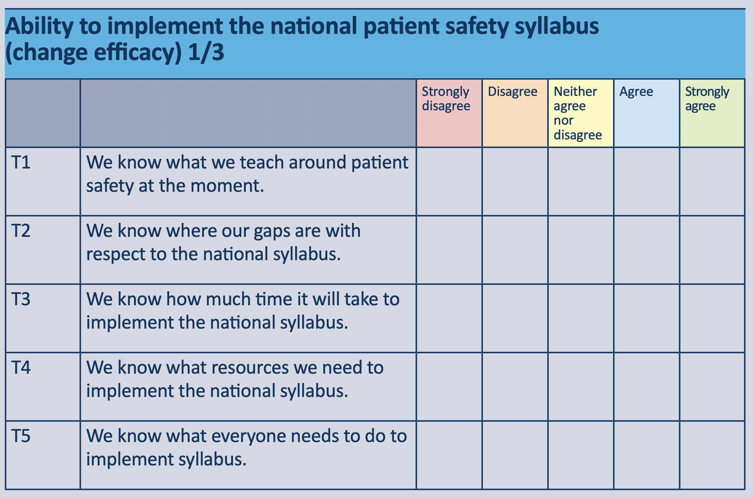
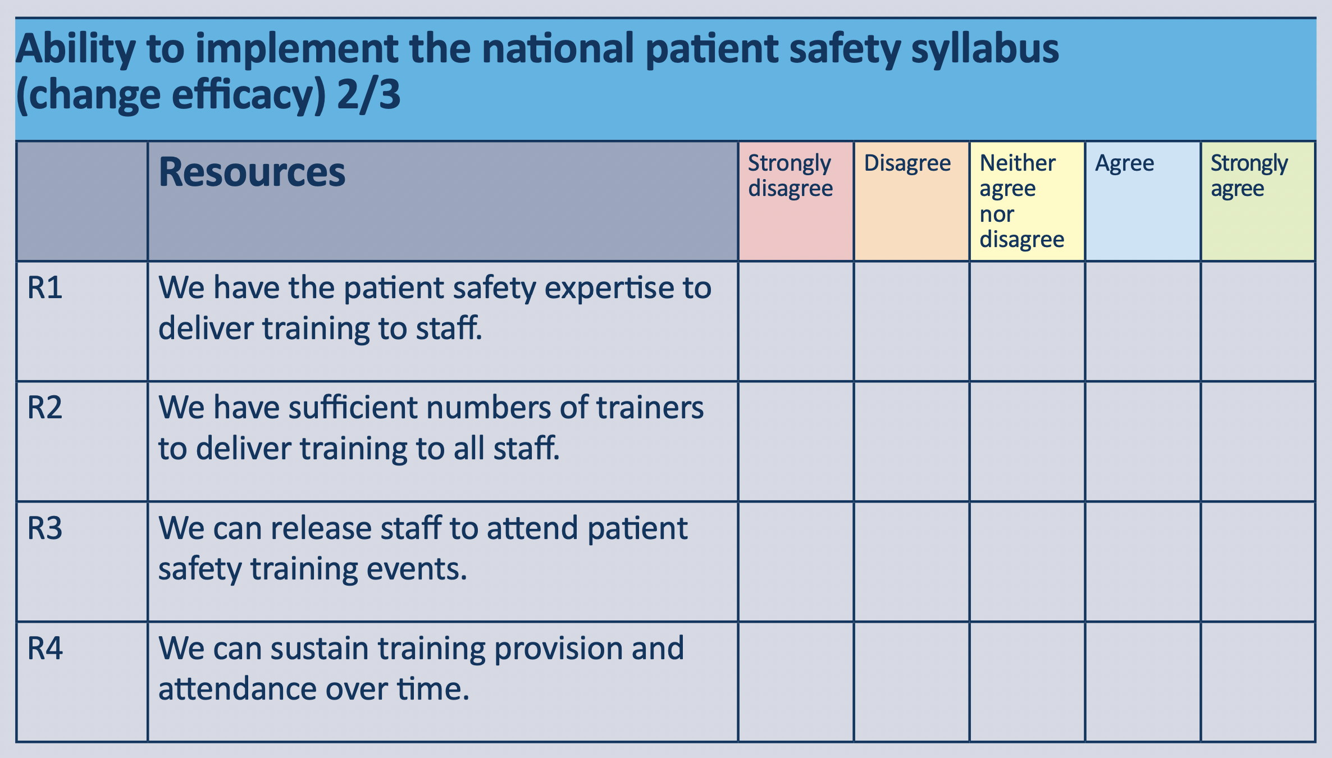
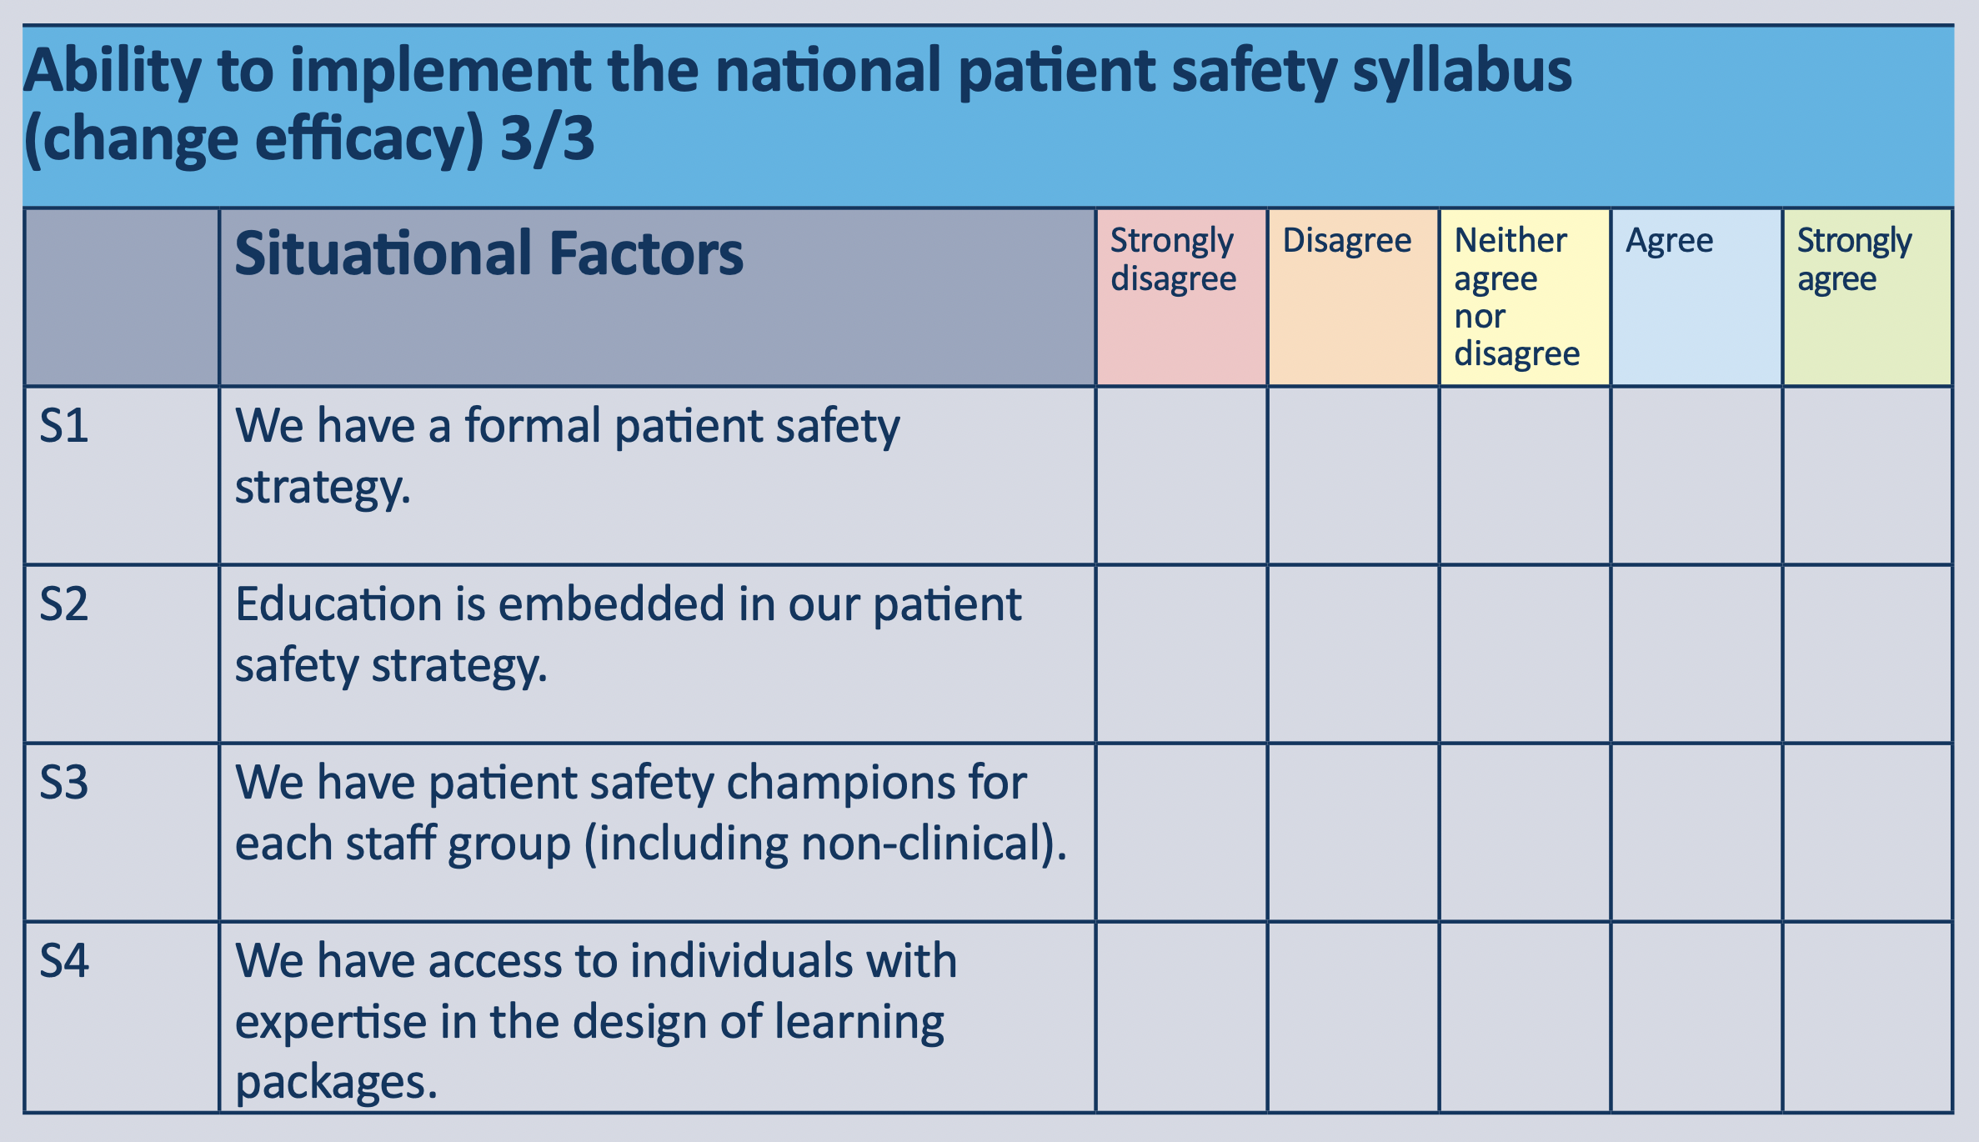
Self-Assessment Tool
Tasks

Slide 9
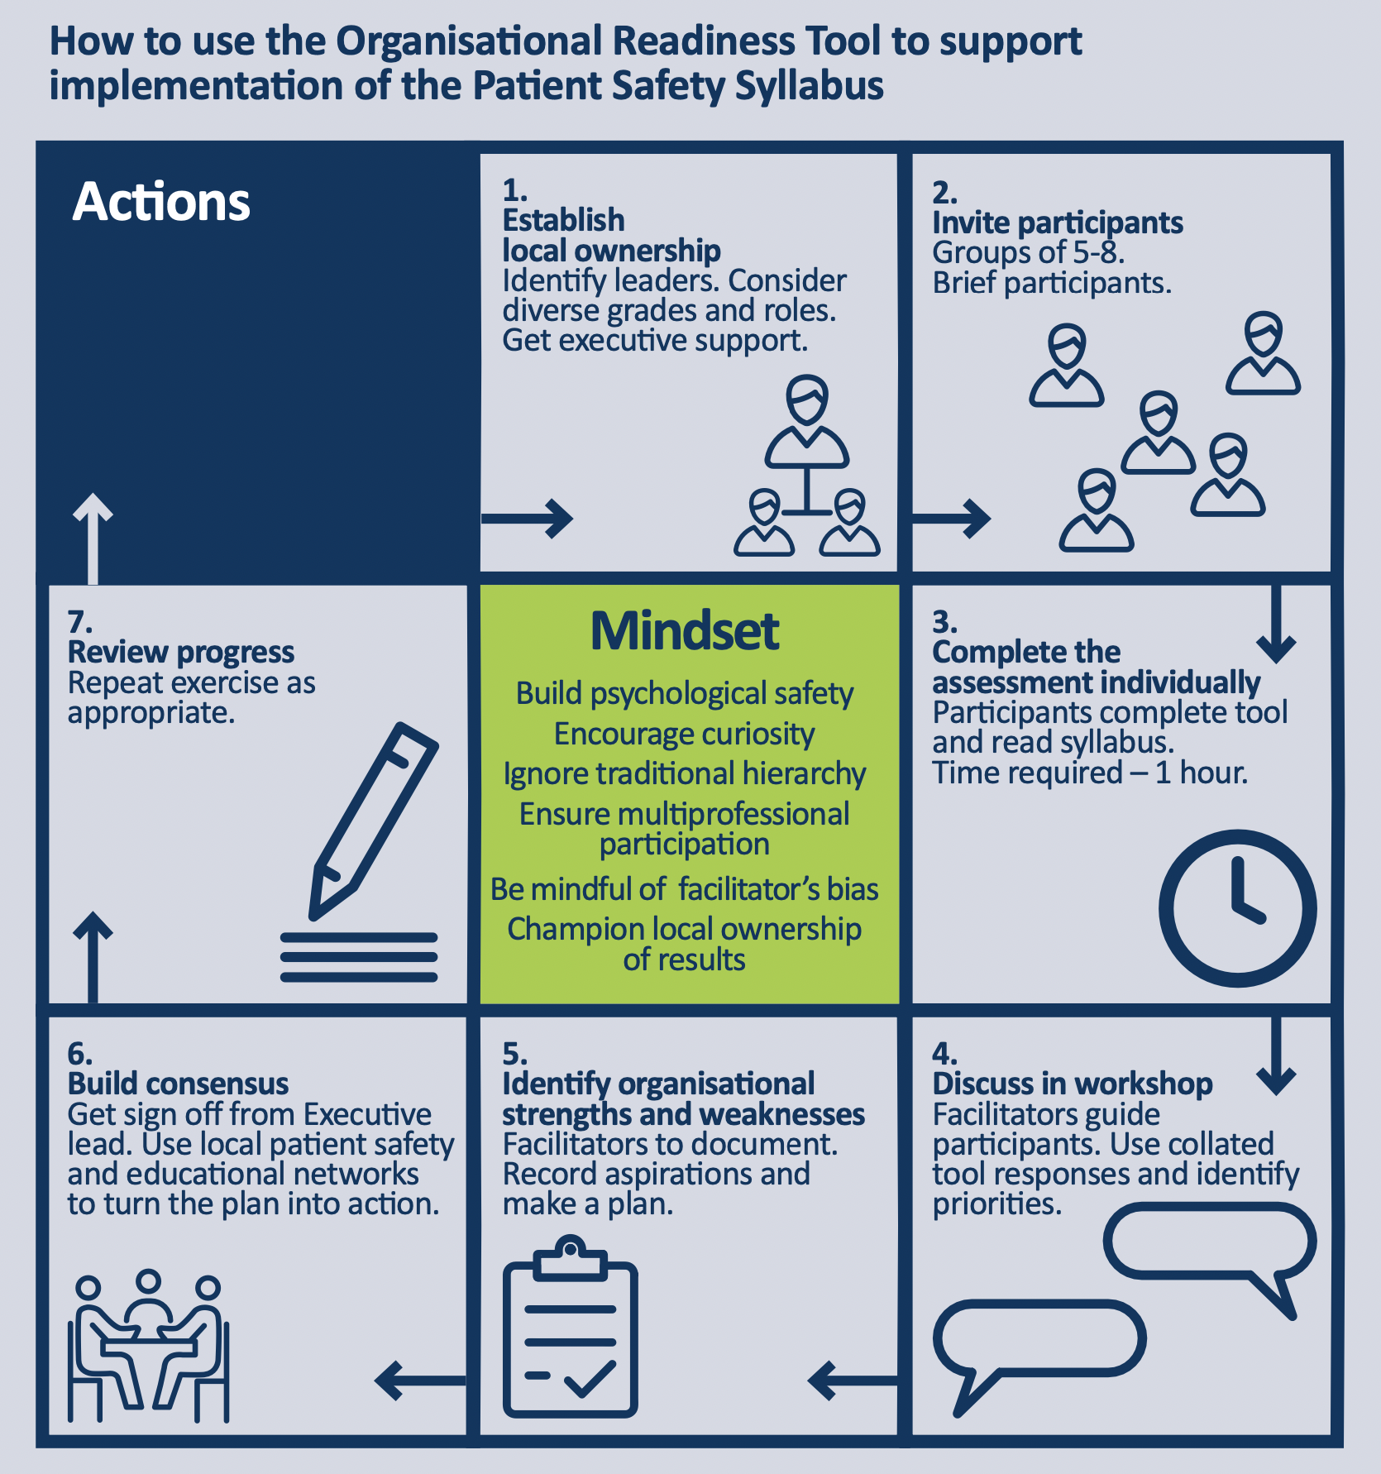

Slide 10
What’s needed
Clear vision for patient safety syllabus
Use suitably qualified people (C.ErgHF)
Senior management commitment
Gradual implementation
Align with existing priorities
HEE Funding
Centralised approach for smaller organisations

