Slide 1


Incorporating psychotherapeutic principles into simulation pre-briefing
Gareth Drake
Psychologist in Simulation
Great Ormond Street Hospital
Kate Drewek
Recent Education Fellow in Clinical Simulation
Great Ormond Street Hospital
Notes:
Overview of whole session:
11:00-11:20 Intros and initial discussion about pre-brief experiences (Kate lead)
11:20-11:30 Introduction to similarities to therapy, epistemic trust and stance (Gareth lead)
11:30-11:45 Post-it activity about stance, including short leg-stretch break (Kate lead)
11:45-12:00 Talk through pre-brief tool and answer questions (Gareth lead)
12:00-12:20 Practicing validating candidate experiences (Kate introduce, Gareth lead discussion)
12:20-12:30 Summary and asking their thoughts/suggestions

Slide 2

Overview
Consider what the pre-brief is, and why it is important
Recognise the similarities between the therapeutic relationship between a psychologist and their patient and an educator and their simulation candidates
Develop tools to recognise and adapt own stance
Short leg stretching break!
Review and critique the new GOSH pre-briefing tool
Practice applying principles to develop epistemic trust
Notes:
11am-11.05am
Kate to introduce session
Who are we?
Orientate to space
Orientate to time – 1.5 hours, time to stretch legs and check phones in middle!
Aiming:
Intros – 5 mins (Kate)
Discussion about pre-brief current practice – 10 mins (Kate)
Explanation of similarities to therapeutic relationships – 10 mins (Gareth)

Slide 3
“The pre-simulation briefing (synonymous with the terms introduction, orientation, and pre-briefing) for a simulation session or entire simulation course sets the tone for all that follows”
(Rudolph, Raemer and Simon, 2014)
Notes:
11:05-11:20 for all initial pre-brief discussion
Kate lead
Pre-brief aim: To create an environment where learners feel contained and safe enough to allow themselves to be temporarily uncomfortable and push the boundaries of their intellectual and social comfort zones in the knowledge that they will be supported to manage difficult feelings and anxiety and be viewed positively even if they make mistakes.
Rudolph, Raemer & Simon talk about a safe container. 4 key areas:
Clarifying expectations
Establishing fiction contract
Attending to logistical details
Conveying a Commitment to Respecting Learners and Understanding Their Perspective
?or can put an actual definition on this slide
?do you think we need actual references and more academic things on our slides

Slide 4

Tell your neighbours about your pre-briefing experience
Do you pre-brief already?
What do you routinely include?
Do you notice it makes a difference?
What are the challenges?
Notes:
11:05-11:20 for all initial pre-brief discussion
Kate lead
Talk in groups of 3-4 (if sitting at round tables of 10)
DO you pre-brief already? What do you routinely include? Do you notice it makes a difference? What are the challenges?
For 2 mins (ish) or until goes quiet
Ask room to share thoughts, particularly barriers to good prebriefing

Slide 5

Establishing a ‘safe container’:
Clarify expectations
Establish a fiction contract
Attend to logistic details
Convey a commitment to respecting learners and concern for their psychological safety
(Rudolph, Raemer and Simon, 2014)
Notes:
11:05-11:20 for all initial pre-brief discussion
Kate lead
Expect their answers to relate to these 4 areas listed by Rudolph, Raemer and Simon.
Most pre-brief tools we have seen are a checklist that focus on what to say from this list.
We have included these essential items in our tool, but the predominant focus is on developing psychological safety through
Rudolph, Raemer & Simon talk about a safe container. 4 key areas:
Clarifying expectations (including roles, learning outcomes and confidentiality agreement)
Establishing fiction contract
Attending to logistical details
Conveying a Commitment to Respecting Learners and Understanding Their Perspective

Slide 6

How is pre-briefing like therapy?
Notes:
11:20-11:30 for introduction to theories and why introduced
Gareth lead
Gareth – what did you notice when starting your role in simulation?
The similarities in what we are asking them to do, be vulnerable and trust us etc.
Introduce two key principles used by therapists: Epistemic trust and stance
- State we know there is already lots in the literature about containment and stance during debriefing, but all the pre-brief tools we have seen focus on WHAT to say, rather than how the educators make the candidates feel

Slide 7


Epistemic Trust
An individual’s willingness to consider new learning as relevant to them and relax their epistemic vigilance
What else have you got?
You get me!
Notes:
11:20-11:30 for introduction to theories and why introduced
Gareth lead
Gareth talks about epistemic trust and epistemic vigilance
Relate to therapy and then to education – e.g. the teenager with their head down example
Two steps:
Meet the learners where they are. E.g. validating any negative attitudes towards simulation
Look for the ‘you get me!’ moment – only then is the door open for discussion about objectives/aims etc

Slide 8
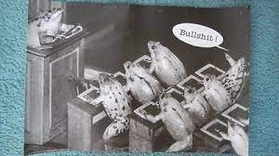
Epistemic Trust
An individual’s willingness to consider new learning as relevant to them and relax their epistemic vigilance
xx
Notes:
11:20-11:30 for introduction to theories and why introduced
Gareth lead
Gareth talks about epistemic trust and epistemic vigilance
Relate to therapy and then to education – e.g. the teenager with their head down example
Two steps:
Meet the learners where they are. E.g. validating any negative attitudes towards simulation
Look for the ‘you get me!’ moment – only then is the door open for discussion about objectives/aims etc

Slide 9
Stance
The baseline against which a therapist notices any emotional pulls or deviations
Notes:
11:20-11:30 for introduction to theories and why introduced
Gareth lead
Gareth discuss stance and how this can affect the learners

Slide 10
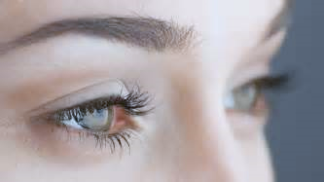
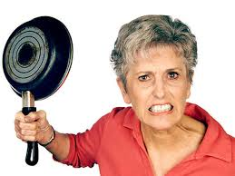

Stance
Background stance: relatively stable once decided upon
Front-ground drama: e.g. strong feelings, defensiveness, sarcastic jokes, heated atmosphere, rushing through, flatness, excessive positivity.
It’s not a doll!
Notes:
11:20-11:30 for introduction to theories and why introduced
Gareth lead
Gareth discuss stance and how this can affect the learners

Slide 11


Discuss with your table:
What affects your stance?
What is your ideal stance?
Notes:
Activity: 11:30-11:45 (including short pause)
Kate lead
Talk in groups of 3-4 (if sitting at round tables of 10). Then will deliver notes (pink/blue appear on clicking) and ask to write on.
1. What affects your stance?
e.g. not eaten! In new environment etc
2. What is your ideal stance?
2 mins or until room quietens.
Then MOVEMENT/phone break! – 5 mins to stick notes on board and Kate arrange into categories
Gareth to talk through notes
?Do we think these may link to Maslow’s heirachy
**Expect there to be some about feelings when do not feel competent to teach more senior people which I don’t recall discussing before.
Ask group to help each-other come up with solutions for more challenging aspects of this.

Slide 12



Short leg stretching break, as promised!
Notes:
Pause: 11:35-11:40

Slide 13
Discuss with your table:
What affects your stance?
What is your ideal stance?
Notes:
Activity: 11:30-11:45 (including short pause)
Kate lead
Talk about own psychological safety as educators
?Do we think these may link to Maslow’s heirachy
**Expect there to be some about feelings when do not feel competent to teach more senior people which I don’t recall discussing before.
Ask group to help each-other come up with solutions for more challenging aspects of this.
?Discuss support for educators at this point. e.g. regular supervision/reflection meetings

Slide 14
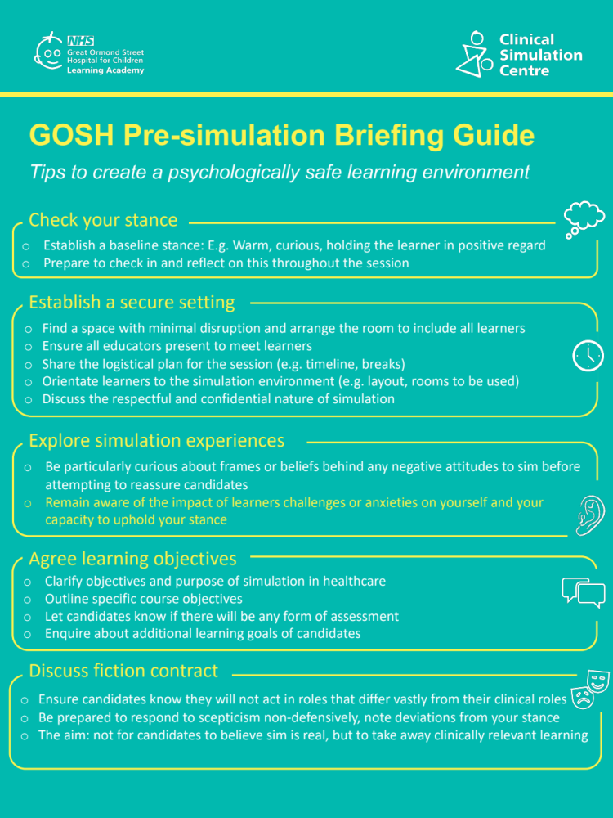
Notes:
11:45-12:00 for whole guide
Gareth
Transition (Kate): Reflection that now we have thought about stance as a group, we will look at how we can develop epistemic trust with our learners during pre-brief.
This page shows the tool that we have developed for use at GOSH – a single A4 page of tips.

Slide 15

Notes:
11:45-12:00 for whole guide
Gareth
Gareth talk through psychological/trust benefits of the other parts of the tool – taken from literature including Rudolph/Simon/Raemer discussed earlier
Answering questions as we go

Slide 16
Notes:
11:45-12:00 for whole guide
Gareth
Gareth talking through psychological/trust benefits of the other parts of the tool
Let them know we are about to give an example of exploring experiences and then let them practice

Slide 17
Explore the previous simulation experiences of the ‘learner’ in your group
You get me!
Notes:
12:00-12:20 for whole activity
Kate to explain and give out envelopes, Gareth to lead discussions
12:00-12:05 introduce activity and do example
12:05-12:10 doing activity – one scenario per group of 3-4
12:10-12:20 discussing activity – observers sharing phrases they observed that lead to the ‘you get me!’ moment
We go first:
Audience asked to watch for the ‘you get me!’ moment
Gareth educator – asking questions then validating Kate’s experience before offering solution
Kate candidate – very nervous because previous similar experience was shouted at by the patient and found it very distressing
Each table has envelopes labelled 1, 2 or 3 with candidate scenarios in
Groups of 3-4: One educator, one student (opens envelope), one/two observers (looking for ‘you get me!’ moment)
e.g. **Elaborate story and add extra details to make more realistic as you wish!**
Very anxious candidate
Sceptical candidate
Over-confident candidate

Slide 18
Summary
Pre-brief is essential to psychological safety of candidates and educators
We can apply psychotherapeutic principles to pre-briefing:
  Our stance as educators
  Epistemic trust
Introduction to new pre-briefing tool being introduced in our centre
Rudolph, Jenny W. PhD; Raemer, Daniel B. PhD; Simon, Robert EdD. Establishing a Safe Container for Learning in Simulation: The Role of the Presimulation Briefing. Simulation in Healthcare: Journal of the Society for Simulation in Healthcare: December 2014 - Volume 9 - Issue 6 - p 339-349
Notes:
12:20-12:30 for summary and thoughts from group

Slide 19
What are your thoughts?
Stay in touch: simulation@gosh.nhs.uk
Notes:
12:20-12:30 for summary and thoughts from group
Is this all things that you did anyway?
Can you see any barriers to implementing a similar tool in your centre?
Do you have any suggestions for improvement?

