Slide 1

The NHS Patient Safety Strategy
Vicky Aldred, Deputy Director Patient Safety
NHS England and NHS Improvement, London
London Patient Education Symposium
14 October 2021 vicky.aldred@nhs.net

Slide 2
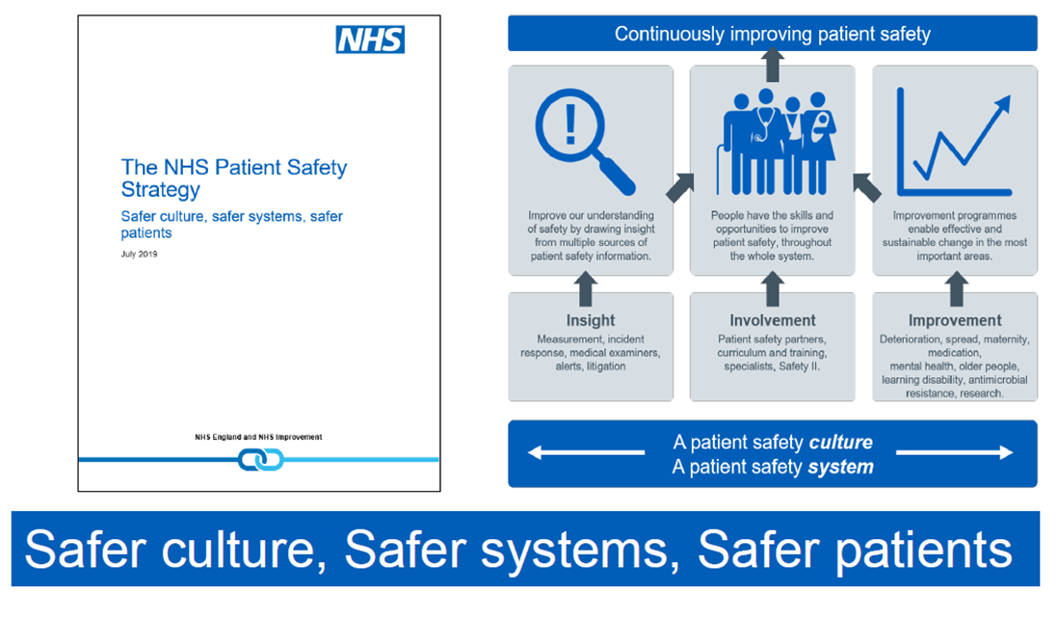
The NHS Patient Safety Strategy - Launched 2 July 2019

Slide 3
NHS Patient Safety Strategy
PS curriculum for training NHS staff
National PS Improvement Programme delivered by Patient Safety Collaboratives
New digital incident reporting system for staff & patients. Now called LFPSE (Learn from patient safety events)
National medical examiner service
More effective National Safety Alerts
New Patient Safety Incident Response Framework to improve how the NHS responds to harm
PS specialists to lead safety improvement
New cultural metrics to measure safety

Slide 4
NHS Patient Safety Strategy
PS curriculum for training NHS staff
National PS Improvement Programme delivered by Patient Safety Collaboratives
New digital incident reporting system for staff & patients. Now called LFPSE (Learn from patient safety events)
National medical examiner service
More effective National Safety Alerts
New Patient Safety Incident Response Framework to improve how the NHS responds to harm
PS specialists to lead safety improvement
New cultural metrics to measure safety

Slide 5

Job Description
The Role of PS Specialist
This role supports the development of a patient safety culture and safety systems and requires sufficient seniority to engage directly with the executive team (or the equivalent level of leadership).
They will support the executive team to understand the most effective approaches to improving patient safety, and ensuring that any patient safety-related responsibilities held by different executives are effectively aligned.
The expectation is 1 x FTE at band 8 range, but this may be a shared role, or more than 1 x FTE across large organisations

Slide 6
Background to PS Specialist Appointments
Invitations to designate PSS sent to trusts and CCGs in September 2020
Nationally there are over 700 PSS covering around 340 organisations, that is 96% coverage of trusts and CCGs.
The requirement for organisations to have a PSS is included in the NHS standard contract
A needs analysis was undertaken by national team and the aim is to help develop and support the PSS at national and regional level

Slide 7


London’s Patient Safety Specialists
115 PS Specialists
34 trusts
5 CCG/ICSs
2 IHPs
One trust has 9 PSS, many have just one.
The average is 2.5 each

Slide 8
Priorities for Patient Safety
All Board members should be aware of and support the PSS’s role and discuss as a board agenda item by February 2022 (letter from Aiden Fowler, August 2021)
The PSS priorities document (circulated April 2021) should be reviewed and a PSS work plan agreed with the patient safety executive lead
The PSS should be provided with sufficient time and resources to undertake their role and complete the patient safety training requirements (to level 5 of the Patient Safety Syllabus once available)
There should be sufficient support / coaching / mentoring in place for the PSS to progress their personal and leadership development
Notes:
The PSS’s name(s) to be sent to NHSEI via email: patientsafetyspecialists.info@nhs.net

Slide 9
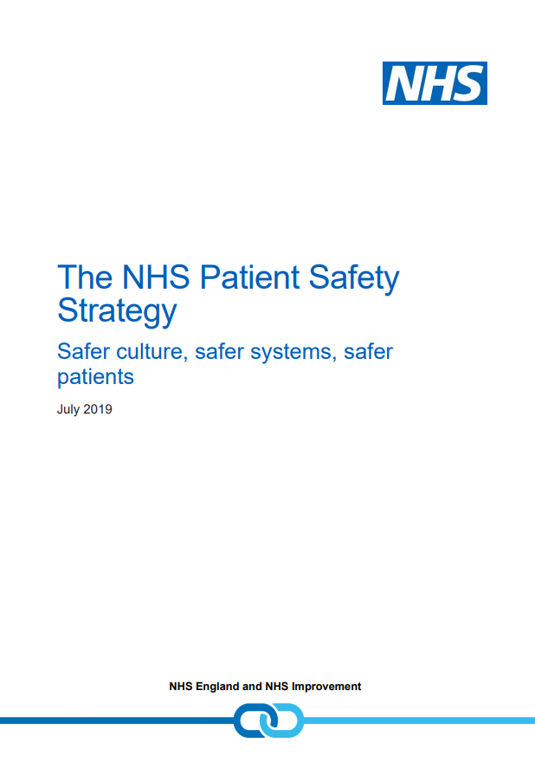
Patient Safety Strategy – Key Work Programmes 2021-22
Just culture
National Patient Safety Alerts
Improving quality of incident reporting
Support transition from NRLS and StEIS to LFPSE (fka PSIMS)
Involvement in implementing the new Patient Safety Incident Response Framework (PSIRF)
Implementation of the Framework for Involving Patients in Patient Safety
Patient safety education and training
National patient safety improvement programmes
COVID-19 recovery planning
10. Health Inequalities

Slide 10
1. Just Culture
Local systems to set out how they will work to embed the principles of a safety culture. These should include:
monitoring and response to NHS staff survey results and any other safety culture assessments
adoption of the NHS Improvement A Just Culture Guide or equivalent
adherence to the well-led framework

Slide 11
2. National Patient Safety Alerts (NatPSAs)
All national bodies that issue alerts are going through a process of accreditation to issue National Patient Safety Alerts to ensure they meet a set criteria to improve their effectiveness and support providers to better implement the required actions
Organisation must establish robust and responsive systems for receipt and actioning of NatPSAs.
Ensure implementation is centrally managed to trigger an organisation wide response to embed actions into practice.
Executive oversight of alert compliance sign off to 'action completed' is critical along with Board visibility of organisational compliance on the publicly accessible Central Alerting System (CAS) website.
At 1 Oct 2021, 10 London trusts were non-compliant with actioning a total of 21 NatPSAs.
Notes:
NatPSAs require an organisation-wide coordination of responses
A key feature of NatPSAs is the need for leaders in each organisation to manage the implementation of all relevant actions for each alertThe system needs to be able to respond to complex and straightforward alerts
Board notification of NatPSAs and an organisation wide coordination response is critical

Slide 12
3. Improving quality of Patient Safety Incident reporting
Incident reporting highlights opportunities for patient safety to be improved both locally and nationally but is dependent on effective and sustainable action and high-quality reporting
Interrogation of NRLS explorer reports will help improve local capture of incidents and board understanding
Free text and degree of harm categorisation in local incident reporting must be aligned to NRLS degree of harm FAQs, and national guidance / tools to optimise local action and support national learning

Slide 13
4. Support transition from NRLS and StEIS to LFPSE (PSIMS)
The NRLS enables national-level surveillance for new or under-recognised risks, while StEIS tracks the management of Serious Incidents through an investigation process.
The new system, Learn from patient safety events (LFPSE) rationalises these functions to create a single, simple portal, making it easier and more efficient for frontline staff to use and with improved capability for analysis and insight generation
Launched into public beta phase in July 2021.
StEIS module on LFPSE is still in development - continue with StEIS as usual

Slide 14
5. Patient Safety Incident Response Framework (PSIRF)
The Patient Safety Incident Response Framework (PSIRF) guides the NHS on how to develop the cultures, systems and behaviours necessary to respond to patient safety incidents in a way that ensures we learn from them and improve.
The PSIRF will, in time, replace the 2015 Serious Incident Framework (SIF).
The introductory version of the framework is currently being tested by a small number of early adopters nationally ahead of the planned full introduction of the PSIRF in Spring 2022.
Independent evaluation of the early adopter phase is currently underway which will inform and shape the final version of the framework and the approach to roll out nationally.

Slide 15
Patient Safety Incident Response Framework 2020
Foreword:
‘Our approach refocuses systems, processes and behaviours on delivering a sustained reduction in risk, rather than simply applying a reactive, bureaucratic process that too often does not lead to change’.
MM

Slide 16
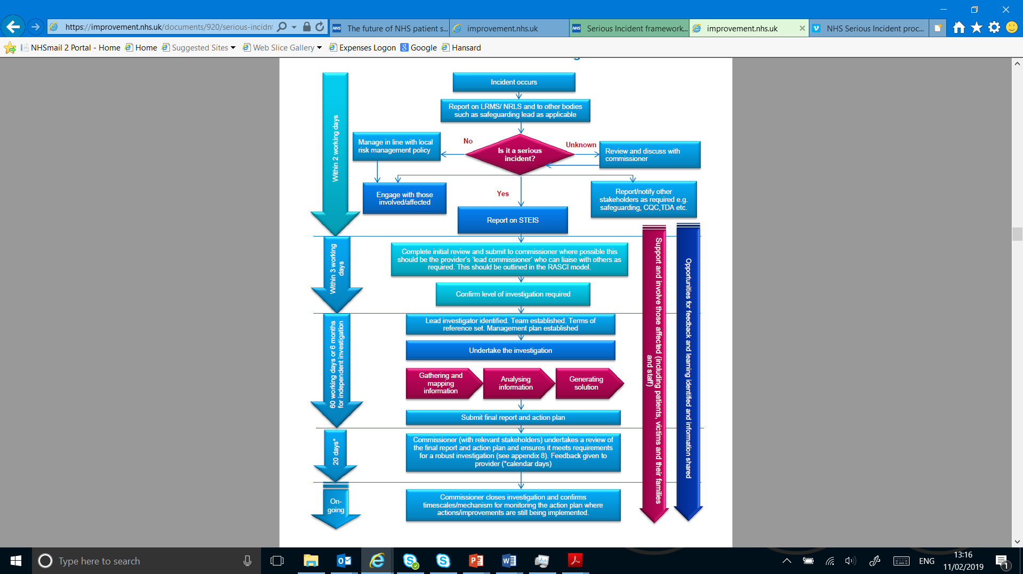
Existing process - linear and process focused
Significant amount of focus/debate on whether an incident should be deemed ‘serious’ or not.
‘Cut off’ inappropriately applied as a safety performance measure
Different templates and expectations about the purpose of the 72 hour report (providers are often asked to provide assurance that systems are safe when too little is known about the problems and their causes)
‘Cut off’ inappropriately applied as a safety performance measure
Inconsistent uptake of evidence based practice. Often very limited analysis of problems result in weak recommendations
‘Cut off’ inappropriately applied as a safety performance measure
Commissioners sometimes monitor performance against this but importance of the skills and capacity of those overseeing this process is often overlooked
Slide produced by the National Patient Safety Team, NHS England and NHS Improvement
Notes:
Currently a significant amount of time is spent determining whether or not an incident should be declared as a ‘Serious Incident’. The process is very reactive, restrictive, an often feels punitive.
Often the definition of a ‘Serious Incident ’ is restricted to locally pre-defined incidents types, or incidents thought to be directly linked to death or severe (i.e. permanent) harm.
There is limited national guidance about how other, less ‘serious’ incidents should be managed/responded to
Sometimes full investigations are mandated based on outcomes of concern even when initial findings indicate no significant problems in care or service delivery.
Governance and oversight of SI investigations has been limited to process measures; this has driven a focus on timeframes and process rather than the essential steps that should be undertaken to deliver a good quality investigations, which includes effectively supporting and involving those affected (including patients, families and staff).
This also means the majority of energy and effort is spent completing the process rather than delivering the improvement required.

Slide 17
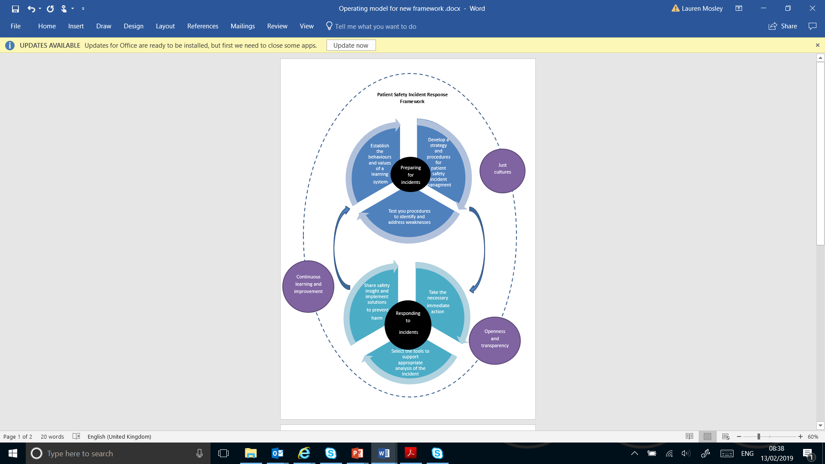
The new approach – system & outcome focused
Preparing for incidents: The first part of the framework focuses on the role of executives/leaders and the actions that should be taken to set the right foundations to ensure NHS funded organisations are prepared to respond effectively when patient safety incidents occur.
Responding to incidents: Care must be taken to ensure there is a risk based approach; to balance resources applied to reporting, reviewing and investigating incidents with the resources applied to implementing and embedding solutions to prevent recurrence. The second part of the framework provides guidance on the steps that need to be undertaken when incidents occur, and how different tools (including but not limited to patient safety investigation) may be judiciously applied to generate insight and recommendations to support reduction of risk and potential for future harm.
Slide produced by the National Patient Safety Team, NHS England and NHS Improvement
Notes:
The new framework aims to support the development of systems, processes and behaviours that support an appropriate response to patient safety incidents more broadly, using a range of tools, including system based patient safety investigation (for which standards will be set) where there is the most significant risk and/or opportunity for learning.
This will include more attention to the preparation and testing of procedures for responding to patient safety incidents, near misses and/or unexpected outcomes, and a more proactive approach to determine which incidents will be subject to a systems based patient safety investigation
New oversight systems - managed largely by boards and executive teams within provider organisations, and supported by commissioning and regional team - will enable a change in focus on limited process measures to the effectiveness of system and processes that underpinning incident management

Slide 18
Patient Safety Incident Response
Framework - Key points 1:
Patient Safety Incident Response Framework
Responding to patient safety incidents (not just ‘Serious Incidents’) as part of a proactive system of learning and improvement
Support and involvement of patients, families, carers and staff affected by patient safety incidents
National standards for Patient Safety Investigation
A more strategic approach to the investigation of incidents to enable a greater focus on generating actions which lead to effective and sustainable improvement

Slide 19
Patient Safety Incident Response Framework
Patient Safety Incident Response
Framework - Key points 2:
A new system for governance and oversight of incident management, emphasising the role of boards and executive teams, and commissioning and oversight bodies, to support the development of more effective systems for preparing for and responding to incidents
Completion times for investigations to average 3 months and never to exceed 6 months
Better co-ordination of investigations across multiple settings

Slide 20
SIF | PSIRF
 | Proactive approach (all Incidents)
Reactive approach (‘Serious’ Incidents)
 | Patient Safety Incident Response Plans (PSIRPs)
Trigger Lists
 | A range of responses
Investigation

Slide 21
PSIRF preparatory work for non-early adopters
Organisations are urged not to start work on specific elements of the PSIRF, such as Patient Safety Incident Response Plan (PSIRP) development or amending their policies to align with the framework at this stage, but to focus on broader areas of patient safety and the development of a strong safety culture within the organisation.
Suggested areas for review at this stage include:
how organisations include patients, family and staff in investigations to ensure an inclusive approach throughout
the organisation’s approach to investigation to ensure a systems approach
ensuring that the organisation is only using trained investigators who have dedicated time to lead investigations
ensuring that the organisation has the systems in place to encourage reporting and subsequent learning and improvement.

Slide 22
6. Implementation of the Framework for Involving Patients in Patient Safety
The importance of involving patients, families, carers & lay members as 'patient safety partners' in improving safety of NHS care is recognised in NHS Patient Safety Strategy
A two-part Framework (A&B) was published in June 2021 Framework for involving patients in patient safety
Part A relates to supporting patients to take responsibility for their own safety (where willing )
Part B relates to the development of the Patient Safety Partner role to support safety related governance committees (Q1 –22)
Notes:
Part A – involving patients in their own safety – Part B involving patent safety partners in organisational safety by supporting and contributing to patient safety governance and management processes.
- avoid tokenism, consider readiness of leaders to provide an effective culture to support PSPs – this will include training.
NPST are developing resources to further support organisations further

Slide 23
7. Patient Safety Education and Training
Publication of the patient safety syllabus is pending
Five levels of patient safety training will be available across organisations starting with training in the essentials of patient safety for all staff by April 2023.

Slide 24
8. National Patient Safety Improvement Programmes
  Aligned to national improvement priorities - mental health, maternity, medication safety, deterioration, scale and spread
  Delivery supported by Patient Safety Collaboratives (PSC) as hosted by the 3 London Academic Health Service Networks (AHSNs)
  PSCs are aligned to specialist networks e.g. cancer etc.
Notes:
Provide Patient Safety Lead contacts – will update post meeting

Slide 25
9. COVID-19 recovery planning
Implementation of national planning/recovery guidance when available. Including the guidance on Learning from hospital-onset COVID-19 Guidance Note 28, July 2021
Investigating outstanding declared Serious Incidents during COVID-19 as required
Introduction of new models of care.

Slide 26
10. Health Inequalities
COVID-19 has had a disproportionate impact on many who already face disadvantage and discrimination. Important to:
Support improvement programmes which proactively engage those at risk of poor health outcomes
Ensure safety related datasets are complete and timely

Slide 27
Thanks for listening

