Slide 2
Immersive Extended
Reality (XR) technologies:
Where we are?
Dr Elena Skryabina, KCL
Professor Gabriel Reedy, KCL
LSN Networking Event
21st February 2023

Slide 3
Project Purpose
To understand the factors affecting the uptake of immersive XR technologies to support the training of healthcare professionals.
Part 1
Rapid Literature Review to understand the effectiveness of XR technologies
Part 2
Interview study
to understand the uptake and learning needs in XR amongst the London Simulation Network
Notes:
King’s College London (KCL) was commissioned by UCLP to undertake a study on behalf of Health Education England to understand the factors at play in the uptake of immersive XR technologies to support the training of healthcare professionals.
Interview purpose: The purpose of this work is to understand more about the learning needs for immersive virtual reality (VR)/extended reality (XR) technologies in postgraduate health education and to understand more about the current use of these technologies by experienced simulation educators in the London Simulation Network (LSN).

Slide 4
KCL Project: Presentation Plan
Definitions of XR technology (AR, VR, MR)
Literature review findings
Interview findings
Learning from IMSH (Orlando, 19-26 January 2023)

Slide 5
Definitions of Immersive Extended Reality (XR) technology
Immersive Extended Reality (XR) is a term that describes VR, AR, MR technology as a whole.
Augmented reality (AR) is a superimposition of computer-generated content onto our visible surroundings Virtual reality (VR) is a simulated 3D environment created by computer technology.
Mixed reality (MR) is enhanced AR
Real Environment Augmented Reality Augmented Virtuality Virtual Environment
(Reality- virtuality continuum (Milgram & Kishino, 1994)*
Mixed Reality (MR)
Notes:
The concept of immersive technology is not new and first appeared around 50 years ago when the first immersive human-computer interaction prototype “Man-Machine Graphical Communication system” was built. However, despite the relatively mature state of the technology, there is no consensus in the definition of immersive technology. Immersive Extended reality technology is used as a term that describes virtual reality (VR), augmented reality (AR) and mixed reality (MR) technologies as a whole.
Augmented reality (AR) is a superimposition of computer-generated content onto our visible surroundings. The term AR is used to define a set of different technologies, that include display-based systems, aiming to project digitally generated virtual content into the real environment to combine real and virtual imagery. For example, in surgery, in AR, computer-generated information is superimposed onto the surgical field to give a 3D semi-immersive experience and a more integrated vision of the patient’s status.
Virtual reality (VR) is a simulated 3D environment created by computer technology. Users wearing a head mounted display (HMD) and haptic sensors (tactic sensors) react to the environment as if it were an actual physical environment.

Slide 6
Augmented Reality
Augmented reality (AR) is a term defining technologies, that include display-based systems, aiming to project virtual content (digitally generated) into the real environment to combine real and virtual imagery.
Two principle ways to augment a physical environment:
Head-Mounted Display (HMD) (mostly well known display technology used for AR)
Non-immersive monitor-based video (window on the world).
HMD classification:
Optical-See-Through HMD (see-through lenses such as the Microsoft HoloLens)
Video-See-Through HMD (uses additional camera for surrounding reality)
Notes:
Augmented reality (AR) is a superimposition of computer-generated content onto our visible surroundings. The term AR is used to define a set of different technologies, that include display-based systems, aiming to project virtual content (digitally generated) into the real environment to combine real and virtual imagery.
In AR visual display technology augments the physical environment in two principal ways: head-mounted display (HMD) and non-immersive monitor-based video (window on the world). The HMD is the most well-known display technology used for AR. These displays are further classified into “Optical-See-Through Head-Mounted Display” and “Video-See-Through Head-Mounted Display”. The Optical-See-Through enables a user to see the real world augmented with information via see-through lenses such as the Microsoft HoloLens. Video see-through displays use an additional camera to provide the user with surrounding reality.
The display technologies showed the ability to stimulate the learning process and support the learner in acquiring several competencies: to understand spatial relationships and construct mental 3D models of; to acquire cognitive-psychomotor abilities; prolong learning retention; experience student-centred motivation and obtain flexibility to learn anytime and anywhere in their own pace and style. Other promising learning factors facilitated by the display technologies were related to visualization, directing attention, intrinsic benefits of motivation, skill retention, mobile learning and using oneself as a learning object (7). It was suggested that AR/MR based applications may outperform traditional learning approaches in surgical training

Slide 7
Virtual Reality
Virtual reality (VR) is a computer-generated simulation of a 3D environment.
Term VR (1968): combination of three device
  a) computer capable of interactive 3D visualization
  b) HMD
  c) controllers with position trackers
  Fully Immersive Simulator (FIS): a+b+c
  Skill Immersive Simulator (SIS): a+c
  Non-Immersive Simulator (NIS): a +keyboard/mouse
  Two main categories of VR:
          Desktop VR (D-VR), non-immersive
          Immersive VR (I-VR), HMD+ controllers and trackers
  HMDs for I-VR: Google Glass®, Microsoft HoloLens®, Oculus Quest, Samsung Odyssey, Oculus Rift.
Notes:
Virtual reality (VR) is a computer-generated simulation of a 3D environment. Users wearing a head mounted display (HMD) and haptic sensors (tactic sensors) react to the environment as if it were an actual physical environment. The human brain actively models the physical world using its sensory inputs. Virtual reality is created by replacing sensory inputs (e.g., auditory, visual, tactile) with digital ones. Immersion, presence, and interactivity are core characteristics of VR technology.
Fully Immersive Simulator (FIS). Several new HMDs for FIS are available today, such as Google Glass®, Microsoft HoloLens®, Oculus Quest, Samsung Odyssey, and Oculus Rift, (which can be combined with hand position/motion detection devices like Leap Motion® to allow the operator to interact with the virtual environment). If, at least the 3D graphics and some realistic tool controllers are present, they are referred to as a Skill-Immersive Simulator (SIS). Otherwise, when the VR is created through a computer screen with keyboard/mouse controllers, they are referred to as Non-Immersive Simulator (NIS)
I-VR – HMD – provides a stereoscopic computer generated or 360 degree video image to the users.

Slide 8
Literature review
Across medical and educational databases

Slide 9
Literature review
Aim: to collect, review and analyse readily available evidence related to the effectiveness of XR in postgraduate health education.
Methodology
Six databases
PICO search strategy : P(postgraduate stud* OR professional OR graduate); I (Immersive virtual reality OR Immersive technology* OR Head Mounted Display OR HMD OR Extended Reality OR Mixed Reality OR Augmented reality); C (health education OR medical education)
Out of 141 Systematic literate reviews (SLR), 55 underwent full text review; 24 papers met inclusion criteria ad were analysed
Source | No of results
 | SLR* | RCT**
Cochrane Library | 3 | 78
Embase | 1 | 4
ERIC | 91 | 0
Medline | 10 | 61
PubMed | 54 | 72
Web of Science | 101 | 14
Total | 260/ 141 | 229/ 152
Notes:
AIM: to understand the effectiveness of XR technologies

Slide 10
Literature review

Slide 11
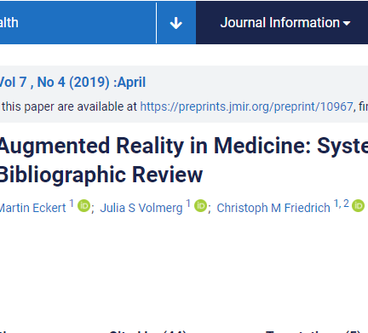
Augmented Reality (AR)
Reported benefits:
Improves understanding of spatial relationships and construction of 3D mental models
Assists in the acquisition of cognitive psychomotor skills
Improves visualisation
Prolongs learning retention
Improves precision and reduces time of operations
Improves students’ motivation
Main application areas:
Surgery, including Neurosurgery, and Dentistry
Applications beyond surgery and dentistry are less well developed
Notes:
For motor skills development AR offers a better user experience than VR as it provides real tactile feedback, improved haptics and lack of reliance on complex digital graphics that are often unrealistic.

Slide 12
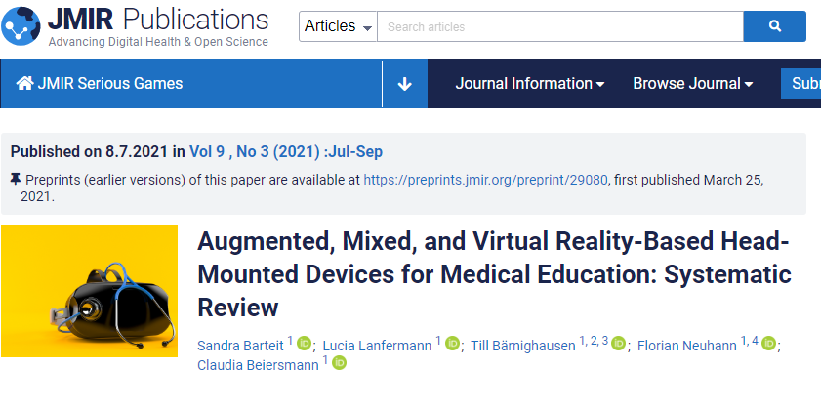
Immersive Virtual Reality (I-VR)
Reported benefits:
Effectiveness in teaching procedural skills
Immersive learning opportunities for complex medical contexts (rich contextual experience)
Repeated practice for mastery of skills
Ability to set quality and performance standards
Tracking training progress
Reduced training time
Learning mobility
Main applications: surgery specialities, nursing
Limitations: cost, fragmented market, effort and eye fatigue, motion sickness (prevalent in female users)

Slide 13
Literature review: Overview and Summary
      Evidence of XR technology effectiveness in improving skills (predominantly procedural skills in surgery and clinical skills in nursing), knowledge (predominantly of anatomical structures via a 3D visualisation), attitudes (including self-efficacy, confidence and stress-resilience).
      Positive attitudes from learners towards XR as an engaging and motivating training modality.
      Data is dominated by the evidence from surgery specialities and is mainly related to the procedural skills development.
      Evidence of effectiveness in procedural and clinical skills beyond surgery specialities is limited
      Evidence of effectiveness in non-technical, affective skills is very limited

Slide 14
Literature review: XR technologies publication trends
Large number of publications on XR, various quality, heterogeneity
Countries of publications (North America dominance)
Prevalent publication journals – Surgery disciplines
Publication trends (increase in recent years of scientific publications but not in educational publications)
Notes:
There is evidence for the effectiveness of XR technologies in improving skills (predominantly procedural skills in surgery and clinical skills in nursing), knowledge (predominantly of anatomical structures via a 3D visualisation), and attitudes (including self-efficacy, confidence and stress-resilience).
Reference list for all 24 publications is included in our summary outcomes paper, but here are two useful good quality reviews that can give you a good overview of trends, developments and directions with the XR technologies.

Slide 15
Interviews
Interviews with experienced simulation educators

Slide 16
Interview study – Methodology
Purpose: to understand the uptake and learning needs in XR amongst the LSN
Ethics Permission: Minimal risk study, KCL MRA-21/22-33763 from 19/08/2022.
Participants recruitment: Purposeful sampling, followed by snowball sampling
Interview schedule: understanding and experience with XR, benefits for learners/educators, barriers and facilitators for implementation
Interview conduct: MS Teams, video recorded, average interview length 46 min
Data analysis: Framework Approach, involving thematic analysis of transcripts following a framework incorporating the factors used to structure the interview schedule.

Slide 17
Interview study: Participants and Uptake of XR by Trusts
Study participants
        16 colleagues from 13 trusts (12 from LSN):
        Trust-level simulation leaders
        Simulation Centre managers
        Simulation technicians and educators Medical education leader
        Gender: females (11), males (5)
        Experience: median (1 year), range [6 m – 20 y]
        Simulation centres (LSN):
          Large (N=4)
          Medium (N=5)
          Small (N=3)
    Uptake of XR by Trusts
Limited implementation of XR technologies amongst the LSN trusts (7/13)
Limited familiarity with AR/I-VR
Experience with AR/VR technologies in teaching procedural skills (e.g. in surgery)
Experience with I-VR is limited and is only emerging, except one Centre (XXX) where there is a more advanced programme of work already in place :
40 PICO headsets,
technologies for CGI and 360 videos,
technical staff, VR Champions
and a programme of expanding the use of I-VR in education
Notes:
. A VR Champion training programme was implemented in one Trust where VR Champions were trained to support ongoing VR clinical (on wards) and non-clinical (in community) training of staff. In this trust a technical team has been set up to create their own scenarios (using 360 degree cameras) that can be pre-loaded to PICO VR headsets, ready for use by learners at their convenience. This trust has substantial experience with VR technologies (including platforms for creating their own CGI scenarios and 360 degree videos); their experience would be useful to share with colleagues to help facilitate the uptake of I-VR technologies by the NHS.

Slide 18
Interview study: I-VR potential benefits for learners
Flexibilities offered by I-VR technologies, that include an option to receive training at the learner’s convenience (time and space), to control the pace and stimulus during the session, as well as monitoring learning progress through detailed and immediate feedback.
Enhanced debrief achieved through enhanced observer experience and the perceived psychological safety offered by a VR scenario. The importance of supporting I-VR training with a group debrief, particularly for human factors training was strongly emphasised by some interview participants.
High fidelity scenarios, including scenarios of rare clinical events, emergencies, or situations that are not always possible or safe to re-create in traditional simulation.
Training of soft skills: such as empathy, communication, emotional resilience, responding under pressure.
Meeting learners’ expectations. As VR is an integral part of undergraduate medical education, younger learners have already developed practice and expectations for learning opportunities and teaching modalities, including I-VR.
Notes:
In addition, for facilitating the delivery of specific courses to develop various skills, VR technologies were thought to be also potentially useful for facilitating the delivery of:
staff induction programmes
pre-simulation preparations
clinical placement programmes

Slide 19
Interview study: I-VR potential benefits for educators
Facilities capacity: to address limited space of Simulation Centres
“And I think they were the main advantages: that, and the variety of the scenarios. So we have from cardiology, to Obs and Gynae, to mental health. We have every primary care, we have everything. And so it felt like it was almost building a simulation suite without having to build a simulation suite because we could have it portable and it could be very transportable that way.” [012, VR]
Staff capacity (less facilitator and faculty)
“When you're running a scenario in person, then you need a lot of staff to do that. So it could reduce the burden on our faculty to actually be present. You know you wouldn't necessarily have to have all faculty present for every simulation, so it could reduce the workload for staff on the day, and also maybe free up some faculty to be doing other work at some points, cause you would need less people to run, an XR scenario”. [06, VR Pilot]
Notes:
Facilities capacity: Several interviewees acknowledged that limited resources (both staff and space) within a Simulation centre impedes their ability to satisfy increasing learning demands from their Trusts. By delivering I-VR training in-situ and remotely, they can help provide learning to a greater audience, including those who traditionally would be less involved, thus improving learning availability and inclusivity.
.
Generally, participants thought that once established, I-VR simulations will require less facilitators and faculty support compared to traditional simulations. However, colleagues recognised setup challenges, such as creating and validating VR scenarios and training staff, which could require an initial investment of extra resource. As such, any relief for issues of staff capacity may only be achieved gradually and after a phase of increased workload.

Slide 20
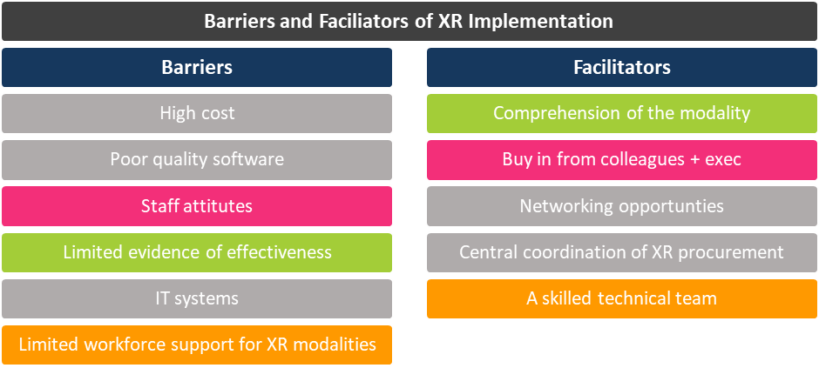
Interview study: Barriers and Facilitators of XR Implementation
Notes:
Several factors were mentioned by interviewees as barriers for the wider uptake of XR technologies by the NHS for their workforce education and factors that may facilitate this uptake. From the picture obtained (See Fig 1) it is clear that these barries and facilitators are enmeshed and interlinked and include themes like: funding challenges, engagement of people, executive “buy in”/leadership, comprehension of modality, and taskforce. Knowing facilitators and barriers could help to advance furthur XR uptake in postgraduate health education by setting up actions to address barriers and reinforce facilitators.

Slide 21
Interview study: Barriers of XR Implementation
High cost
Staff attitudes
HOSPITAL it systems
Limited workforce

Slide 22
Interview study: Barriers of XR Implementation
Cost (HMD, creating scenarios)
“I I've seen augmented reality used alongside simulators, particularly obstetric simulators, to great effect. However, it's very expensive to get started… Firstly finance… these VR headsets are expensive. Good headsets are very expensive” [013, no VR]
“But when you look at it, actually, VR is a lot cheaper than buying a whole simulation. I think on the surface level it feels quite expensive, but when you probably look at the numbers, it actually works out cheaper. [03, VR]
Staff Attitudes (fear of new technologies, lack of control in simulation, belief in face-to face simulation and perceptions of remote learning being less effective - resistance to change)
“I think that there are some educators in the same way that we have been slow to adopt simulation as an education, when we had to rip people away from the whiteboard and the PowerPoint presentation. I think that there will always be. There will always culturally be those people that will want to stick to it now they have found simulation. That they're gonna be quite happy to hang on to this for a few decades, I anticipate”. [010, VR Pilot]
Notes:
Some remain sceptical that funds for these technologies would be available to them in the near future, as there is a perception that education and training have never truly been a priority.
Staff attitudes, resistance to change was another perceived barrier mentioned by several interviewees. People are naturally resistant to change and if educators are seeing that current simulation practices are effective in delivering their objectives there will be little motivation and resistance to adopt new technologies and learn new skills. Fear of new technologies and the lack of control in digital simulations was identified as a perceived barrier for both learners and educators. Several interviewees pointed to the different attitudes among younger and older colleagues (both educators and learners) with younger colleagues being more willing to engage with new technologies, due to their greater exposure and experience with them. However, the biggest barrier was a strong belief in the value of face-to face hands-on simulations on learning and perceptions of remote learning being less effective.
To address these negative believes educating colleagues on the potential benefits by offering hands-on experiences to develop their own beliefs and attitudes may facilitate the uptake of these new technologies. Several participants described their own eye-opening experience and excitement about the multiple possibilities of I-VR technologies in education after they had tried them. Initiatives such as technology open days, LSN roadshow, and the HEE pilot, offering hands-on experience with technologies, were greatly appreciated by participants as an opportunity to build up awareness and have direct experience with these technologies.

Slide 23
Interview study: Barriers of XR Implementation
Hospital IT system – one of the major barriers in adopting new technologies (data protection,cybersecurity, hospital WiFi)
“So I think because it is a still a very new piece of equipment and a very new process. That even trying to adapt some things is taking a while. If we wanted to download apps onto the HoloLens, we have to go through a whole IT process. It's nothing that can be done instantaneously when we can't just download things onto it. It does take a while to get IT to approve different things.” [019, VR]
“One of the major barriers is a hospital IT systems. Hospital IT systems are very skeptical of new technologies. You know everybody at that … roadshow... Almost everybody has the same problem: IT systems. IT departments I think have to start to designate personnel that work in these.” [05, VR Pilot]
Limited workforce
“It just wouldn't be used because the amount of time and energy and passion that needs to go into creating a good VR or AR experience. We do not have the staff, the funding or anything in the trust already to cover that.” [013, no VR]
Notes:
Hospital IT systems were perceived as one of the major barriers in adopting new technologies due to the length of time it takes to get IT approval for new equipment and its software. There are data protection and security considerations that IT departments need to address, but it has been questioned whether the process should be the same for an educational department or simulation centre that does not handle confidential patient data but rather uses fictious learning scenarios. Inefficient hospital Wi-Fi systems were mentioned as another barrier that may impede the most effective use of XR technologies on-site.
Limited resources for healthcare education and the lack of technically skilled staff to drive the implementation of XR technologies were another barrier; Training success would depend on the facilitation and supervision, and re-training of staff and learners would need to be taken into account. This infrastructure support, that would require money and space. Concern was expressed by a few participants in this study about the very limited resources and funding available for Simulation leads and Simulation Centres in their Trusts, where educational innovations are often driven by enthusiastic volunteers, the observed tendency that has been in place over the entire history of simulations education implementation in the NHS that continues today.

Slide 24
Interview study: Facilitators of XR Implementation
Comprehension of modality
Networking opportunities
Central coordination of XR implementation
Skilled workforce

Slide 25
Interview study: Facilitators of XR Implementation
Comprehension of Modality/ Evidence of effectiveness
“And you know the data on effectiveness in terms of teaching programs... And I think the reality is, as clinicians, we think about effectiveness, we think about trials. If I'm going to prescribe something for a patient, I'm going to want to know that it works and it works well and it works better than anything else. I know what to do if it doesn't work, at cetera. And when we teach people, we also need to quality assure and look at evaluations of that. And … I don't know if the strength of data is there to back up some of these things.” [07, no VR]
Networking opportunities
“I think it's very difficult for one trust to sort of lead the way. I think… bringing the trusts together across our patch has been really powerful and I think there's an opportunity to, sort of, spread innovation. And HEE, there's the TEL team, they have been really helpful. You know their web pages and the digital fellows, great sources of information about what's available and how we might implement it”. [011, VR]
“The London Simulation Network have been really useful. They're putting you in touch with people who are already doing things. It is really, really helpful because …Looking outside your organization to what different simulation teams are doing… I think some people are already doing a lot and some people are not doing so much…..I think probably the networking thing is going to be quite big for us definitely for a while because it really is something that we have very little knowledge about, and we need to learn from other people as to how they're using technologies, and not everything is gonna suit us…” [06, VR Pilot]
Notes:
Comprehension of modality was the most prevalent theme when participants talked about the facilitating factors for the implementation of XR technologies in postgraduate health professionals education. Participants strongly felt that evidence of effectiveness across various types of simulations and learning objectives, would be hugely beneficial for convincing themselves and their colleagues to invest the time and resources into these new technologies and building up evidence-backed business cases for the technology uptake and implementation. Potential evidence could include: learners’ positive reactions and experiences with technologies; effective and persistent participant learning; cost effectiveness of training; and a positive impact on patient safety.
Networking, learning from others, sharing experience and resources was a prominent theme facilitating the uptake of XR technologies, helping participants develop the understanding of this new educational modality, which remains rather limited at present. Interviewees praised the LSN and HEE for providing practical assistance with networking and hands-on experience via technologies road shows and equipment loan schemes.

Slide 26
Interview study: Facilitators of XR Implementation
Central coordination of XR implementation
“I think the worst thing that could happen is if each centre is allowed to develop their own approach and have random enthusiasts picking up a bit of kit and playing with it for a bit and then putting it down again, and then in ten years’ time, we just got random bits of kit scattered all over the country. Are your hospitals next to each other? Having both spent half a million on the same thing and no other hospitals nearby being able to access it? I think it must be coordinated centrally if we're gonna get this technology into training effectively and without wasting a hell of a lot of money and time on everyone doing their own thing, but unfortunately the NHS tends to like everyone does their own thing model.” [01, no VR]
Skilled workforce
“Yeah, we definitely need [tech support]. We definitely do need some support to … make the most of the technology. I think we can probably get our heads around the basics of what we can do and especially with any preloaded content... But I think to make the make the absolute most of it then then we probably need someone who is more experienced than we are, for sure. [06, VR Pilot]
Notes:
Central coordination of XR procurement could prevent fragmented and dispersed implementations of XR technologies in healthcare education, and would help to ensure quality standards as well as equality of opportunities to engage with these new technologies.
Interview participants discussed, at some length, the importance of investing in knowledgeable, technology-enthusiasts and growing champions who will drive these new technologies implementation. All technicians involved in this study shared their personal experiences with immersive VR technologies and their enthusiasm about XR technologies as a great educational modality in general.

Slide 27
Recommendations
1. Set Realistic Expectations for XR Technologies supported by evidence of their effectiveness, required human and infrastructure resources and additional funding for hardware and software purchase and update.
2. Facilitate Access to XR Technologies by providing colleagues with the opportunities to trial and experiment with them, as well as share experiences (both successful and otherwise) and learn from others through networking opportunities.
3. Develop and Fund Strategic Research about XR Technologies to focus on applications and contexts beyond procedural skills, and the mechanisms by which these technologies support learning. There is a clear opportunity for research that both contributes to the wider knowledge base while supporting the strategic needs of healthcare educators in the NHS.
4. Financially Support the Development and Acquisition of XR Technologies for the NHS Context to address the high cost of XR hardware and low quality of medical software.
5. Regional and National Strategies are Needed for XR Technologies adoption to achieve an equitable training experience within regions; focusing on surgical and procedural skills development would be a low-risk application. A second, exploratory application of XR could be in theoretical knowledge acquisition, as a more engaging and motivating modality.
6. Continue to Address Digital Readiness by promoting and supporting the implementation of the TEL Readiness Assessment Matrix to support educators and organisations to identify suitable technologies for local adoption.
7. Faculty Development is Central to XR Adoption and should initially focus on understanding the technology and terminology (both theoretical and hands on experience).
Notes:
Recommendations
1. Set Realistic Expectations for XR Technologies supported by evidence of their effectiveness, required human and infrastructure resources and additional funding for hardware and software purchase and update.
2. Facilitate Access to XR Technologies by providing colleagues with the opportunities to trial and experiment with them, as well as share experiences (both successful and otherwise) and learn from others through networking opportunities.
3. Develop and Fund Strategic Research about XR Technologies to focus on applications and contexts beyond procedural skills, and the mechanisms by which these technologies support learning. There is a clear opportunity for research that both contributes to the wider knowledge base while supporting the strategic needs of healthcare educators in the NHS.
4. Financially Support the Development and Acquisition of XR Technologies for the NHS Context to address the high cost of XR hardware and low quality of medical software.
5. Regional and National Strategies are Needed for XR Technologies adoption to achieve an equitable training experience within regions; focusing on surgical and procedural skills development would be a low-risk application. A second, exploratory application of XR could be in theoretical knowledge acquisition, as a more engaging and motivating modality.
6. Continue to Address Digital Readiness by promoting and supporting the implementation of the TEL Readiness Assessment Matrix to support educators and organisations to identify suitable technologies for local adoption.
7. Faculty Development is Central to XR Adoption and should initially focus on understanding the technology and terminology (both theoretical and hands on experience).

Slide 28
Acknowledgements
The authors would like to thank all study participants who volunteered their time to take part in the interviews and support this study.

Slide 29
Reference List
1. Kovoor JG, Gupta AK, Gladman MA. Validity and effectiveness of augmented reality in surgical education: A systematic review. Surgery. 2021;170(1):88-98.
2. Williams MA, McVeigh J, Handa AI, Lee RT. Augmented reality in surgical training: a systematic review. Postgraduate Medical Journal. 2020;96(1139):537-42.
3. Cannizzaro D, Zaed I, Safa A, Jelmoni AJM, Composto A, Bisoglio A, et al. Augmented Reality in Neurosurgery, State of Art and Future Projections. A Systematic Review. Frontiers in Surgery. 2022;9.
4. Cho J, Rahimpour S, Cutler A, Goodwin CR, Lad SP, Codd P. Enhancing Reality: A Systematic Review of Augmented Reality in Neuronavigation and Education. World Neurosurg. 2020;139:186-95.
5. Eckert M, Volmerg JS, Friedrich CM. Augmented Reality in Medicine: Systematic and Bibliographic Review. Jmir Mhealth and Uhealth. 2019;7(4).
6. Farronato M, Maspero C, Lanteri V, Fama A, Ferrati F, Pettenuzzo A, et al. Current state of the art in the use of augmented reality in dentistry: a systematic review of the literature. BMC Oral Health. 2019;19(1):135.
7. Gerup J, Soerensen CB, Dieckmann P. Augmented reality and mixed reality for healthcare education beyond surgery: an integrative review. Int J Med Educ. 2020;11:1-18.
8. Choi J, Thompson CE, Choi J, Waddill CB, Choi S. Effectiveness of Immersive Virtual Reality in Nursing Education Systematic Review. Nurse Educator. 2022;47(3):E57-E61.
9. Plotzky C, Lindwedel U, Sorber M, Loessl B, König P, Kunze C, et al. Virtual reality simulations in nurse education: A systematic mapping review. Nurse Educ Today. 2021;101:104868.
10. Shorey S, Ng ED. The use of virtual reality simulation among nursing students and registered nurses: A systematic review. Nurse Educ Today. 2021;98:104662.
11. Mao RQ, Lan L, Kay J, Lohre R, Ayeni OR, Goel DP, et al. Immersive Virtual Reality for Surgical Training: A Systematic Review. Journal of Surgical Research. 2021;268:40-58.
12. Bielsa VF. Virtual reality simulation in plastic surgery training. Literature review. Journal of Plastic Reconstructive and Aesthetic Surgery. 2021;74(9):2372-8.
13. Grall P, Ferri J, Nicot R. Surgical Training 2.0: A systematic approach reviewing the literature focusing on oral maxillofacial surgery - Part II. J Stomatol Oral Maxillofac Surg. 2021;122(4):423-33.
14. Hamilton D, McKechnie J, Edgerton E, Wilson C. Immersive virtual reality as a pedagogical tool in education: a systematic literature review of quantitative learning outcomes and experimental design. Journal of Computers in Education. 2021;8(1):1-32.
15. Tang YM, Chau KY, Kwok APK, Zhu TC, Ma XD. A systematic review of immersive technology applications for medical practice and education-Trends, application areas, recipients, teaching contents, evaluation methods, and performance. Educational Research Review. 2022;35.
16. Bracq MS, Michinov E, Jannin P. Virtual Reality Simulation in Nontechnical Skills Training for Healthcare Professionals A Systematic Review. Simulation in Healthcare-Journal of the Society for Simulation in Healthcare. 2019;14(3):188-94.
17. Chan J, Pangal DJ, Cardinal T, Kugener G, Zhu Y, Roshannai A, et al. A systematic review of virtual reality for the assessment of technical skills in neurosurgery. Neurosurg Focus. 2021;51(2):E15.
18. Davids J, Manivannan S, Darzi A, Giannarou S, Ashrafian H, Marcus HJ. Simulation for skills training in neurosurgery: a systematic review, meta-analysis, and analysis of progressive scholarly acceptance. Neurosurg Rev. 2021;44(4):1853-67.
19. Mazur T, Mansour TR, Mugge L, Medhkour A. Virtual Reality-Based Simulators for Cranial Tumor Surgery: A Systematic Review. World Neurosurgery. 2018;110:414-22.
20. Pfandler M, Lazarovici M, Stefan P, Wucherer P, Weigl M. Virtual reality-based simulators for spine surgery: a systematic review. Spine Journal. 2017;17(9):1352-63.
21. Lowe S, Mares K, Khadjesari Z. Immersive technology in ophthalmology education: a systematic review. Bmj Simulation & Technology Enhanced Learning. 2021;7(6):600-4.
22. Munoz EG, Fabregat R, Bacca-Acosta J, Duque-Mendez N, Avila-Garzon C. Augmented Reality, Virtual Reality, and Game Technologies in Ophthalmology Training. Information. 2022;13(5).
23. Ong CW, Tan MCJ, Lam M, Koh VTC. Applications of Extended Reality in Ophthalmology: Systematic Review. Journal of Medical Internet Research. 2021;23(8).
24. Barteit S, Lanfermann L, Barnighausen T, Neuhann F, Beiersmann C. Augmented, Mixed, and Virtual Reality-Based Head-Mounted Devices for Medical Education: Systematic Review. Jmir Serious Games. 2021;9(3).

Slide 30
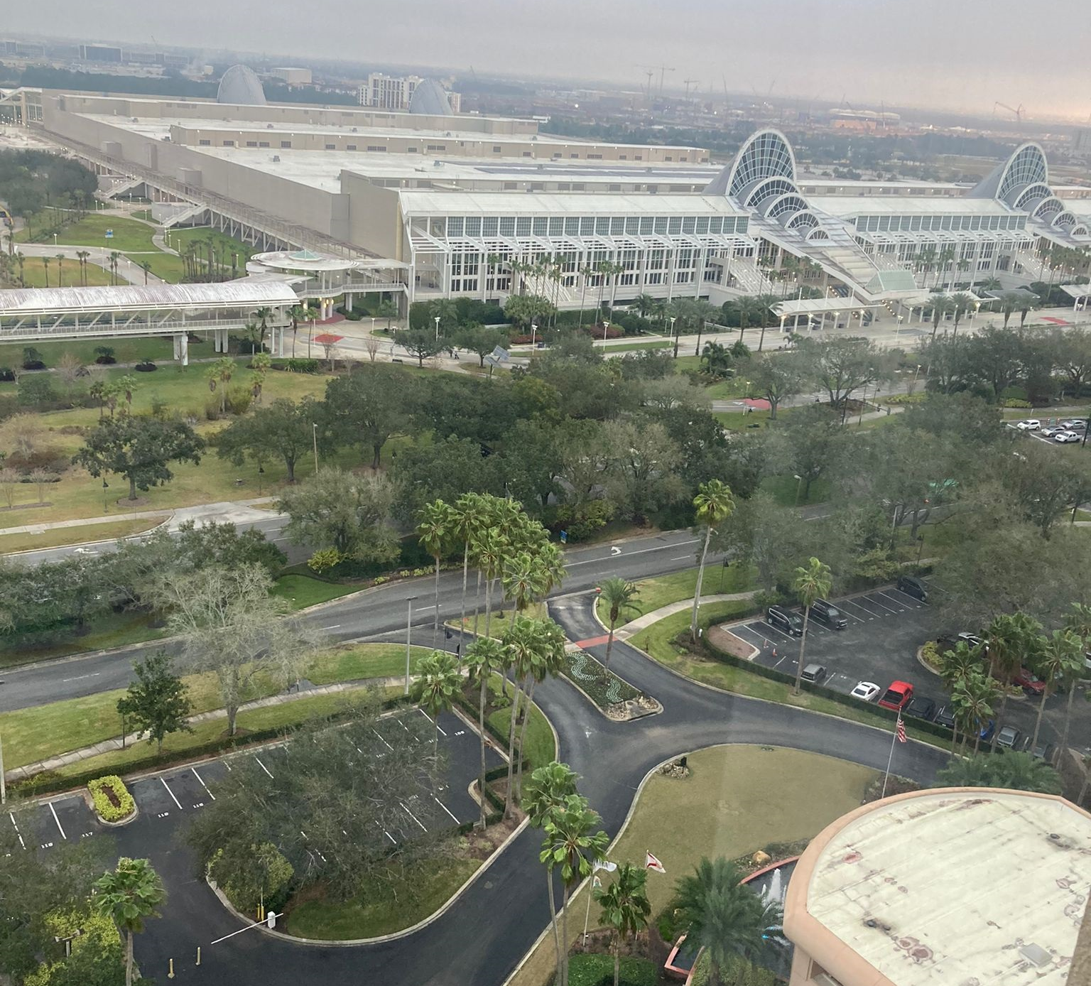
IMSH Conference, Orlando, 20-25 January 2023
Research Summit (20-21 January 2023)
IMSH Conference (22-25 January 2023)
>4000 participants
125 Exhibitors/Manufactures
Large interest towards XR technologies as a useful instrument in delivering immersive simulated education
Disclosure: No financial interest in any of the manufacturers/products discussed
Notes:
The International Meeting on Simulation in Healthcare (IMSH) is a scientific conference that explores the latest innovations and best practices in healthcare simulation.
I would like to share some of my learning from this conference related to XR technologies that may of useful for a more global understanding of issues, trends and developments with XR technologies in healthcare education

Slide 31
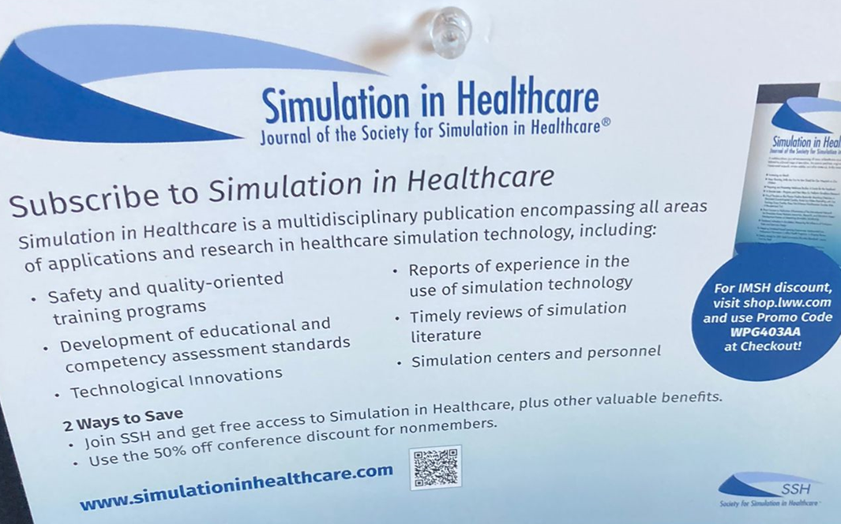
IMSH Research Summit 2023
Purpose: Linking research with guidance across 12 topics
1. Mastery learning/deliberate practice
2. Feedback/Debriefing
3. Spaced learning/Booster Training/Just in Time Training
4. Self-guided learning /Regulated learning/Peer to peer learning
5. Team training/Nontechnical skills training
6. In-situ Training
7. Virtual Reality/Augmented Reality/Hybrid
8. Distance Learning
9. Standardised Patients
10. Simulation fidelity
11. Faculty Development
12. Immersive Virtual Environments for Summative Assessment Purposes
Notes:
Overview of the state of existing evidence to understand whether the evidence is sufficiently developed to support with the development of guidance to assist with medical simulations across 12 topics

Slide 32
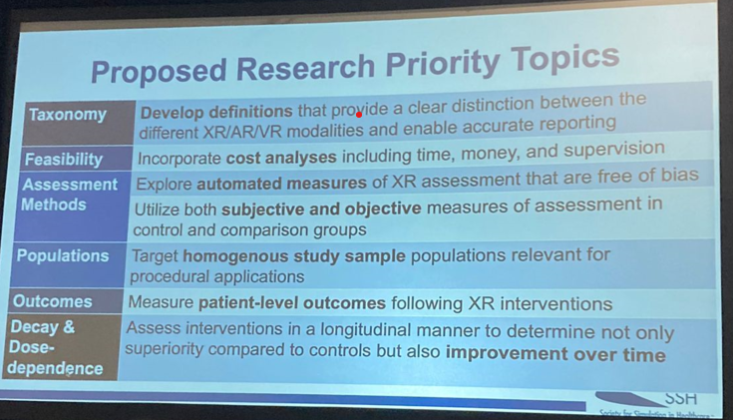
Research Summit: Virtual Reality/Augmented Reality/Hybrid

Slide 33
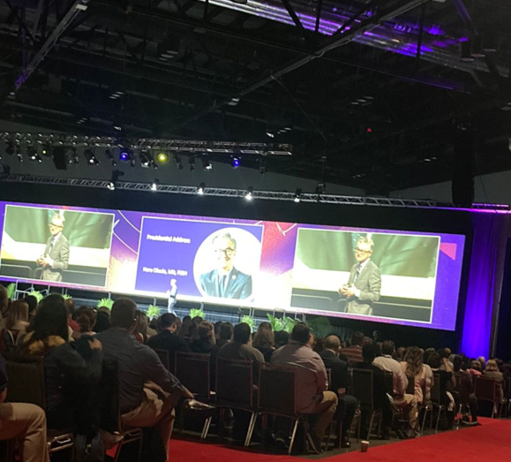
IMSH Conference and Exhibition, 22-25 January, 2023
Summary of ES learning:
“Immersion does not depend on technology, but new technologies can be highly effective at delivering immersion” (Assess VR)
Choosing the right technology should be driven by level of learners and learning objectives
VR considered the most mature type of XR technologies
“Chaos with definitions of VR”
Need longitudinal studies
Need Patient level outcomes for XR

Slide 34
IMSH Conference and Exhibition, 22-25 January, 2023
WHY are we using XR?
Visualisation (e.g. hidden structures; 3D)
Facilitates Immersiveness (different environments)
Engagement (activate attention; emotional involvement )
Activate emotional learning (emotional involvement plays huge role in learning; retention, transferability – can have an impact on patient outcomes)
VR – solves many issues of high fidelity simulations (high cost of mannequin; maintenance, lab space, manpower)
Soft skills (Empathy training; Practice with intelligent Avatars (doctor-patient interview; difficult conversations; team communication)
Issues to consider
Hospital IT (cybersecurity)/ Hospital WiFi (Multiple users will require higher WiFi speeds )
Need in special staff (administrator, facilitator, technician)
Need to understand how to mix and match technologies to a) meet educational needs b) make learner comfortable and engaged.
VR will require a Pre-session (pre-briefing) orientation to prepare a learner that includes:
        Technology orientation
        Instructional/facilitator orientation
How to provide debrief/feedback (single/multiplayer; delayed/real time
Notes:
Pre-briefing instructions for learners still emerging?? (needs major consideration; emersion can take time to achieve and experience can feel different; build up expectations/ learning outcomes)

Slide 35
IMSH Conference and Exhibition, 22-25 January, 2023
User Experience:
Implementation in 5 weeks was achieved with 50K budget (bought 6 HMD)
Selection of a platform (VR fair, invite companies and show case; then survey participants to select products
Bigg challenge – rules and regulations that are not in place in a hospital (IT/ reliable WiFi)
Important to trial a system using hospital IT (users experienced problems when headsets were not connected; consider buying headsets that comply with cybersecurity requirements)
Cost ( hardware, software, human support)
Learn about HMD (charge, store, maintain, understand learners needs; can manufactures provide HMD tutorials?)
Understand software ( using controls; connecting to headsets; multiple learners – calibration, set up boundaries (pass through feature))
Personal intolerance (observational role can be offered by viewing actions on a big screen)
Trial period (get learner, facilitator and moderator feedback)
VR adds additional planning factor – pre- debrief
Biggest challenges to implement VR
Time of learners and instructors
Creating content ( still limited by the available content, but foresee this will be overcome in the future)

Slide 36
IMSH Exhibition, 22-25 January, 2023
Met manufactures/companies:
SimX (largest VR database of 250 medical scenarios; Virtual Patient (replaces mannequin) – claimed benefits: 1/10 cost of mannequin; building the ability for customers to edit/customise scenarios)
Lucid Reality Labs (a range of medical scenarios; users can edit scenarios; edit function to software is available)
Accurate – VR, >50 clinical scenarios; on-line database (can use if have a licence); software upload to Oculus; Individual learning (Italian-based company)
Tobii – global leader in eye tracking; assessment of performance – where the focus/attention is; PICO, HTC headsets; Consent from participants will be required; Sweden-based company
Immersive interactive – immersive rooms, emergency response scenarios
ArchieMD - nurse-residency training programmes; 45 topics/50 hours of material; EMT/paramedics
Lumet – first responders; clinical skills lab (higher fidelity training of clinical skills)
Access VR – 360 video medical simulation (immersive learning opportunities: patient safety, clinical practice, sensitive topics, community health )

Slide 37
Thank you
Contact details/for more information
Dr Elena Skryabina: elena.1.Skryabina@kcl.ac.uk
Prof Gabriel Reedy: Gabriel.Reedy@kcl.ac.uk
+44 (0)20 7848 3692
© 2020 King’s College London. All rights reserved

