Slide 1


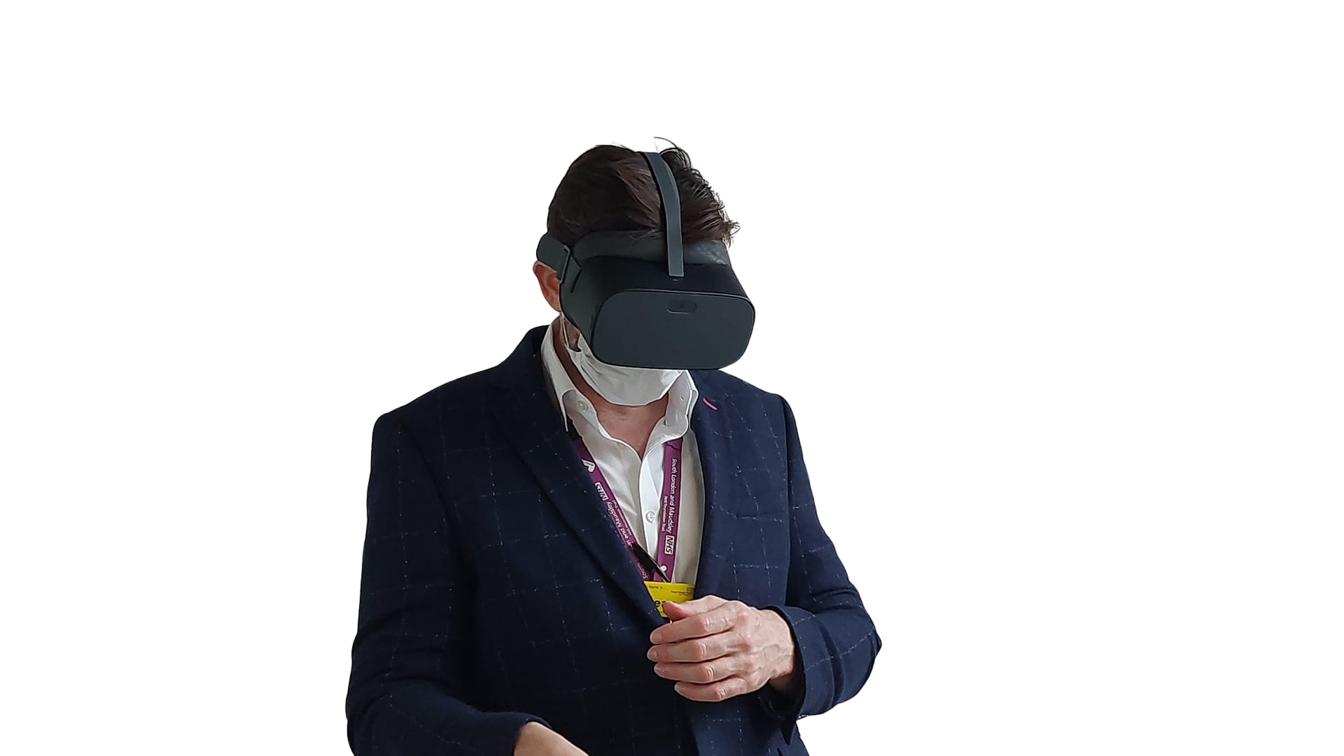



VR Champions: Beyond the headset
How VR is helping us tackle de-escalation and race inequality training
Helen Welsh
Media and VR Producer
Kiran Virk
Head of Broadcast & Live Delivery
Gareth Evans
Head of Media Production

Slide 2
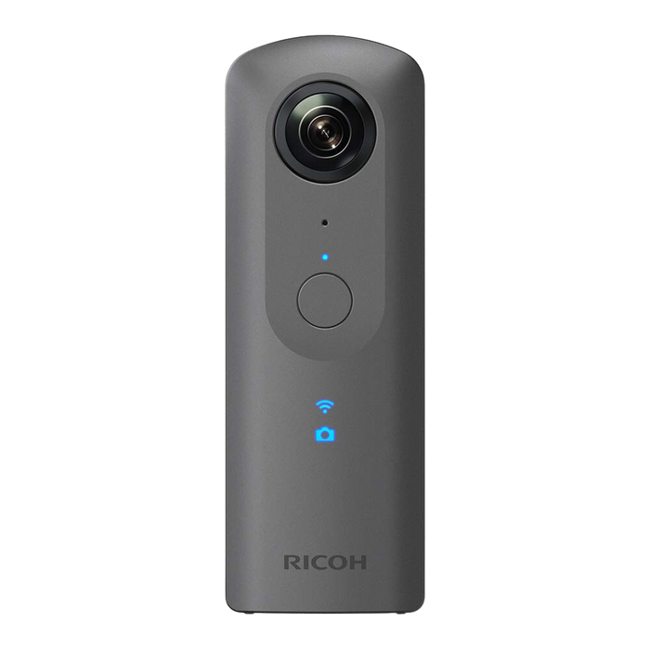
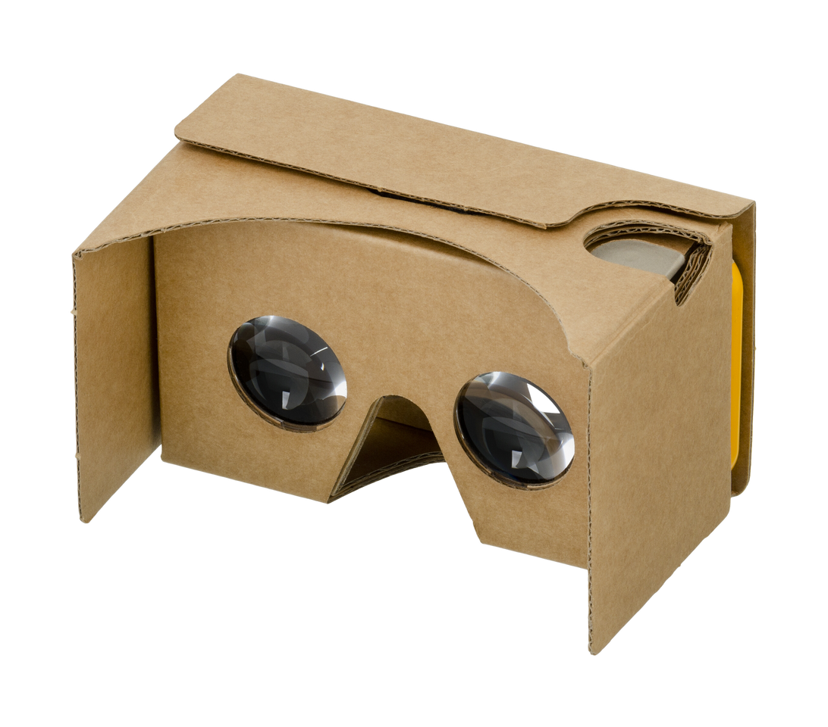


Where we started
Rico 360 Camera (2 lens)
Cardboard headsets with phone inserts
Notes:
GE

Slide 3
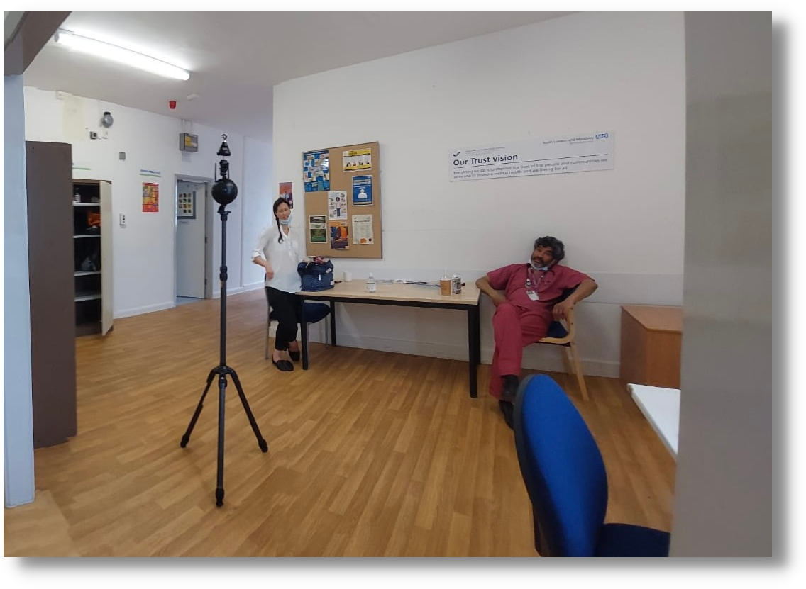

How we got here
Eating Disorders
Burdette Project - Reducing restrictive practices (RRP)
Lawful and conscientious seclusion
De-escalation
Mind and Body / Wellbeing
Suicide Prevention
Notes:
GE

Slide 4
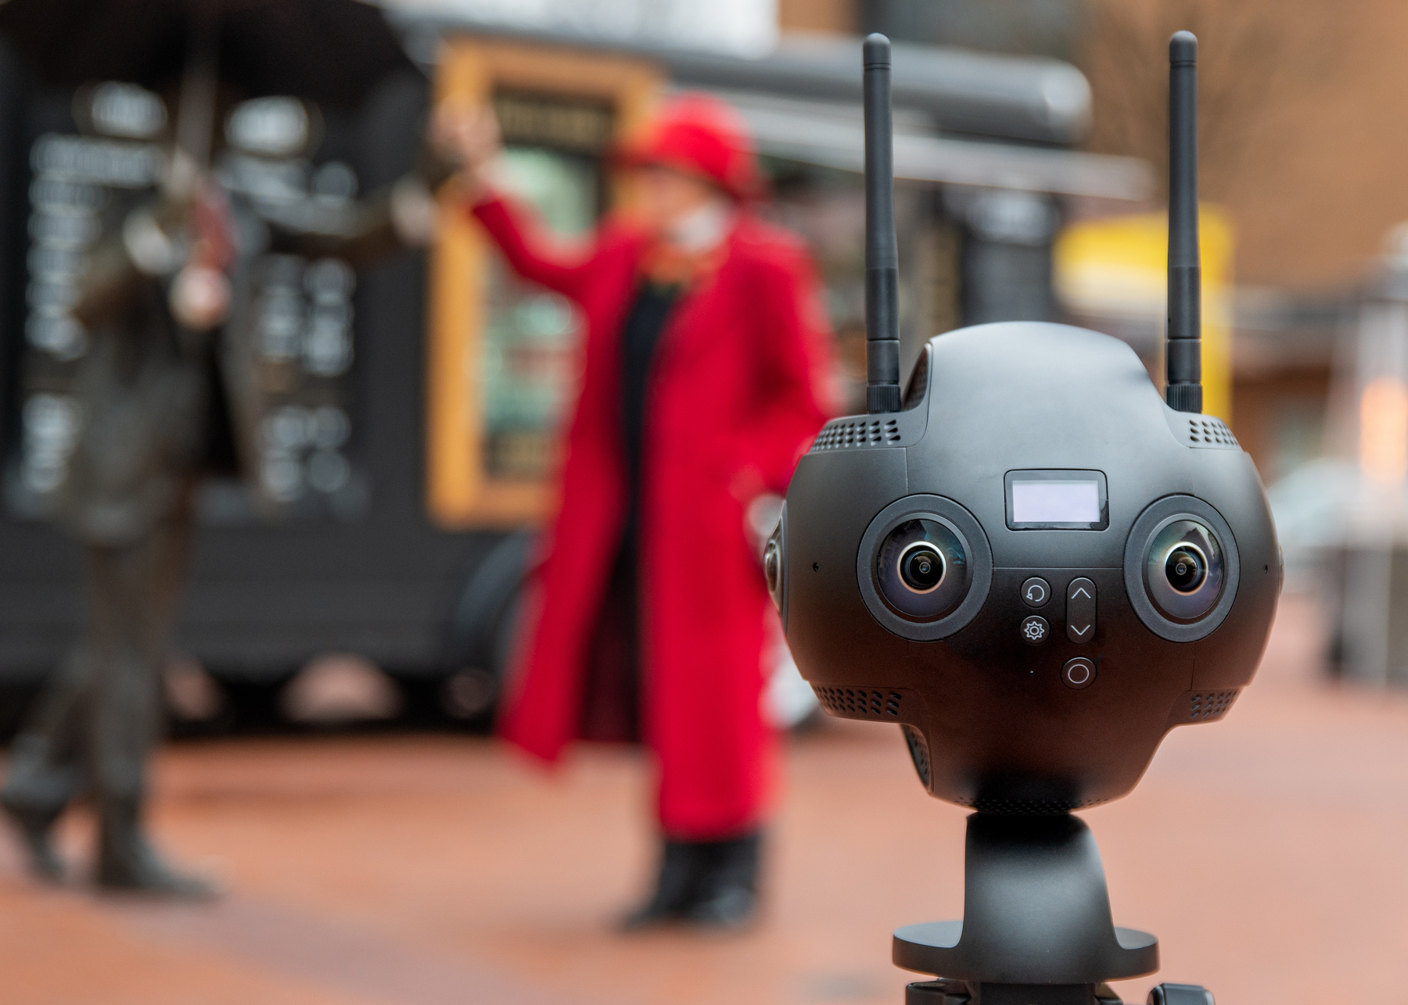


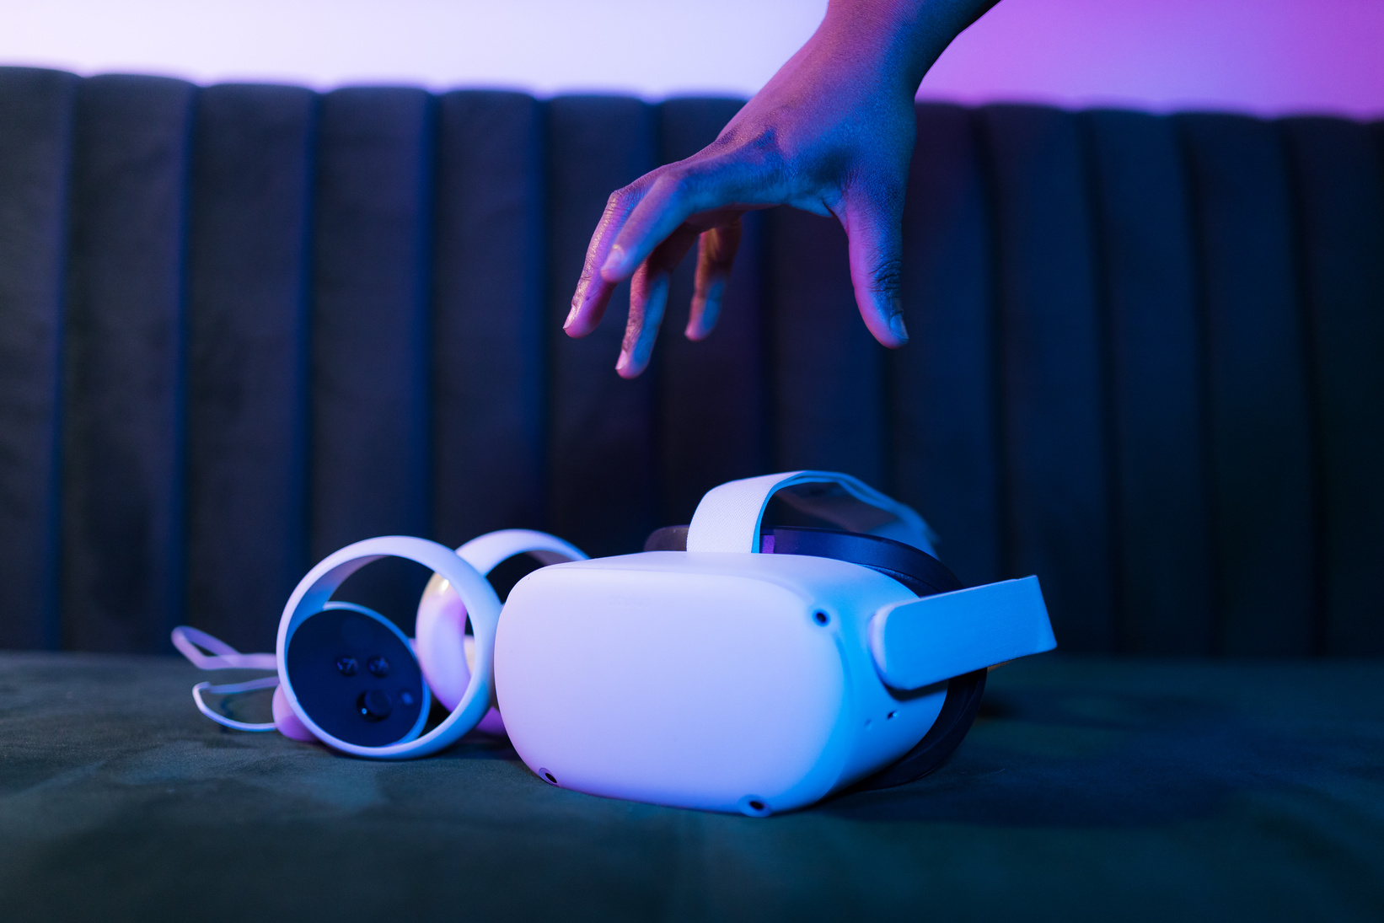
360 Video platform & software
Insta 360 Pro 2
Pico Neo Pro with eye tracking
Notes:
GE

Slide 5
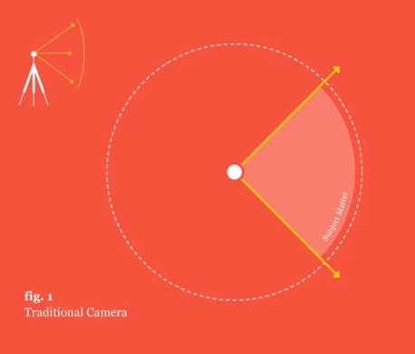
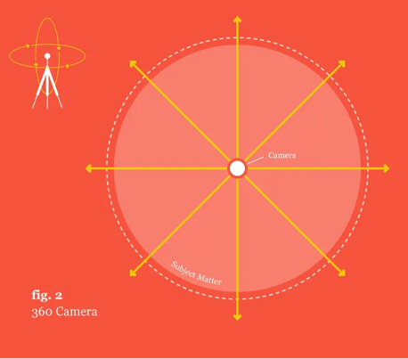
  Traditional videos force all viewers to receive only the information provided at the same time. It is the same experience every time
  There is nowhere to hide with 360 video
  360° videos allow for an immersive viewing experience with high levels of fidelity, accessible via a range of devices
  Often utilise a camera as a character of its own or through 1st person narrative
  Placement of the camera during filming can drastically alter engagement and immersion for learners
Notes:
KV
So let's start by having a quick recap of a traditional camera view: in fig1 - we're presented with a 2D view, where your view is determined by the director /creator- There is a SPECIFIC FOCUS that you are drawn to, and the editing of footage, where it can cut between different shots, will tell the story in a very specific way - key thing here is (slide)
Moving to fig2 - we are presented with omnidirectional viewpoints from all the angles of a 360-degree radius , which is under the control of the viewer- meaning they are free to gaze where they wish>resulting in in higher cognitive effort
>increased degree of immersion
Fig 2 places learners in real life environments (unlike CGI £££s) where although static in position, you choose what you focus on dynamically -
Can feels visceral and immersive and we know that learning is more impactful when it has an emotional impact --- (professionally trained actors)
360-degree is also moving from a passive experience to more interactivity, which we'll draw more on later.
replicates traditional high fidelity simulation -
Theatre in the round, except the audience in the centre of the action
just to menton on Set dressing is vitally important as there is nowhere to hide

Slide 6
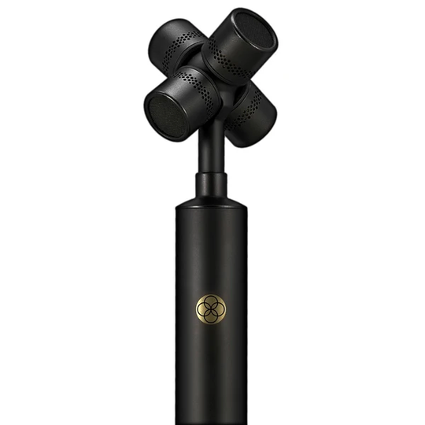
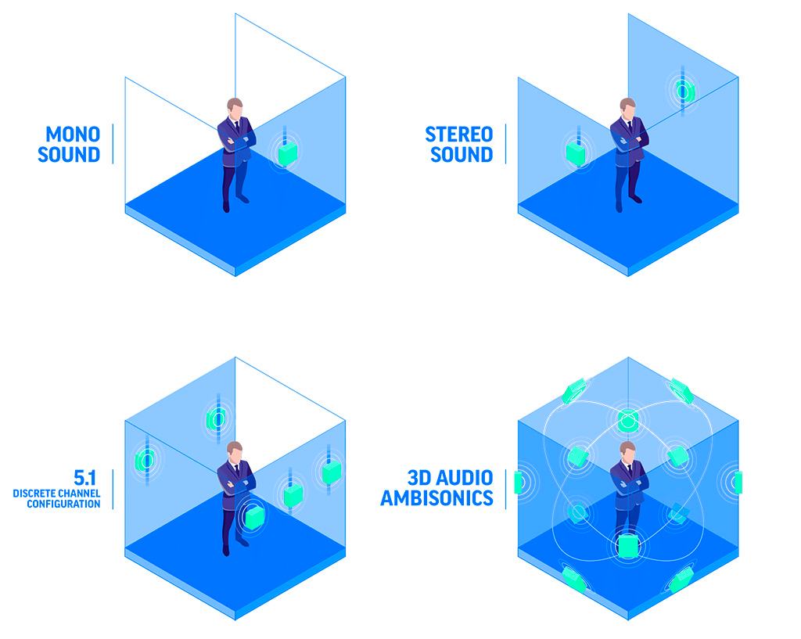
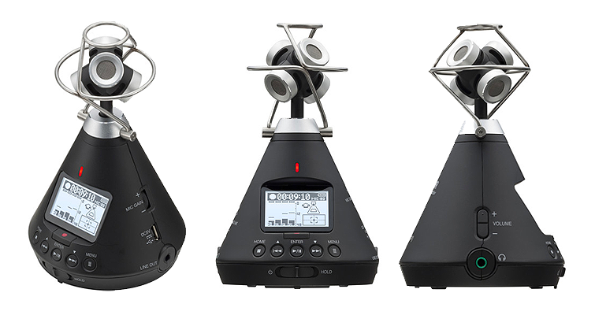
Rode NT SF1
Zoom H3 VR
Notes:
KV
And when we're thinking about audio in mental health, we know from simulation training, it's massively important for us in terms of fidelity for our active observers when watching a live simulation session. If they can't clearly hear the scenario the debriefs can feel flat..
The same applies to 360-degree production - as we started out early the 360 audio technology was lagging behind>
Initially started with only camera's built in mic, poor quality
Eventually we were able to invest in the Zoom H3 recorder which has 4 built-in mics arranged in an Ambisonic array and has the full sphere of surround sound recording. This creates more realistic sound which draws your attention in the headset.
Lightweight and portable, the Zoom H3 sits discretely on top of the Insta Pro 2 camera like a hat
The Rode NT SF1 is another 360 recorder on the market and also useful for old‑fashioned stereo

Slide 7

Notes:
KV
So, we're going to play you a short Selective attention test which you may have seen before...
So with our VR work , we are taking this sort of concept, but in a more enhanced way - the way we direct our attention can vary from person to person for various different reasons
People will miss things - our readings are subjective
the same concept applies to debriefing 360-VR content, there will be things you don't notice -
the learning happens in our debrief and our trained facilitators make feel psychologically safe to discuss, not trip you up!

Slide 8



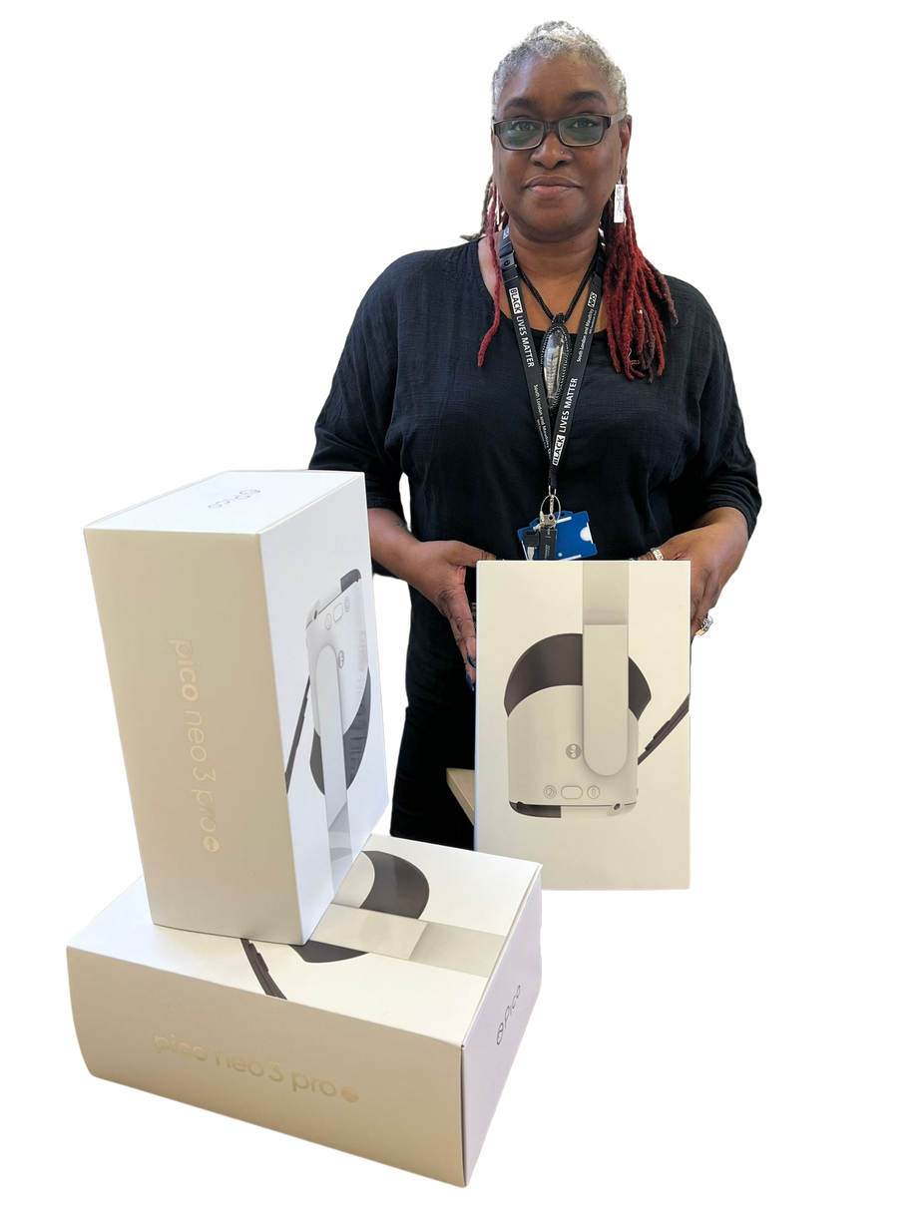

Phase 1
(Race inequality) - Maudsley Learning's VR Debrief Champion Programme
Select SLaM wards & Community teams to have access to VR headsets
VR champions selected from their base to deliver training
VR Champions receive debrief & technical training from expert faculty
VR Champions deliver training to their teams
Notes:
KV
Introducing you to Phase 1 of our VR work - which ran last year - tackled Race Inequality in a series of videos > Helen is going to talk about shortly.
As part of this work, we rolled out a VR debrief champion programme over the Zoom platform - which ininvolved debrief and technical training from expert faculty
implementing headsets in-situ within dif locations within slam - making novel technology available
Recruitment was internal within slam - initially target enthusiasts (for vr / subject) within the org -
We trained them to become debrief champions so that they could take these skills backinto their own workplaces

Slide 9

About the Tides Videos
  Investigates discrimination experienced by both patients and healthcare practitioners generating and perpetuating inequalities in health and health service use
  Phase 2 “walking in their shoes” project looked to turn the real life experiences of ethnic minority staff into 360 degree virtual reality videos.
  These videos were created from interviews with ethnic minority staff before and during the Covid-19 pandemic
  The data at the focus of this presentation came from “Tunde’s Story” - a look at night staff’s unequal access to PPE compared to day staff

Slide 10

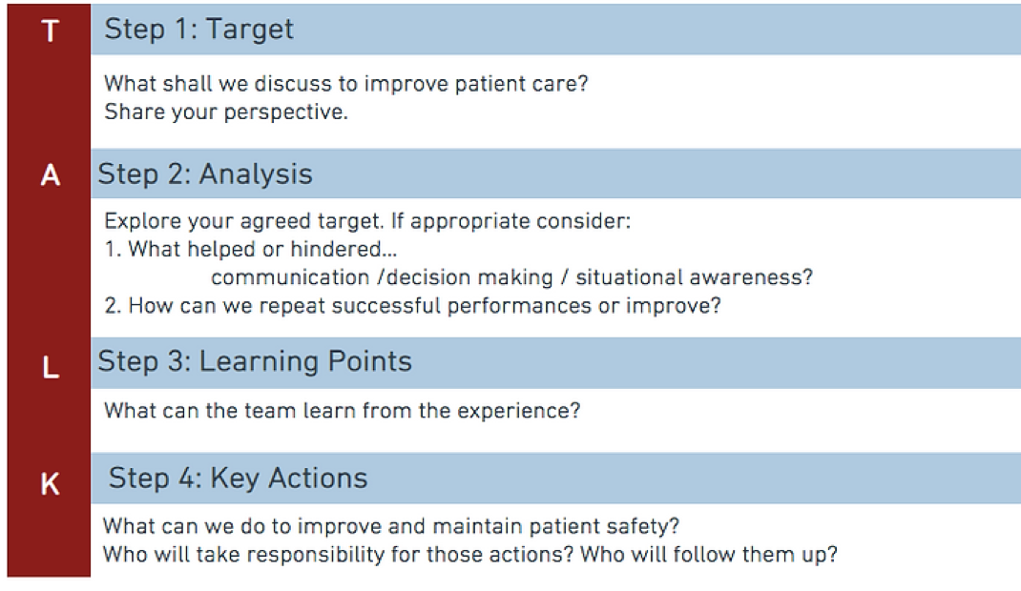
Talk Debrief Model
The target step is highlighted as a description phase for this project and champions have been taught to use this step to gain a clear understanding of what learners saw and to highlight what they may have missed

Slide 11
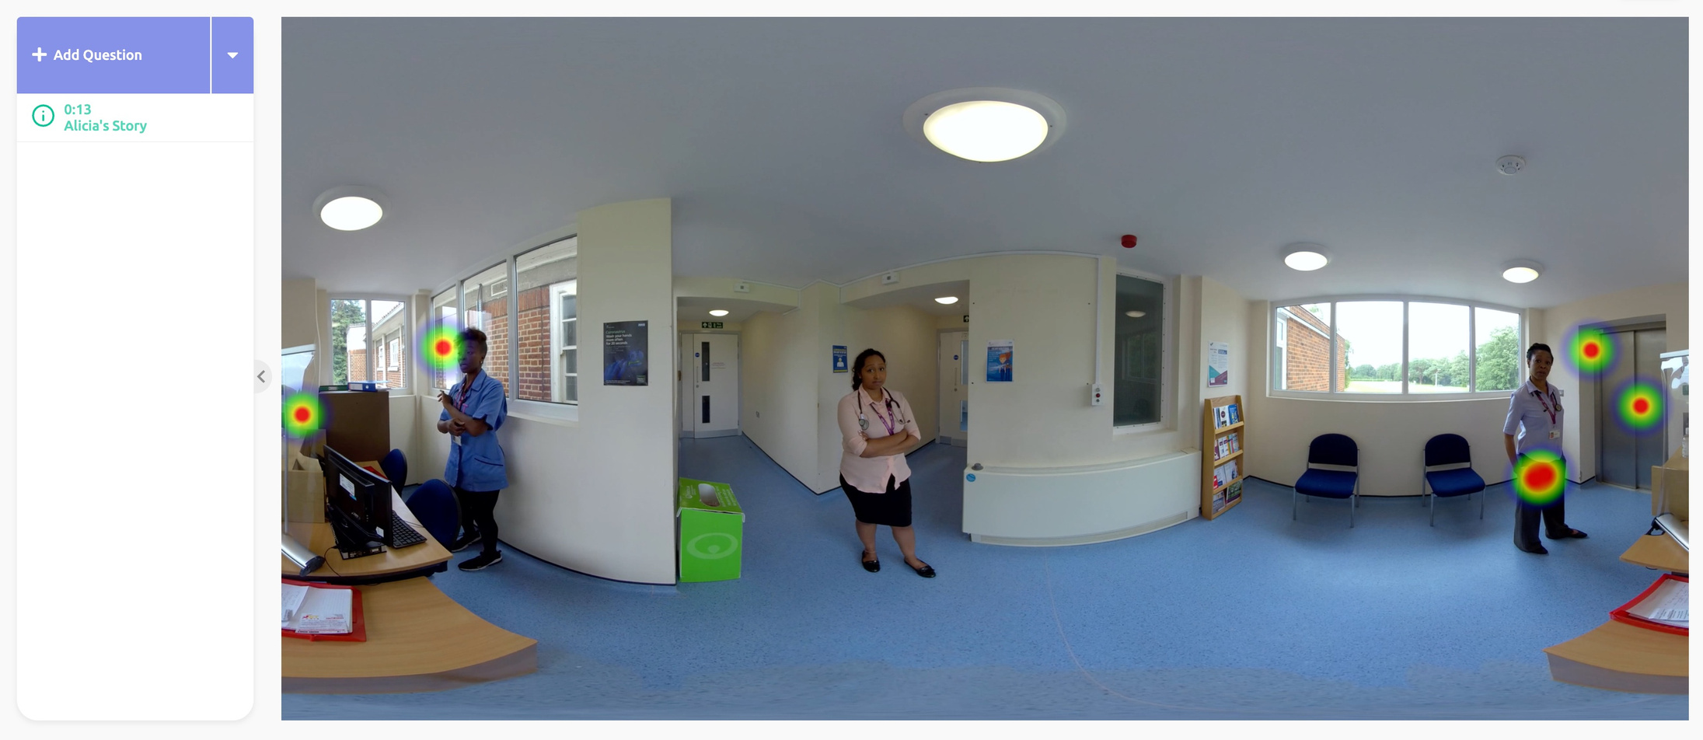

Slide 12
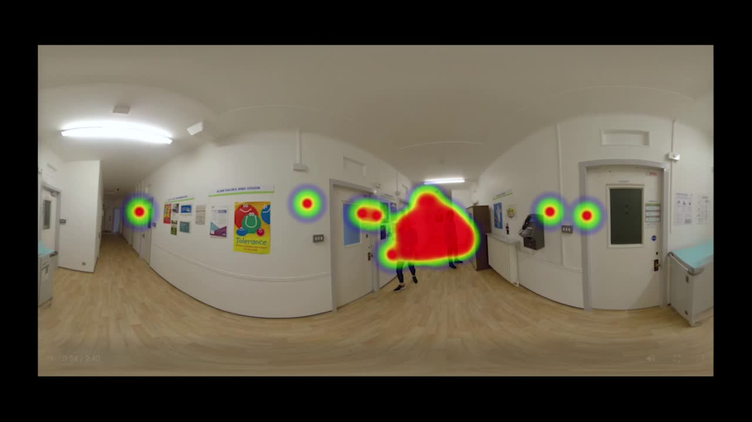

Slide 13
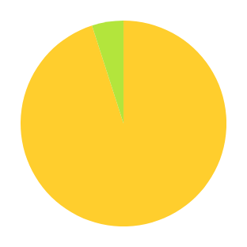

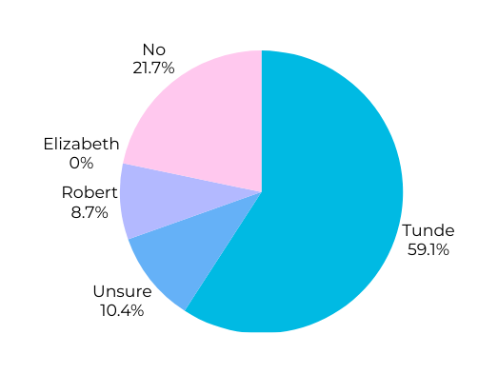
95% of users did not witness female staff member hitting wall
3 in 8 users, unprompted,
highlighted the black male in the video’s behaviour as being ‘aggressive’
Pre debrief - When asked "is there anyone you'd consider to be at fault?" over 59% answered Tunde
Notes:
ge

Slide 14
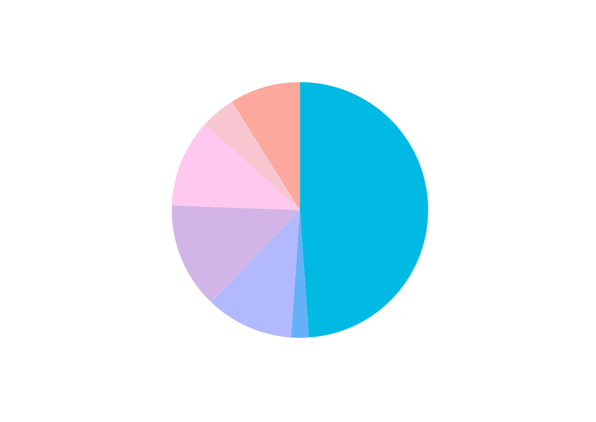
Most common themes discussed in debriefs
100% of users witnessed the wall slap on second viewing
100% of users noted that the white male’s tone was the most confrontational, while the white female’s actions were the most
‘aggressive’, both after second viewing
Notes:
ge

Slide 15
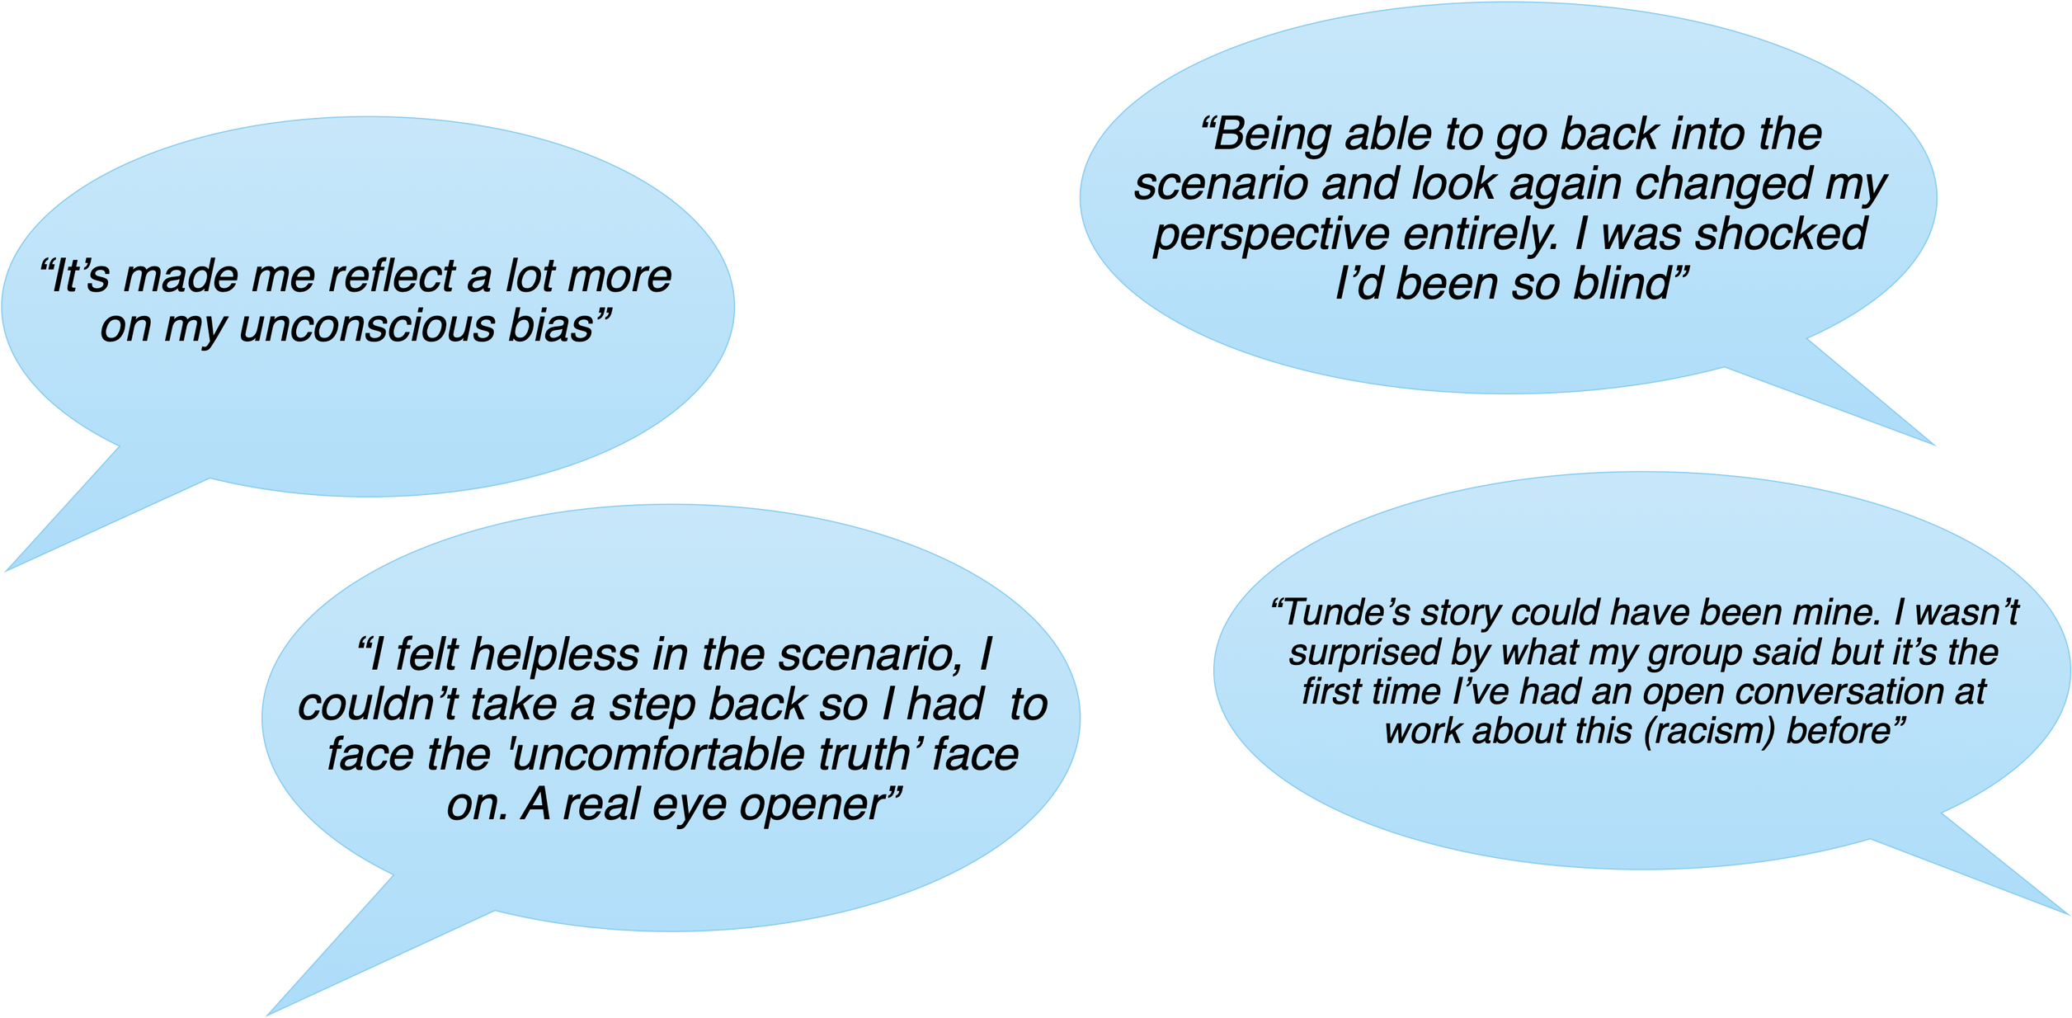
What our Learners said...
Notes:
ge

Slide 16
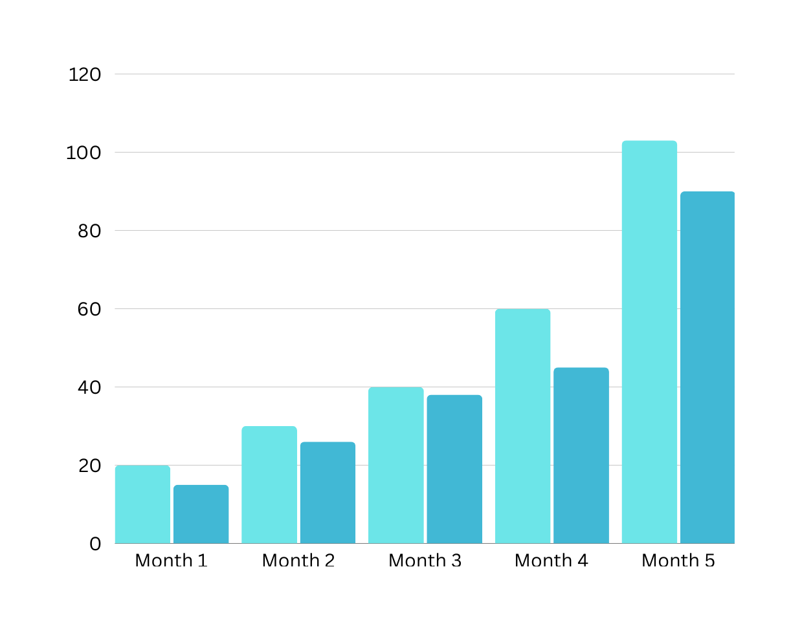
  415% user increase across 5 months
  Average repeated use rate was 85.6%
  Repeated use rate never dropped below 75% in 5 months
  100% of champions achieved their training target, with 5 of 6 exceeding it
  100% of champions worked with their direct teams to further embrace training by implementing changes or adding support as a direct result of this training
Single view by an individual
Repeat view by an indivudal in same month
Notes:
KV
This graph is nice visual representation of the increased engagement with the content over 5 months.
Light blue representatiins single view by an individual, and of those in dark blue, 15 have watched

Slide 17
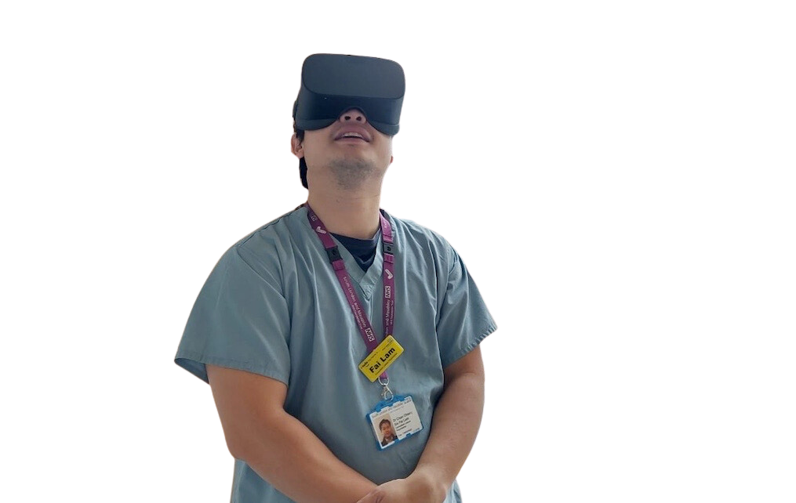
Phase 2
(De-esculation) - Maudsley Learning's VR Debrief Champion Programme
Select global Acute & Mental Health NHS wards & Community teams to have access to VR headsets
VR champions selected from their base to deliver training
VR Champions receive debrief & technical training from expert faculty
VR Champions deliver training to their teams
Notes:
KV So this is Phase 2, building on the work we've already done, but with a focus on De-Escalation
- roll out in September of this year has expanded to a national and even global level
Plus also including acute hospitals. What recognise de-escalation it's not just an issue within mental health hospitals
We understand the importance of offering this to acute hospital > broaden our scope and doing our own research

Slide 18
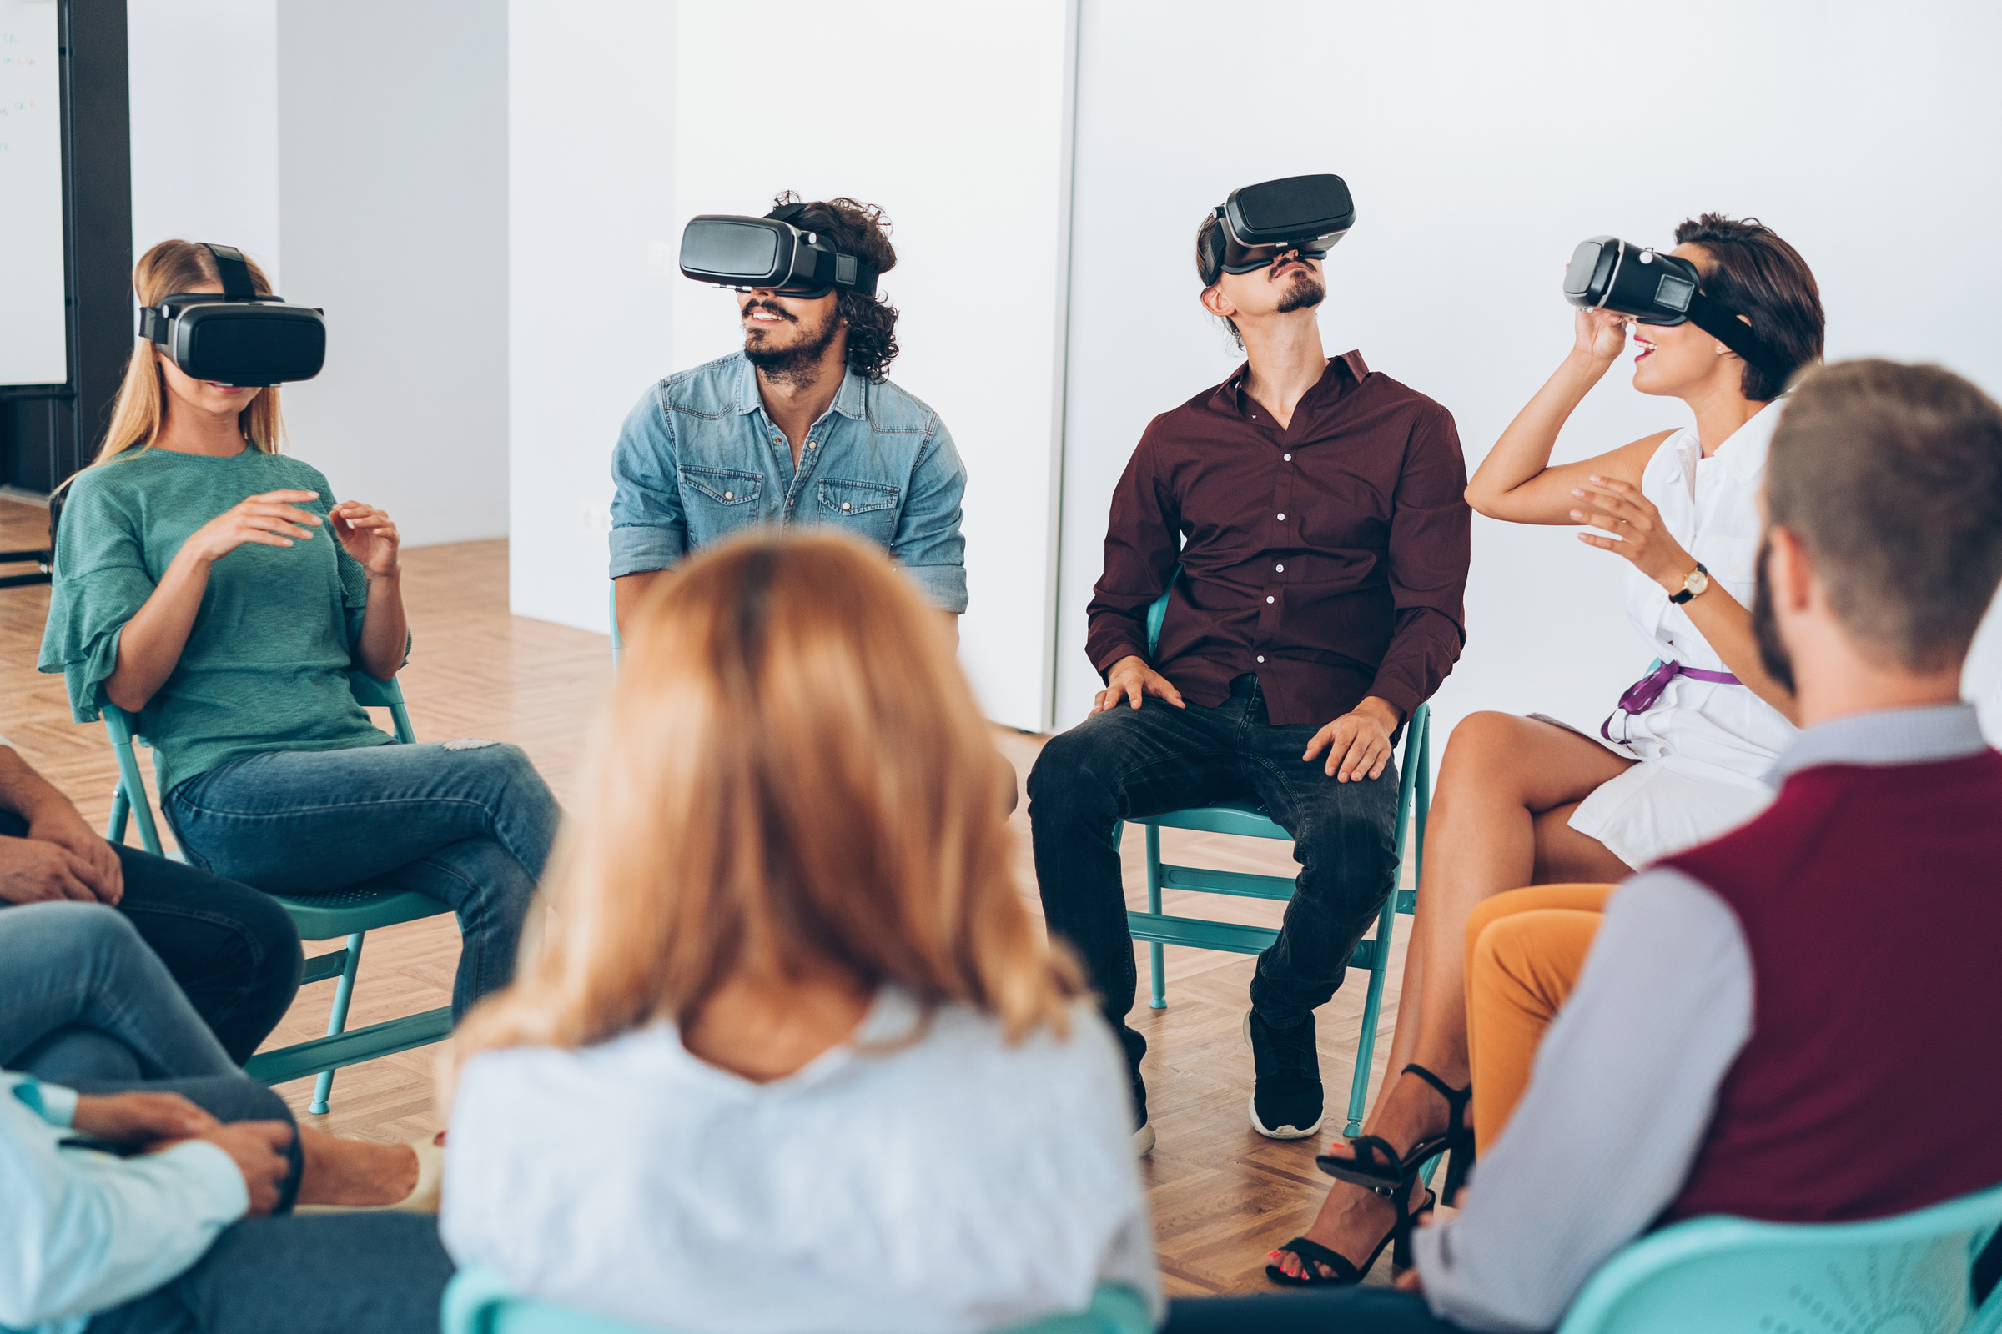
VR Debrief Champions Programme: Phase 2
  Content around Reducing Restrict Practice and De-escalation
  Training via 1 day Live course & supplementary E-learning
  Each champion aims to show content and provide training for 20 people by March 2024
  Feedback on suitability for staff / team
  Feedback on potential improvements for your staff / team
  Recommendation's adjustments around Local policy’s etc
  Feedback on ease of use
Notes:
KV
Phase 2 , going into a bit more detail
Considerations for phase 2>
local policy - acute hospitals and international - give us adaptions to ensure feasability-
Toronto> Give us local policies that we look to embed for candaian specific or scottish cpedific
Scottish> may not use some of the same modela when it comes to de-esc straterfies

Slide 19
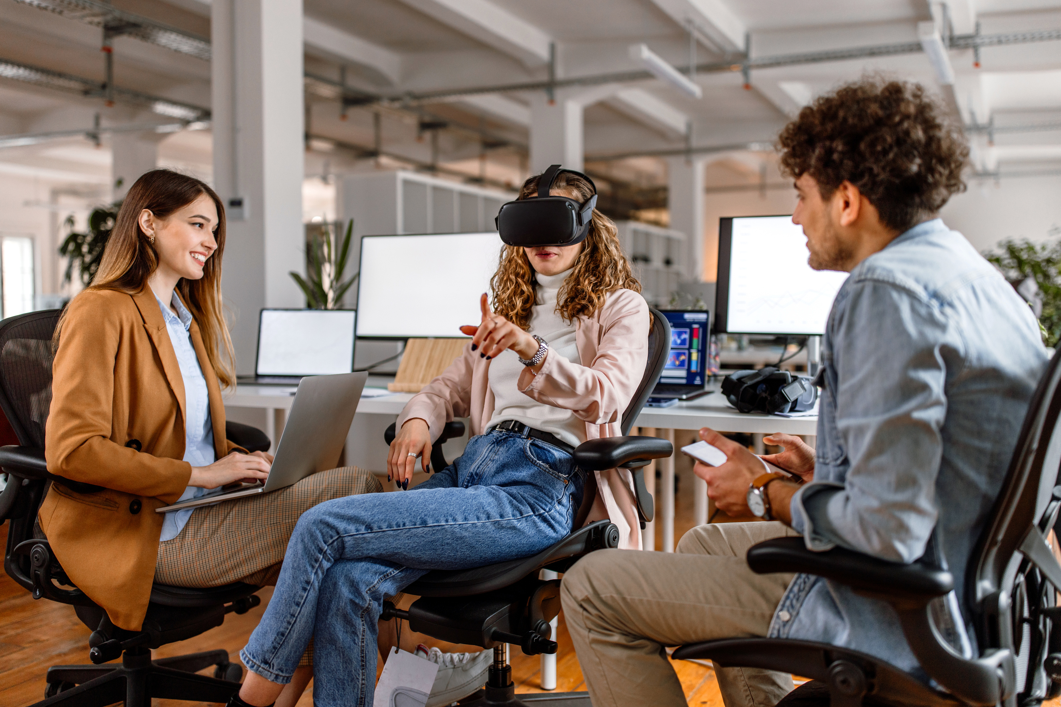
VR Debrief Champions Programme: Phase 2
  8 Videos
  3 patients interconnecting journeys through hospital from A&E admission to a ward
  Multiple staff involvement including clinical and non clinical
  Similar to the Tides Content much that may be missed on first viewing and mulitple themes that can be looked at in each video.
Notes:
HW

Slide 20
Influence from phase 1
Add e learning & course recording
Increased sound design
Creating Psychologically safe space
EDI
Continue to develop scenarios influenced from EBE’s and staff. that highlight inequality, challenge bias and stereotypes.
Champions expressed desire for further learning and ongoing reflection through e learning and replaying course recording
Adding better microphones and combining with ambisonic sound for more immersive experience
Further enhance training for champions to foster safe environment and signposting for support
Notes:
HW

Slide 21
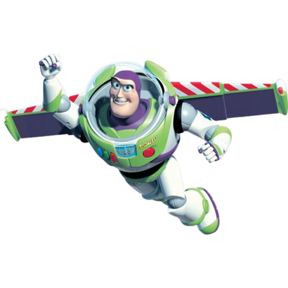

  International Case study
  Roll out for University students - Nurses - Bolton University
  Based on results of phase 2 continue to make improvements and increase champions size
  Create further content around lived experience
  Continue work with Tides team in race inequality and training improvements
  Potential to further breakdown data to further inform debriefs – gender / job roles / age etc
  Branch style scenarios
Notes:
GE

Slide 22
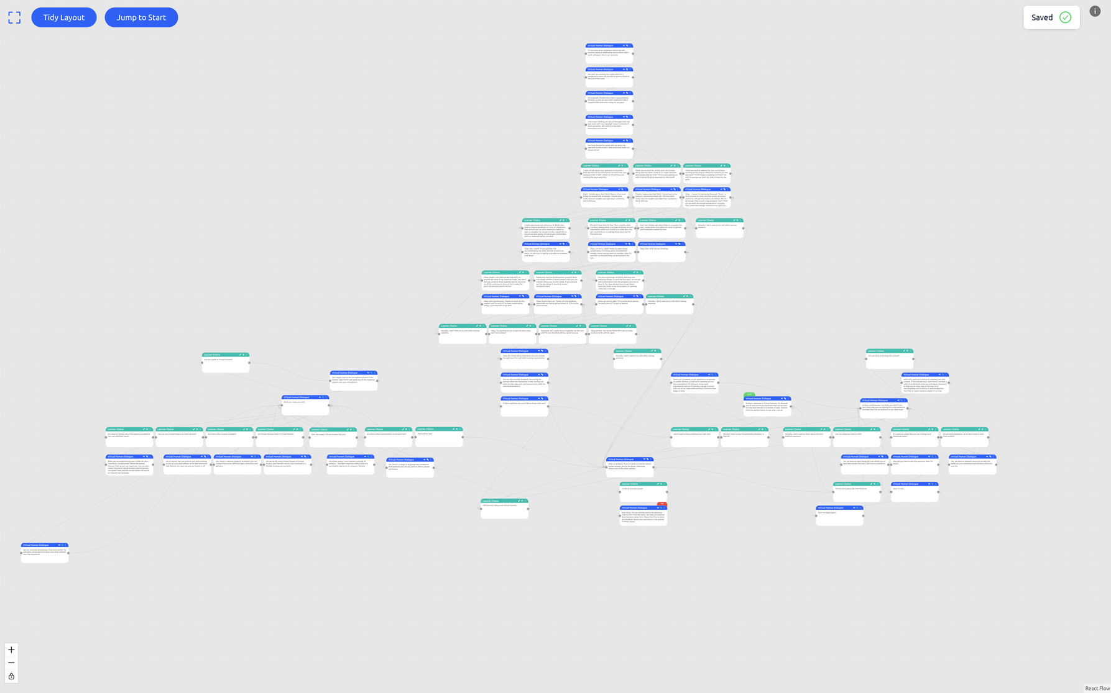
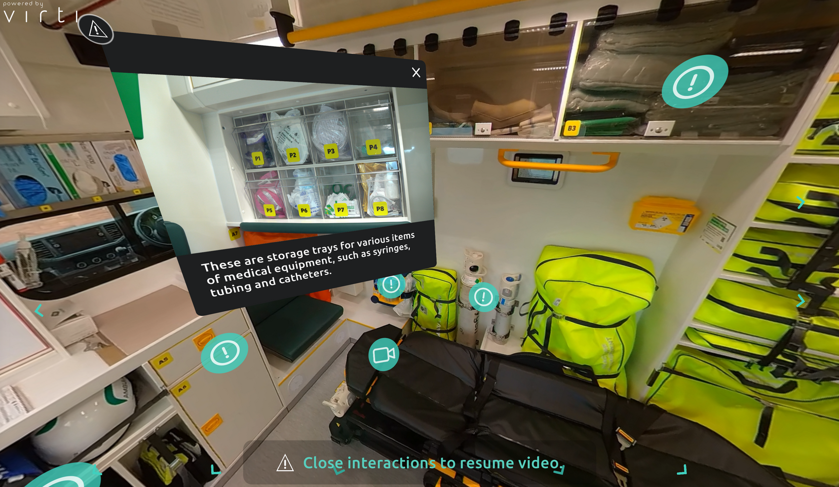

Slide 23




Any questions?
maudsleylearning@slam.nhs.uk
Notes:
GE

